Slide 1
Textural Busts

Slide 2
Ancient Egypt

Slide 3
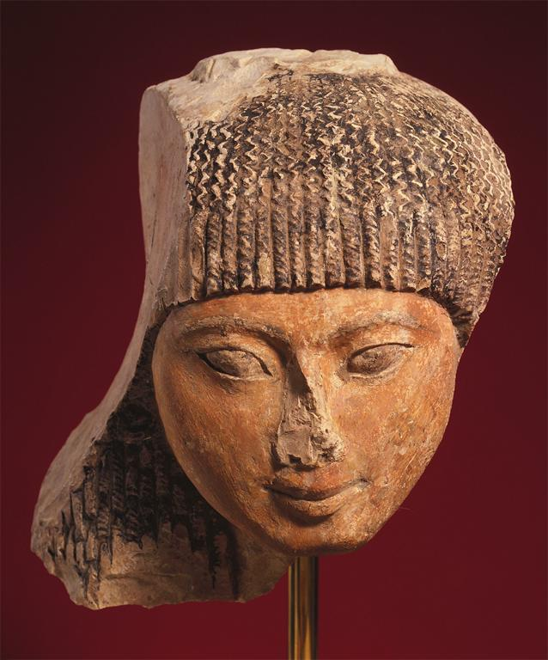
Notes:
Creator: Unknown Culture: African; North African; Egyptian Title: Bust of a prince Work Type: Sculpture Work Type: Bust Date: 1552 BC - 1307 BC Material: limestone with polychrome Measurements: 8 x 6 x 6 (20.3 x 15.2 x 15.2 cm) Repository: Fine Arts Museums of San Francisco Repository: San Francisco, California, USA Repository: Gift of The de Young Museum Society Repository: 1979.47 Repository: http://www.thinker.org/ Collection: Fine Arts Museums of San Francisco Collection Collection: Formerly in The AMICO Library ID Number: FASF.116217 Source: Data From: Fine Arts Museums of San Francisco Rights: This image was provided by Fine Arts Museums of San Francisco. Contact information: Sue Grinols, Director of Photo Services & Imaging, Fine Arts Museums of San Francisco, 50 Hagiwara Tea Garden Drive, Golden Gate Park, San Francisco, CA 94118-4501, (415) 750-3602 (ph), (415) 750-7686 (fax), sgrinols@famsf.org. Rights: Please note that if this image is under copyright, you may need to contact one or more copyright owners for any use that is not permitted under the ARTstor Terms and Conditions of Use or not otherwise permitted by law. While ARTstor tries to update contact information, it cannot guarantee that such information is always accurate. Determining whether those permissions are necessary, and obtaining such permissions, is your sole responsibility.

Slide 4
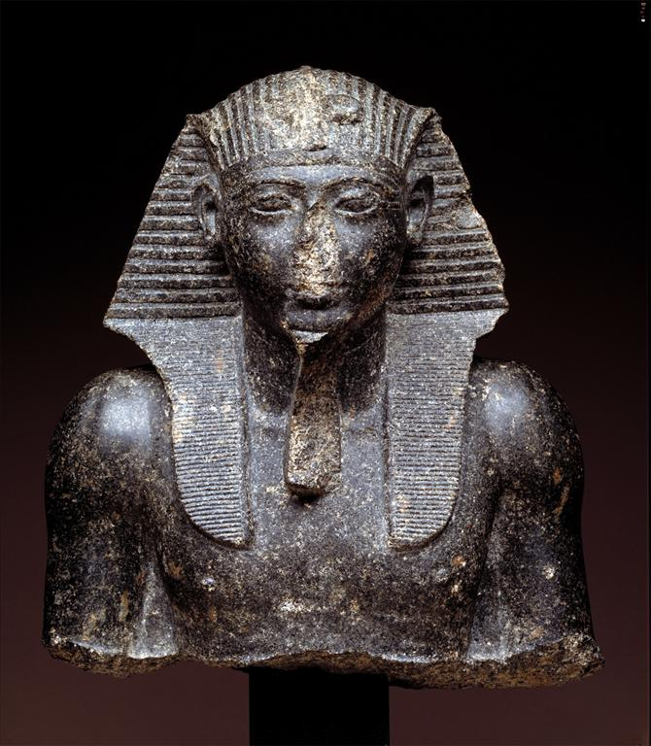
Notes:
Creator: Egyptian Creator: African; North African; Egyptian Title: Head and Upper Torso of Seti I Work Type: Sculpture Date: Dynasty XIX, 1303-1290 BC Material: Black granite Measurements: 15 x 11 3/4 x 7 5/16 in. (38.1 x 29.92 x 18.65 cm.) Description: <p>This superb sculpture is a rare portrait of one of the great kings of Egyptian history. Seti I was the first important pharaoh of the 19th Dynasty. Following the upheavals caused by Akhenaten's religions revolution in the late 18th Dynasty. Seti established a firm military control over all of Egypt and led its armies to conquest in Palestine. He set the pattern for an aggressive Egyptian rule that reached its climax under the long reign of his son Ramses II.</p><p>Relief portraits of Seti I occur at Abydos, Karnak, and in his tomb in the necropolis at Thebes, but this is one of the few three-dimensional portraits of him. It adheres to the classical Egyptian conventions of royal art, showing the king as a vital, muscular man dressed in the ruler's <i>nemes</i> headcloth and false beard. Supporting the back of the bust is the king's cartouche with his regal names. The boldly plastic modeling of the figure indicates the king's divine majesty and his role as a bringer of prosperity to his people. The columnar neck, lifted chin, and gripping gaze of the eyes give the portrait a remarkable sense of living force, thereby equating Seti with Osiris, the undying Lord of the Afterworld. Since Egyptian rulers belonged to the realm of the gods, they were represented as eternally strong and youthful.</p><p>Seti I's rule initiated a revival of Egyptian splendor. Art under Seti emphasized a grandiose monumentality without sacrificing the courtly elegance so notable under the kings of the 18th Dynasty. This portrait bust expresses this union of dynamic power and suave line.</p><p><i>Dallas Museum of Art: A Guide to the Collection,</i> page 20</p> Description: Full View Repository: Dallas Museum of Art Repository: Dallas, Texas, USA Repository: Dallas Museum of Art, purchased in honor of Betty B. Marcus with the Art Museum League Funds, the Melba Davis Whatley Fund, and the General Acquisitions Fund Repository: 1984.5 Repository: http://www.dallasmuseumofart.org/ Collection: Dallas Museum of Art Collection Collection: Formerly in The AMICO Library ID Number: DMA_.1984.50 Source: Data From: Dallas Museum of Art Rights: This image was provided by Dallas Museum of Art. Contact information: Jacqueline Allen, Director of Libraries and Imaging Services, Dallas Museum of Art, 1717 N. Harwood, Dallas, TX 75201, (214) 922-1276 (ph), (214) 954-0174 (fax), jallen@dallasmuseumofart.org. Rights: Please note that if this image is under copyright, you may need to contact one or more copyright owners for any use that is not permitted under the ARTstor Terms and Conditions of Use or not otherwise permitted by law. While ARTstor tries to update contact information, it cannot guarantee that such information is always accurate. Determining whether those permissions are necessary, and obtaining such permissions, is your sole responsibility.

Slide 5
Ancient Rome

Slide 6
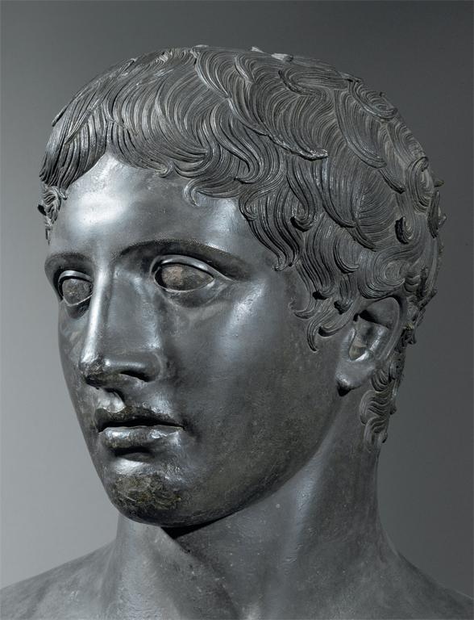
Notes:
Culture: Roman Title: Villa of the Papyri, Pompeii: Head of the Doryphoros Work Type: sculpture Date: c. 440 BCE Location: Pompeii Repository: Museo nazionale di Napoli Collection: Art, Archaeology and Architecture (Erich Lessing Culture and Fine Arts Archives) ID Number: 10-04-03/49 Source: Image and original data provided by Erich Lessing Culture and Fine Arts Archives/ART RESOURCE, N.Y. Source: http://www.artres.com/c/htm/Home.aspx Source: http://www.artres.com/c/htm/TreePfLight.aspx?ID=LES Rights: Photo Credit: Erich Lessing/ART RESOURCE, N.Y. Rights: Please note that if this image is under copyright, you may need to contact one or more copyright owners for any use that is not permitted under the ARTstor Terms and Conditions of Use or not otherwise permitted by law. While ARTstor tries to update contact information, it cannot guarantee that such information is always accurate. Determining whether those permissions are necessary, and obtaining such permissions, is your sole responsibility.

Slide 7
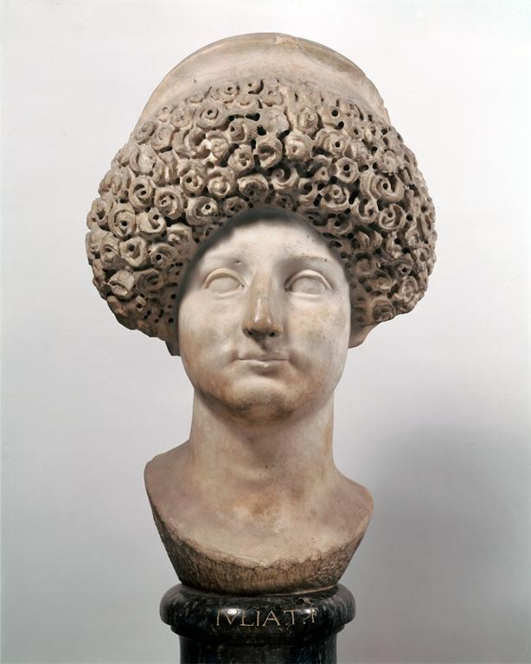
Notes:
Culture: Roman Title: Head of Giulia di Tito (Portrait of a Woman; Bust of a Lady) Work Type: sculpture Date: 1st century CE Material: marble Measurements: height: 44 cm Style Period: Flavian Repository: Galleria degli Uffizi Collection: Italian and other European Art (Scala Archives) Source: Image and original data provided by SCALA, Florence/ART RESOURCE, N.Y. Source: http://www.artres.com/c/htm/Home.aspx Source: http://www.scalarchives.com Rights: (c) 2006, SCALA, Florence / ART RESOURCE, N.Y. Rights: Please note that if this image is under copyright, you may need to contact one or more copyright owners for any use that is not permitted under the ARTstor Terms and Conditions of Use or not otherwise permitted by law. While ARTstor tries to update contact information, it cannot guarantee that such information is always accurate. Determining whether those permissions are necessary, and obtaining such permissions, is your sole responsibility.

Slide 8
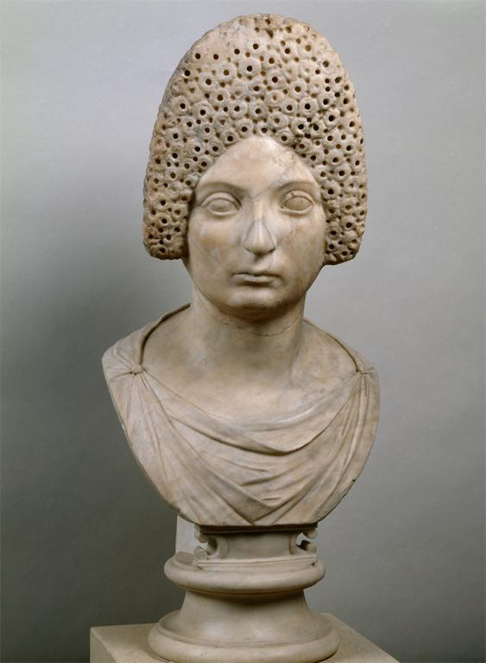
Notes:
Culture: Roman Title: Female Portrait Title: front view Work Type: portrait sculpture Date: end of the 1st century CE Site: Creation Site: Rome, Italy Material: marble Style Period: Flavian-Antonine Description: She is noticeably grown up without too distinctive traits of age. So far, no secure identification could be made. Description: Treatment: Restorations of modern times are as follows: tip of nose, part of bun at head's back, neck and bust. The surface was heavily cleaned. Description: Photographer: Ingrid Geske Repository: Staatliche Museen zu Berlin--Preussischer Kulturbesitz. Antikensammlung Repository: Provenance: The head was acquired by B. Cavaceppi and was formerly part of the Bildergalerie Potsdam-Sanssouci Repository: http://www.smb.museum/smb/home/index.php?lang=de Accession Number: Sk 1893 Related Item: Bibliography: Die Antikensammlung im Pergamonmuseum und in Charlottenburg (1992) p. 208 nr. 98 (with further bibliographical references). Collection: Classical Sculptures (Berlin State Museums) Source: Image and original data provided by Staatliche Museen zu Berlin, Stiftung Preussischer Kulturbesitz Rights: Please note that if this image is under copyright, you may need to contact one or more copyright owners for any use that is not permitted under the ARTstor Terms and Conditions of Use or not otherwise permitted by law. While ARTstor tries to update contact information, it cannot guarantee that such information is always accurate. Determining whether those permissions are necessary, and obtaining such permissions, is your sole responsibility.

Slide 9
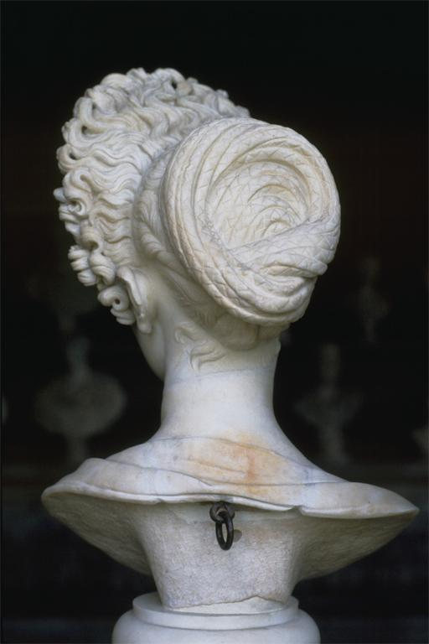
Notes:
Culture: Roman Empire (Flavian period) Title: Portrait bust of a Flavian Lady [rear view, detail of coiffure], ca. 90 A.D. Location: Museo Capitolini, Rome Material: marble Related Item: Adams AAT: 8.48 [alt.] Related Item: Gardner 10: 7-42 [alt.] Related Item: Hartt 4: 9-39 [alt.] Related Item: Gardner 11: 10-36 [alt.] Related Item: H&F 4: 5.60 [alt.] Related Item: Stokstad R: 6-43 [alt.] Related Item: Stokstad 2: 6-42 [alt.] Related Item: Janson 5 R: 277 [alt.] Related Item: Janson 5: 279 [alt.] Related Item: Stokstad: 6-43 [alt.] Collection: Art History Survey Collection Source: Catalogued by: Art Images for College Teaching

Slide 10
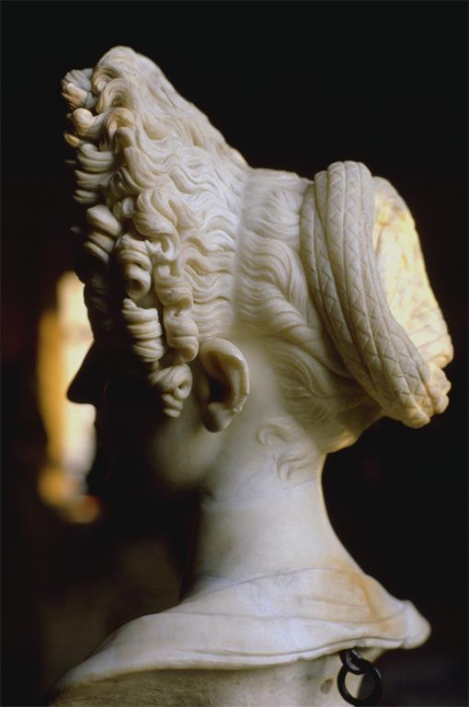
Notes:
Culture: Roman Empire (Flavian period) Title: Portrait bust of a Flavian Lady [L. profile view], ca. 90 A.D. Location: Museo Capitolini, Rome Material: marble Related Item: Adams AAT: 8.48 [alt.] Related Item: Gardner 10: 7-42 [alt.] Related Item: Hartt 4: 9-39 [alt.] Related Item: Gardner 11: 10-36 [alt.] Related Item: H&F 4: 5.60 [alt.] Related Item: Stokstad 2: 6-42 Related Item: Janson 5 R: 277 [alt.] Related Item: Janson 5: 279 [alt.] Related Item: Stokstad: 6-43 Collection: Art History Survey Collection Source: Catalogued by: Art Images for College Teaching

Slide 11
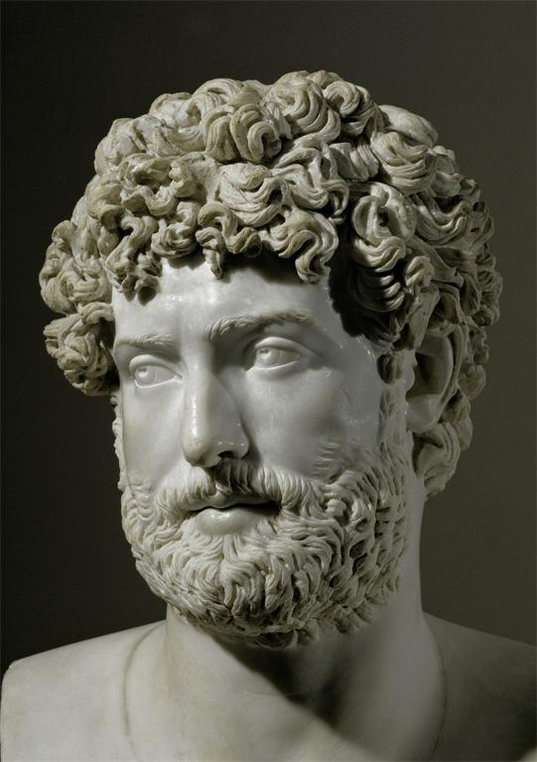
Notes:
Title: Bust of an unknown man or god Work Type: portrait sculpture Date: 1st-3rd century CE Material: marble Measurements: height 43 cm Description: Formerly identified as Perseus. Repository: Musée du Louvre, inv. Ma 381. Collection: Art, Archaeology and Architecture (Erich Lessing Culture and Fine Arts Archives) ID Number: 10-04-05/49 Source: Image and original data provided by Erich Lessing Culture and Fine Arts Archives/ART RESOURCE, N.Y. Source: http://www.artres.com/c/htm/Home.aspx Source: http://www.artres.com/c/htm/TreePfLight.aspx?ID=LES Rights: Photo Credit: Erich Lessing/ART RESOURCE, N.Y. Rights: Please note that if this image is under copyright, you may need to contact one or more copyright owners for any use that is not permitted under the ARTstor Terms and Conditions of Use or not otherwise permitted by law. While ARTstor tries to update contact information, it cannot guarantee that such information is always accurate. Determining whether those permissions are necessary, and obtaining such permissions, is your sole responsibility.

Slide 12
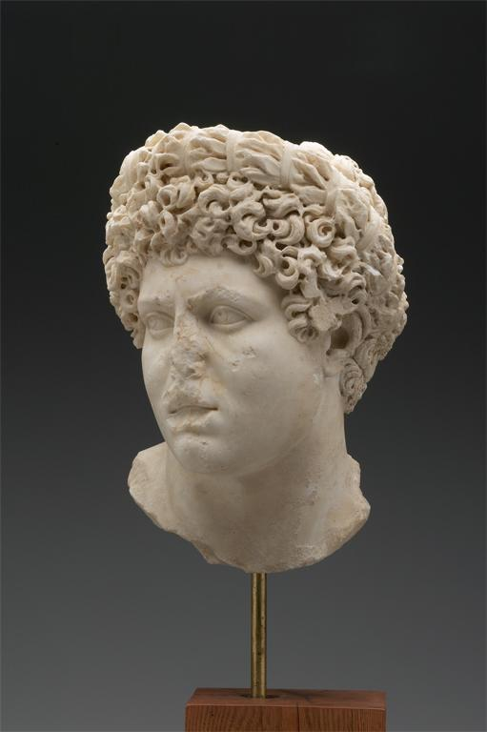
Notes:
Creator: Unknown Culture: Roman Title: Portrait of a Young Man, Possibly an Olympic Athlete Work Type: Sculpture Date: ca. A.D. 140-160 Material: Marble Measurements: Overall: 35.6 x 22 x 22cm (14 x 8 11/16 x 8 11/16in.); Object (Hair to chin Height): 26.5cm (10 7/16in.); Object (depth front to back): 25.3cm (9 15/16in.); Other (width, primary face view): 24.9cm (9 13/16in.) Description: This portrait head represents a young man, with a full, fleshy, face, square chin, slightly parted lips, and wide-set eyes. The irises are indicated by incision and the pupils drilled -- a sculptural convention which begins in the second century A.D. The thick, curly hair was worked extensively with the running drill, creating deep areas of shadow, in a fashion suggestive of a date between A.D. 140 and 160 by comparison with imperial portraits. The head is crowned by an elaborate wreath of bound foliage, probably olive sprigs. Such wreaths were associated in particular with victory at the Olympic games, and the palm fronds carved on the bust support reinforce this theme. Therefore, it has been suggested that this portrait represents a victorious Olympic athlete. Repository: Yale University Art Gallery, Ancient Art Repository: http://artgallery.yale.edu/ Repository: Leonard C. Hanna, Jr., B.A. 1913, and Ruth Elizabeth White Funds. Accession Number: 2000.12.1 Collection: Yale University Art Gallery ID Number: 77987 Source: Image and original data provided by Yale University Rights: For uses outside of the ARTstor terms and conditions of use, contact: John ffrench; Assoc. Director, Visual Resources; P.O. Box 208271; New Haven, CT 06520; Tel: 203-432-0630; Fax: 203-432-9274; Email: yuagrights@yale.edu Rights: Please note that if this image is under copyright, you may need to contact one or more copyright owners for any use that is not permitted under the ARTstor Terms and Conditions of Use or not otherwise permitted by law. While ARTstor tries to update contact information, it cannot guarantee that such information is always accurate. Determining whether those permissions are necessary, and obtaining such permissions, is your sole responsibility.

Slide 13
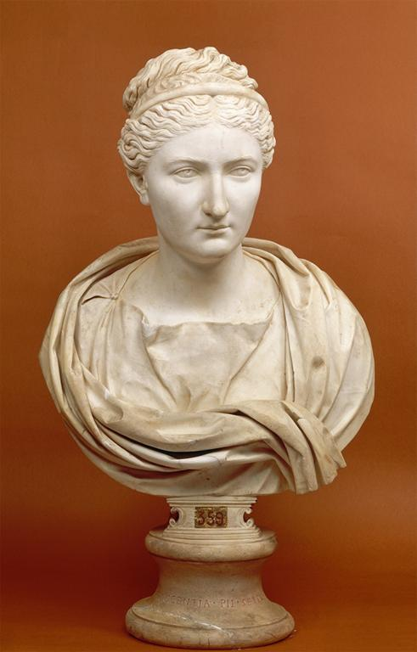
Notes:
Culture: Roman Title: Bust of the Empress Sabina, Wife of the Emperor Hadrian (Modern Copy) Work Type: sculpture Date: c. 135 CE (copy second half of the 18th century, probably 1773-1774) Material: marble Style Period: Hadrianic Repository: Museo Pio-Clementino, Vatican City (inv. no. 634) Collection: Italian and other European Art (Scala Archives) Source: Image and original data provided by SCALA, Florence/ART RESOURCE, N.Y. Source: http://www.artres.com/c/htm/Home.aspx Source: http://www.scalarchives.com Rights: (c) 2006, SCALA, Florence / ART RESOURCE, N.Y. Rights: Please note that if this image is under copyright, you may need to contact one or more copyright owners for any use that is not permitted under the ARTstor Terms and Conditions of Use or not otherwise permitted by law. While ARTstor tries to update contact information, it cannot guarantee that such information is always accurate. Determining whether those permissions are necessary, and obtaining such permissions, is your sole responsibility.

Slide 14
Renaissance

Slide 15
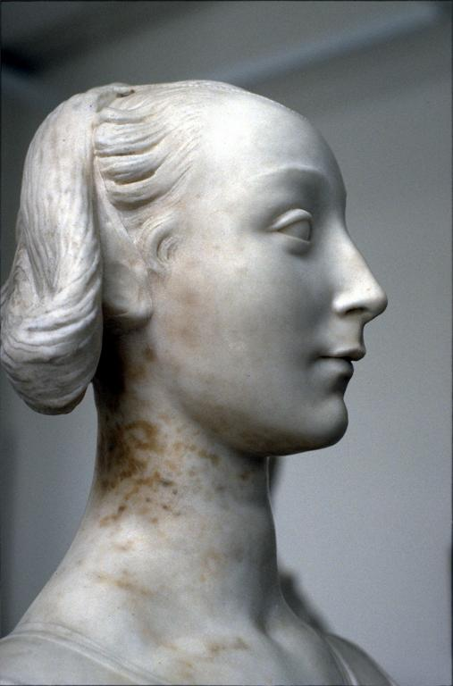
Notes:
Creator: Desiderio da Settignano, Florentine, ca. 1430-1464/5 Title: Portrait Bust of a Young Woman (called Marietta Strozzi) [profile view], ca. 1460-64 Location: Skulpturengalerie, Berlin-Dahlem Museums Material: marble Measurements: h. 52.5cm. Related Item: H&F 4: 10.34 Collection: Art History Survey Collection Source: Catalogued by: Art Images for College Teaching

Slide 16
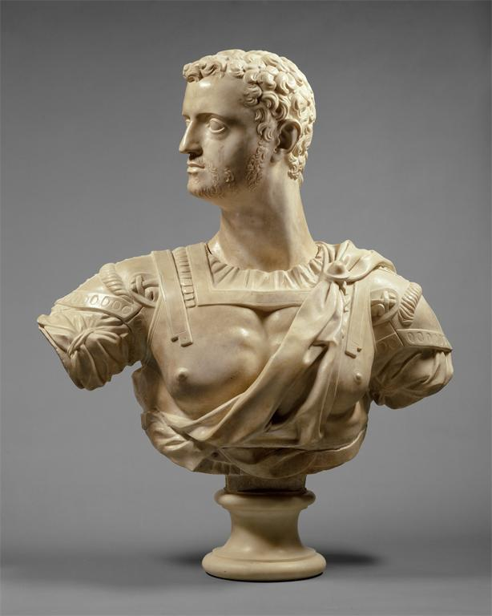
Notes:
Creator: Baccio Bandinelli, 1493-1560 Culture: Italian (Florence) Title: Cosimo I de' Medici (1519-1574), Duke of Florence Title: view #1 Work Type: Bust Date: 16th century (1539-1540) Location: Made in: Italy, Florence Material: Marble Measurements: H. (without socle) 32-1/4 in. (81.9 cm.) Repository: The Metropolitan Museum of Art Repository: http://www.metmuseum.org Collection: Metropolitan Museum of Art - Images for Academic Publishing ID Number: 23835 Source: Data From: The Metropolitan Museum of Art Credit Line: The Metropolitan Museum of Art, Wrightsman Fund, 1987 (1987.280) Image Copyright Notice: Image © The Metropolitan Museum of Art Rights: This image was provided by The Metropolitan Museum of Art. Contact information: Image Library, The Metropolitan Museum of Art, 1000 Fifth Avenue, New York, NY 10028, (212) 396-5050 (fax), Scholars.License@MetMuseum.org Rights: Image © The Metropolitan Museum of Art Rights: This image is available for uses permitted under the ARTstor Terms and Conditions of Use, such as teaching and study, as well as for scholarly publications, through the Images for Academic Publishing (IAP) initiative. If you are seeking to use this image for scholarly publication, you should click on the IAP icon below the thumbnail image.

Slide 17
Baroque and rococo

Slide 18
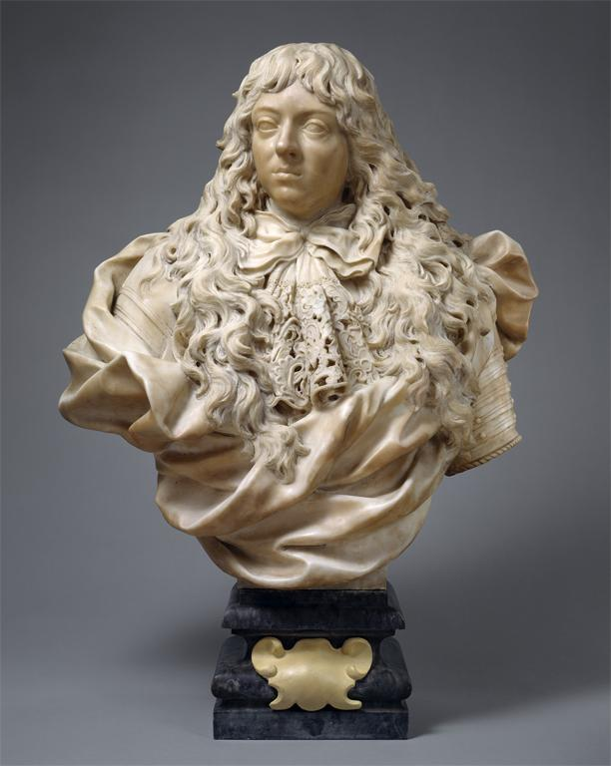
Notes:
Creator: Sculptor: Giovanni Battista Foggini, 1652-1725 Culture: Italian (Florence) Title: Grand Prince Ferdinando de' Medici (1663-1713) Work Type: PORTRAIT BUST Date: 17th century (ca. 1683-85) Location: Made in: Italy, Florence Material: Marble; base of gray marble Measurements: H. (including base) 39 in. (99.1 cm) Repository: The Metropolitan Museum of Art Repository: http://www.metmuseum.org Collection: Metropolitan Museum of Art - Images for Academic Publishing ID Number: 24298 Source: Data From: The Metropolitan Museum of Art Credit Line: The Metropolitan Museum of Art, Purchase, The Annenberg Foundation Gift, 1993 (1993.332.2) Image Copyright Notice: Image © The Metropolitan Museum of Art Rights: This image was provided by The Metropolitan Museum of Art. Contact information: Image Library, The Metropolitan Museum of Art, 1000 Fifth Avenue, New York, NY 10028, (212) 396-5050 (fax), Scholars.License@MetMuseum.org Rights: Image © The Metropolitan Museum of Art Rights: This image is available for uses permitted under the ARTstor Terms and Conditions of Use, such as teaching and study, as well as for scholarly publications, through the Images for Academic Publishing (IAP) initiative. If you are seeking to use this image for scholarly publication, you should click on the IAP icon below the thumbnail image.

Slide 19
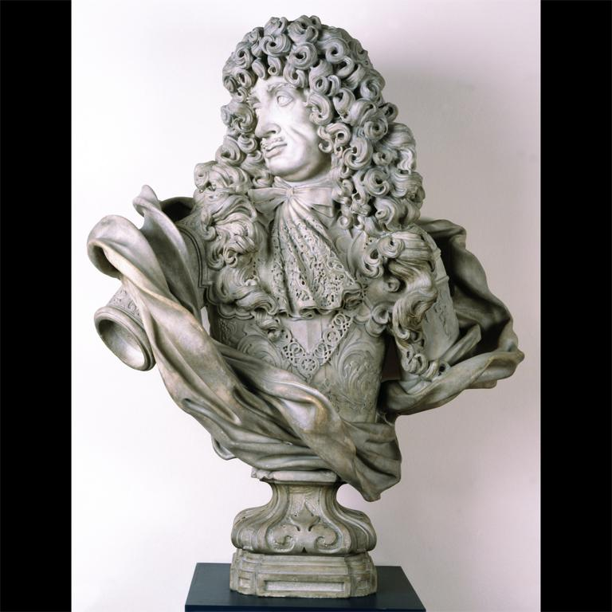
Notes:
Creator: Honore Pelle, active 1679-1694 Title: BUST of Charles II Work Type: Sculpture Date: Signed and dated 1684 Material: Marble Measurements: 128.9 x 103 x 58 cm Description: Carved in Genoa, Italy by Honoré Pelle (active 1679-1694) Description: Signed on the truncated right arm: 1684 HONORE PELLE, F. Description: Bust - Charles II; carved marble; by Honore Pelle (active 1679 - 94); probably Italian (Genoa); Signed and dated 1684. Description: Front Repository: Victoria and Albert Museum Repository: London, England Repository: Given by Henry Durlacher Repository: 239-1881 Repository: http://www.vam.ac.uk/ Collection: Victoria and Albert Museum Collection Collection: Formerly in The AMICO Library ID Number: VAM_.239-1881 Source: Data From: Victoria and Albert Museum Rights: This image was provided by Victoria and Albert Museum. Contact information: Andrea Stern, General Manager of V&A Images, V&A Enterprises, South Kensington, London, SW7 2RL, 44 20 7942 2484 (ph), 44 20 7942 2482 (fax), a.stern@vam.ac.uk. Rights: Please note that if this image is under copyright, you may need to contact one or more copyright owners for any use that is not permitted under the ARTstor Terms and Conditions of Use or not otherwise permitted by law. While ARTstor tries to update contact information, it cannot guarantee that such information is always accurate. Determining whether those permissions are necessary, and obtaining such permissions, is your sole responsibility.

Slide 20
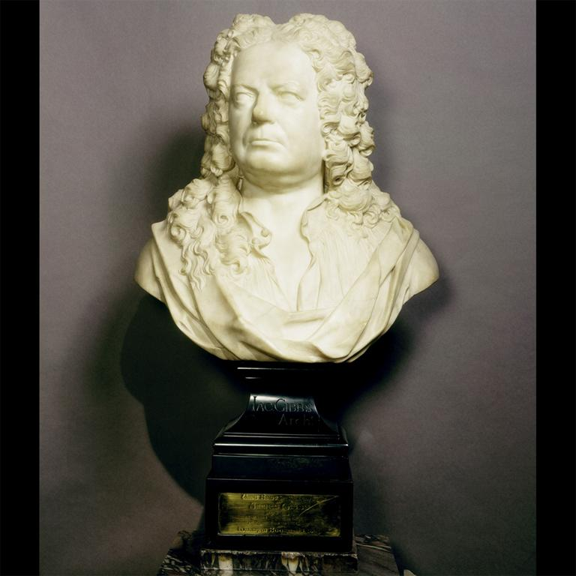
Notes:
Creator: Michael Rysbrack, 1684 - 1770 Title: BUST of James Gibbs Work Type: Sculpture Date: 1726 Material: Marble; the plinth and brass plaque 19th century Measurements: 67.2 x 46 x 30 cm Description: Made in: London, United Kingdom Description: Bust of James Gibbs; marble; by Michael Rysbrack; English, 1726 Description: Front Repository: Victoria and Albert Museum Repository: London, England Repository: Purchased with the aid of the National Art Collections Fund, an independent charity (Eugene Cremetti Fund) Repository: A.6-1988 Repository: http://www.vam.ac.uk/ Collection: Victoria and Albert Museum Collection Collection: Formerly in The AMICO Library ID Number: VAM_.A.6-1988 Source: Data From: Victoria and Albert Museum Rights: This image was provided by Victoria and Albert Museum. Contact information: Andrea Stern, General Manager of V&A Images, V&A Enterprises, South Kensington, London, SW7 2RL, 44 20 7942 2484 (ph), 44 20 7942 2482 (fax), a.stern@vam.ac.uk. Rights: Please note that if this image is under copyright, you may need to contact one or more copyright owners for any use that is not permitted under the ARTstor Terms and Conditions of Use or not otherwise permitted by law. While ARTstor tries to update contact information, it cannot guarantee that such information is always accurate. Determining whether those permissions are necessary, and obtaining such permissions, is your sole responsibility.

Slide 21
neoclassical

Slide 22
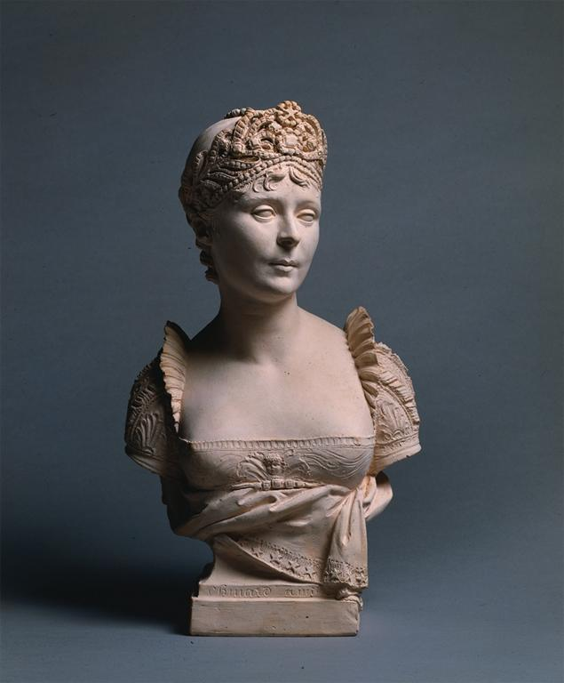
Notes:
Creator: Joseph Chinard, European; French, 1756 - 1825, (artist) Title: Bust of Empress Josephine Work Type: Sculpture Date: 1805 Material: terracotta Measurements: Overall: 29.7cm x 17.2cm x 12.1cm Description: inscribed on front of base in ligature: "chinard a milan"; inscribed on back of base in ligature: "chinard/de/l'institut m(al?)/membre de plusiere [sp]/ academies/milan-an l (3?)" Description: This bust of the Empress Josephine was sculpted in Milan in 1805 when she accompanied Napoleon to that city for his coronation as the King of Italy. Description: Full View Repository: The Cleveland Museum of Art Repository: Cleveland, Ohio, USA Repository: Bequest of Ethlyne J. Seligman Repository: 1994.125 Repository: http://www.clemusart.com/ Collection: The Cleveland Museum of Art Collection Collection: Formerly in The AMICO Library ID Number: CMA_.1994.125 Source: Data from: The Cleveland Museum of Art Rights: This image was provided by The Cleveland Museum of Art. Contact information: Kathleen Kornell, Rights and Reproductions Coordinator, The Cleveland Museum of Art, 11150 East Blvd., Cleveland OH 44106, (216) 707-2498 (ph), (216) 421-8815 (fax), Kkornell@clevelandart.org. Rights: Please note that if this image is under copyright, you may need to contact one or more copyright owners for any use that is not permitted under the ARTstor Terms and Conditions of Use or not otherwise permitted by law. While ARTstor tries to update contact information, it cannot guarantee that such information is always accurate. Determining whether those permissions are necessary, and obtaining such permissions, is your sole responsibility.

Slide 23
victorian

Slide 24
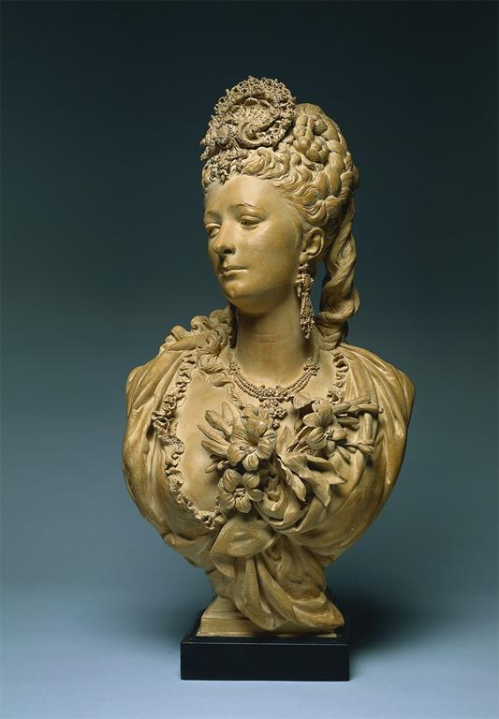
Notes:
Creator: Albert-Ernest Carrier-Belleuse, European; French, 1824 - 1887, (artist) Title: Bust of a Woman Work Type: Sculpture Date: c. 1865-1870 Material: terracotta Measurements: with base: 77.5cm x 38.3cm x 28.6cm Description: incised in the clay on the back: 'A. Carrier' Description: This bust may be a portrait of Marguerite Bellanger, one of the mistresses of Napoleon III who ruled France from 1852 to 1870. Although bearing a resemblance to her, it is more likely an imaginary portrait, perhaps inspired by Carrier-Belleuse's admiration for the beautiful Marguerite. Description: Full View Repository: The Cleveland Museum of Art Repository: Cleveland, Ohio, USA Repository: Andrew R. and Martha Holden Jennings Fund Repository: said to have been owned until recently by descendants of Carrier-Belleuse's daughter Marie-Gabrielle and her husband Joseph Cheret, who was a sculptor and a pupil of Carrier-Belleuse; (Elstir Galerie, Paris). Repository: 1993.38 Repository: http://www.clemusart.com/ Collection: The Cleveland Museum of Art Collection Collection: Formerly in The AMICO Library ID Number: CMA_.1993.38 Source: Data from: The Cleveland Museum of Art Rights: This image was provided by The Cleveland Museum of Art. Contact information: Kathleen Kornell, Rights and Reproductions Coordinator, The Cleveland Museum of Art, 11150 East Blvd., Cleveland OH 44106, (216) 707-2498 (ph), (216) 421-8815 (fax), Kkornell@clevelandart.org. Rights: Please note that if this image is under copyright, you may need to contact one or more copyright owners for any use that is not permitted under the ARTstor Terms and Conditions of Use or not otherwise permitted by law. While ARTstor tries to update contact information, it cannot guarantee that such information is always accurate. Determining whether those permissions are necessary, and obtaining such permissions, is your sole responsibility.

