Slide 1
Surrealism
The Art of Dreamscapes

Slide 2
1922
Andre Breton
coins term
surrealism
1926
Galerie Surrealiste opens with Man Ray exhibition
1942
'First Papers of Surrealism' exhibition in New York.
1917
Freud publishes
Introduction to Psychoanalysis
1929
Breton publishes second Manifeste du Surrealisme, calling for greater political action
1928
Dali and Bunuel make
Surrealist film,
Un Chien Andalou
1947
Exposition Internationale du Surrealisme at Galerie Maeght: last major group exhibition.
1918
Tristan Tzara
publishes
Dadaist Manifesto
1936
Exhibition 'Fantastic Art, Dada, Surrealism' at the Museum of Modern Art in New York. Exhibitions in Paris and London. Dali censured for support of Fascism.
1924
Breton publishes
Manifeste du Surrealisme
(Surrealist Manifesto)

Slide 3
De Chirico
Surreal before it was a thing.

Slide 4
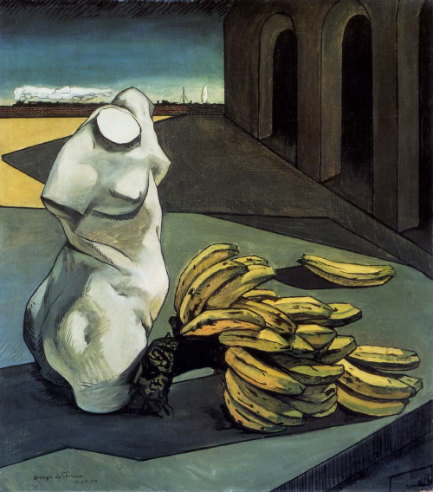
The Uncertainty Of A Poet, 1913

Slide 5
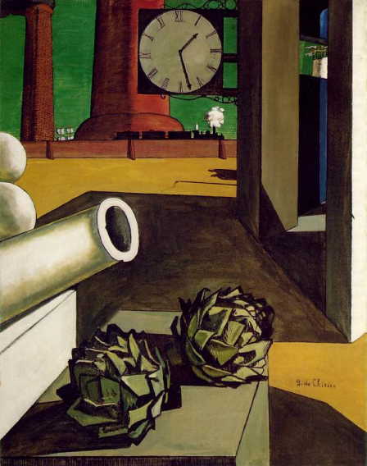
The Conquest of the Philosopher, 1914

Slide 6
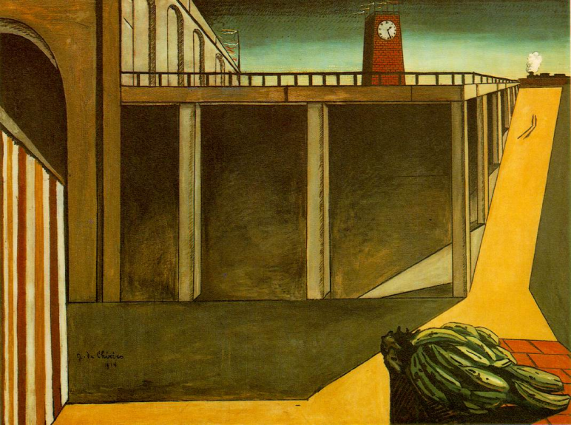
Montparnasse Station, 1914

Slide 7
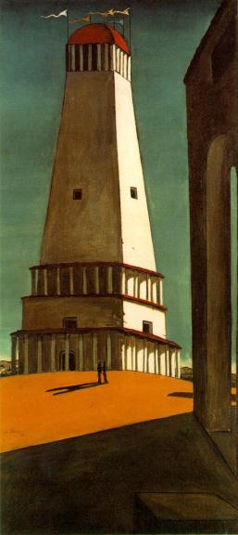
The Nostalgia of the Infinite, 1911

Slide 8
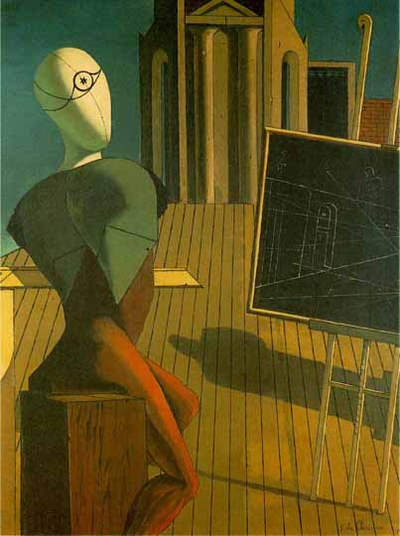
The Prophet, 1915

Slide 9
Max Ernst
Mad for Decalcomania!

Slide 10
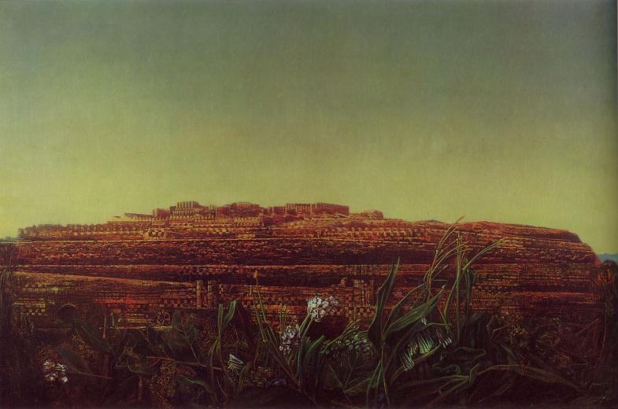
The Entire City, 1935-36.
Notes:
Max Ernst, “The Entire City,” Oil on Canvas, 1935-36

Slide 11
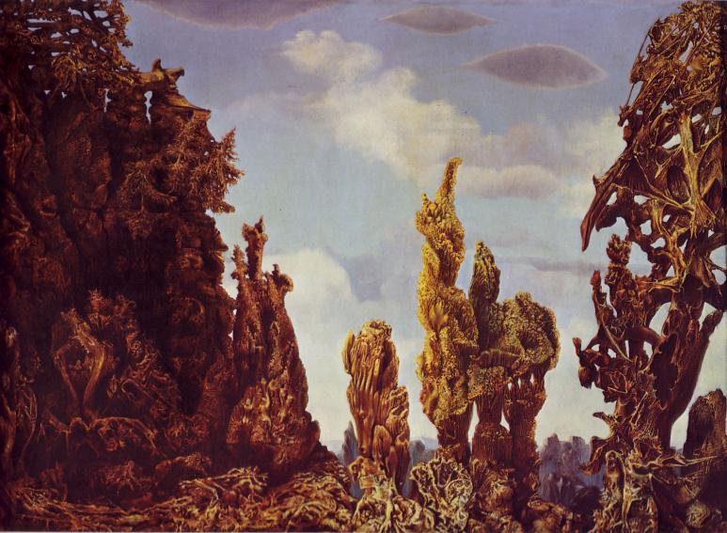
The Fascinating Cypress, 1939
Notes:
“The Fascinating Cypress.” Max Ernst, Oil on Canvas, 1939

Slide 12
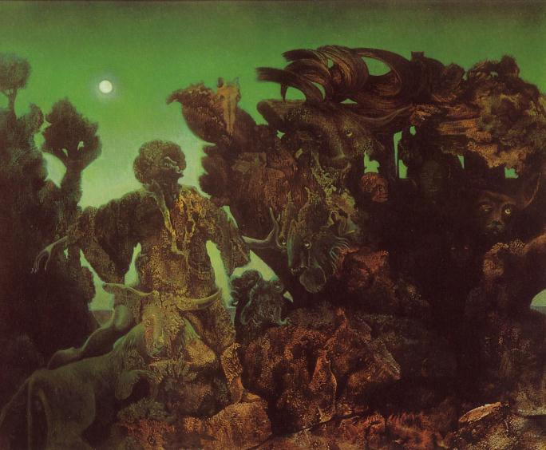
Epiphany, 1940
Notes:
“Epiphany.” Max Ernst, oil on canvas, 1940.

Slide 13
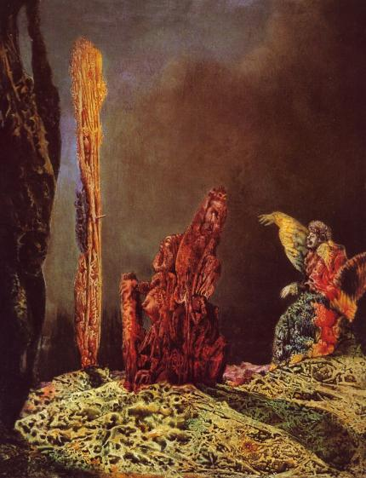
The Harmonious Breakfast (at Santa Monica), 1941.
Notes:
“The Harmonious Breakfast (at Santa Monica).” Max Ernst, oil on canvas, 1941

Slide 14
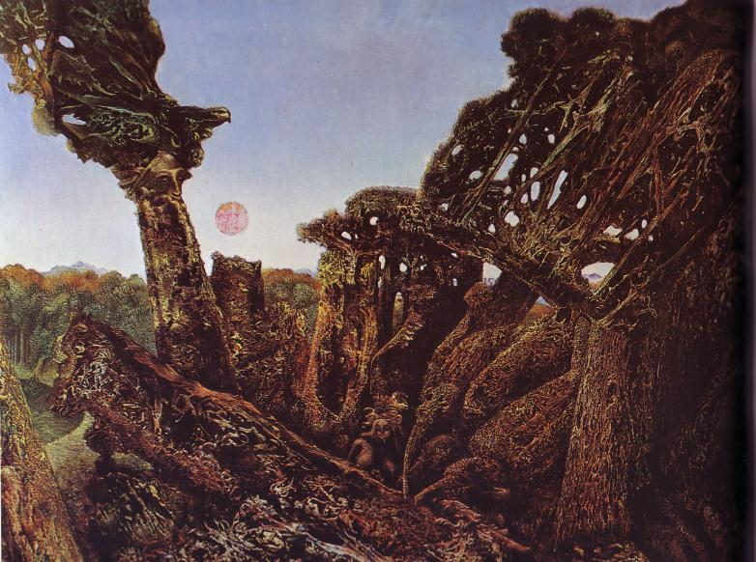
Totem and Taboo, 1941.
Notes:
“Totem and Taboo.” Max Ernst, Oil on Canvas, 1941

Slide 15
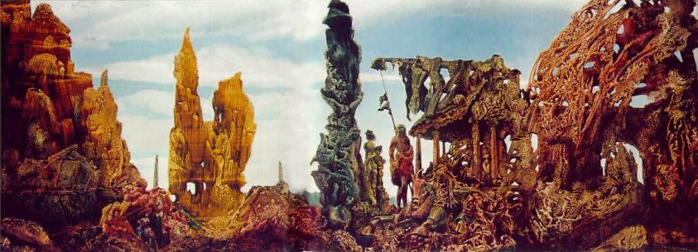
Europe after the Rain II, 1940-42.

Slide 16
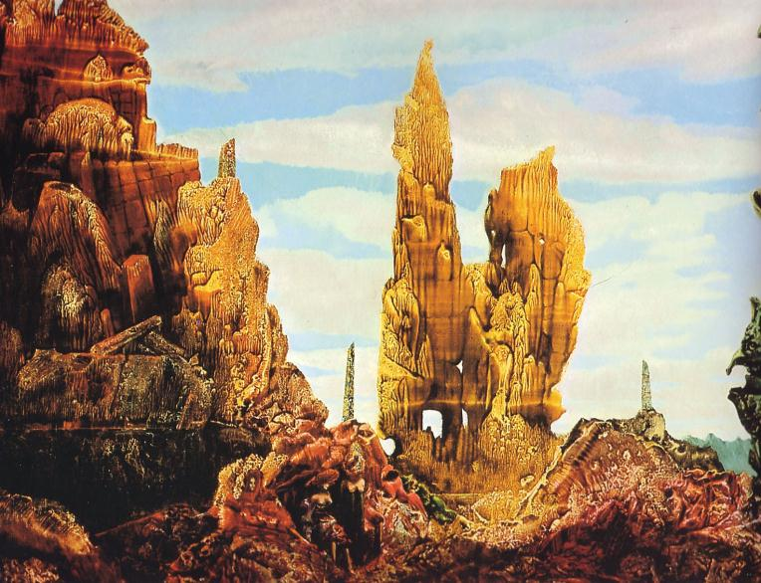
Europe after the Rain II (detail), 1940-42.
Notes:
“Europe after the Rain II” (detail). Max Ernst, Oil on Canvas, 1940-42.

Slide 17
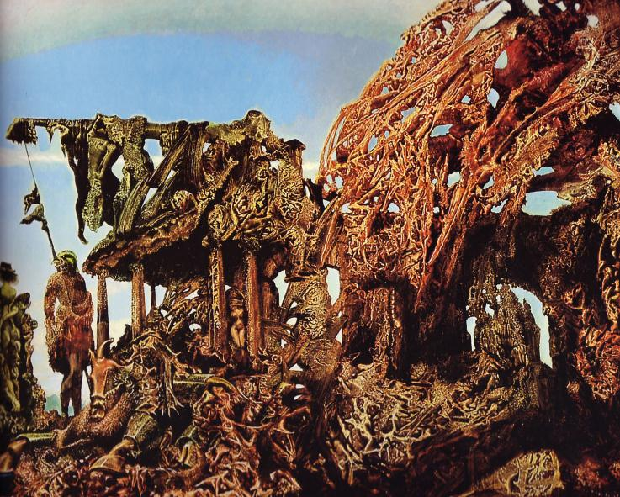
Europe after the Rain II (detail), 1940-42.
Notes:
“Europe after the Rain II” (detail). Max Ernst, Oil on Canvas, 1940-42.

Slide 18
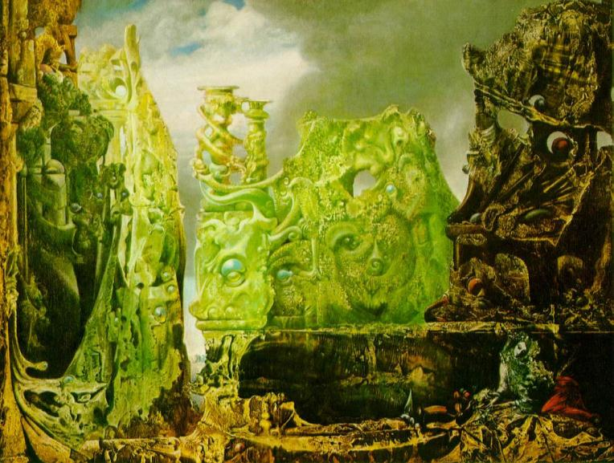
The Eye of Silence, 1943-44.

Slide 19
Salvador Dali
The Man with the Mustache

Slide 20
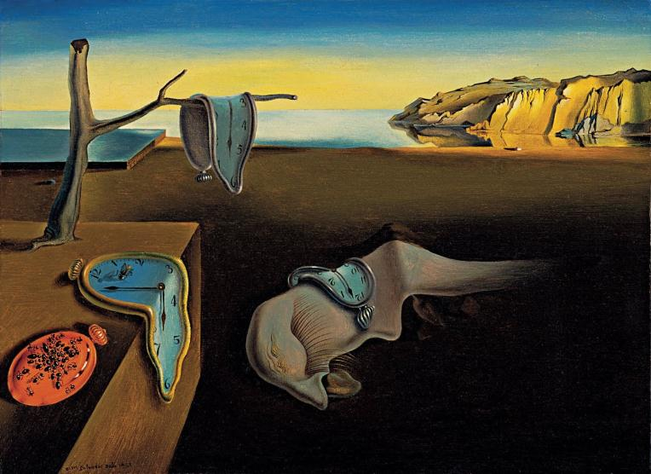
The Persistence of Memory. Salvador Dali, Oil on Canvas, 1931.

Slide 21
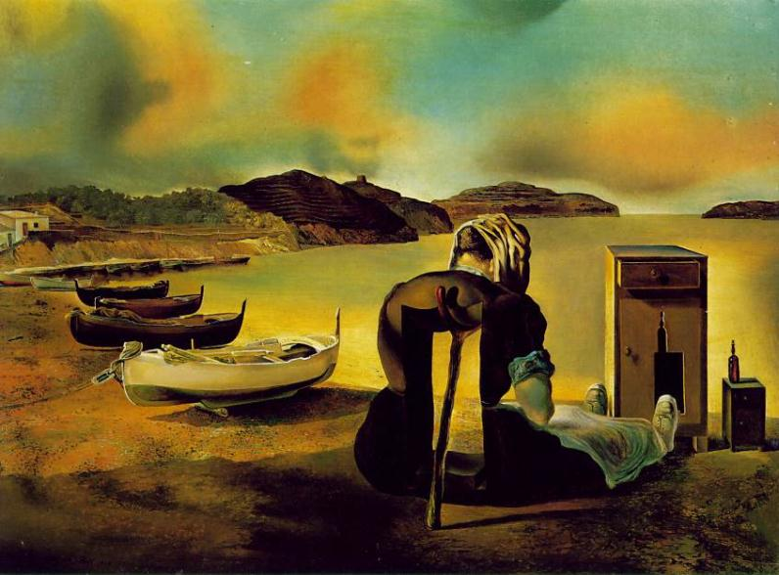
The Weaning of Furniture-Nutrition. Salvador Dali, Oil on Canvas, 1934.

Slide 22
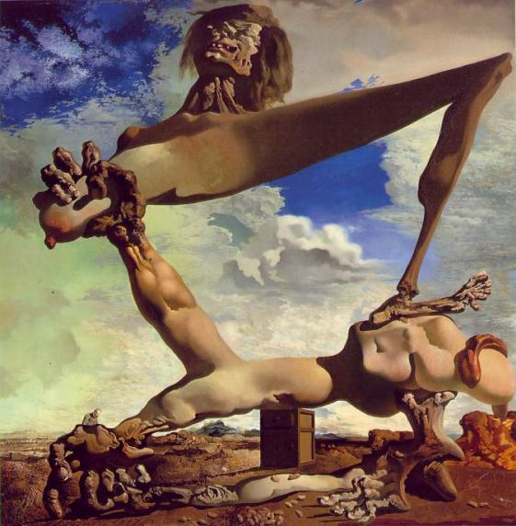
Soft Construction with Boiled Beans: Premonition of Civil War, 1936.

Slide 23
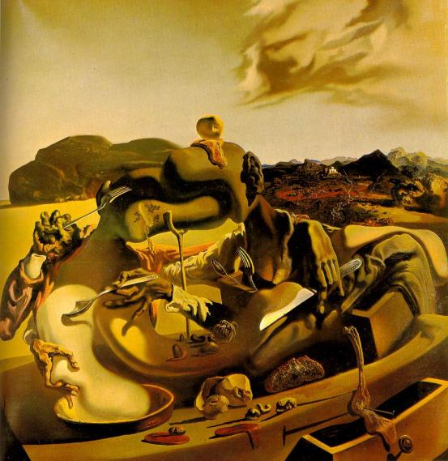
Cannibalism in Autumn, 1936-37

Slide 24
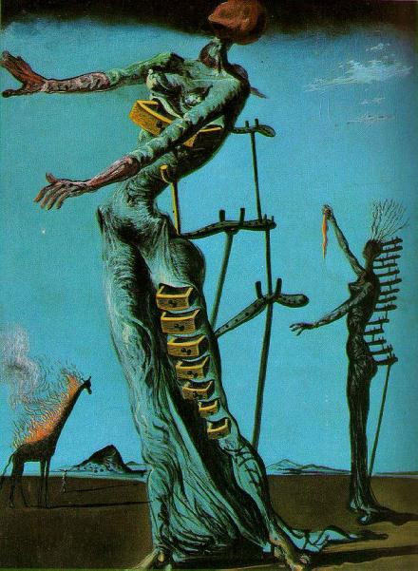
Lighted Giraffes, 1936-37

Slide 25
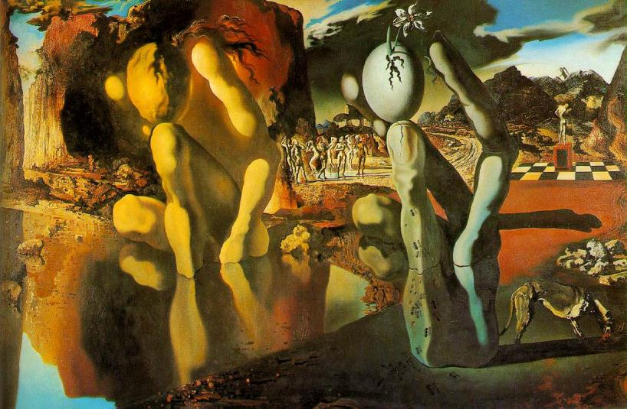
Metamorphosis of Narcissus, 1937

Slide 26
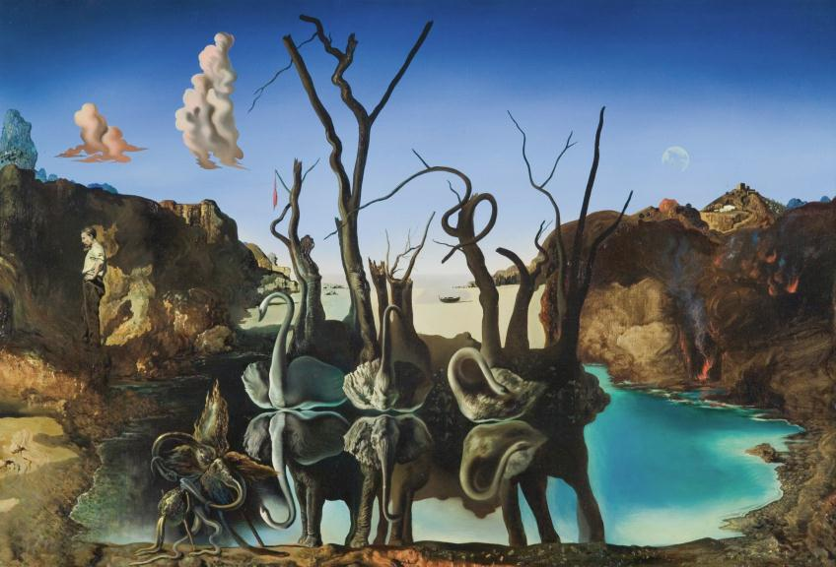
Swans Reflecting Elephants, 1937

Slide 27
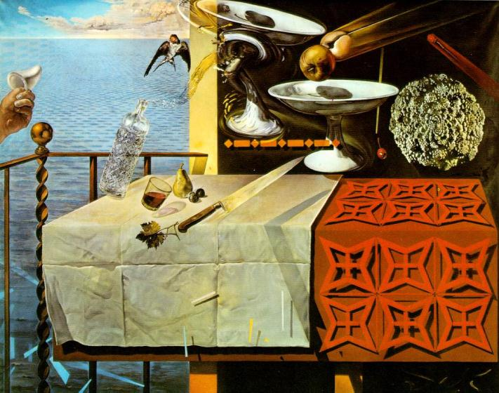
Nature Morte Vivante (Still Life-Fast Moving), 1956

Slide 28
René Magritte
"Ceci n'est pas une PowerPoint"

Slide 29
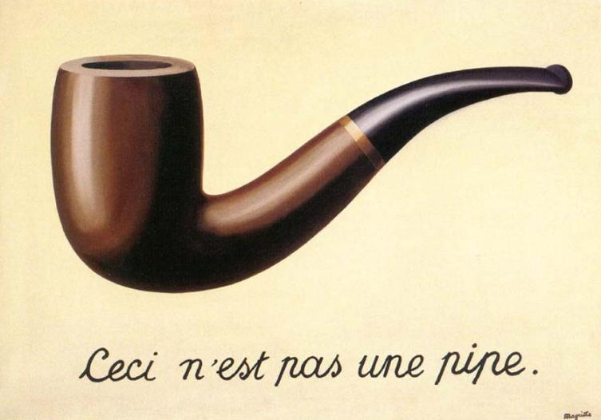
The Treachery of Images, 1928-29
Notes:
when Magritte once was asked about this image, he replied that of course it was not a pipe, just try to fill it with tobacco

Slide 30
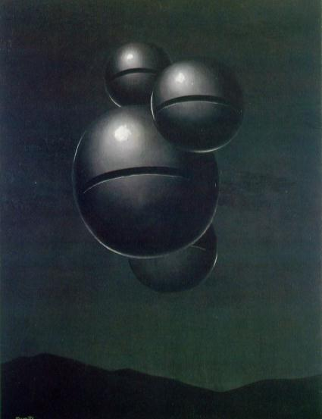
The Voice of Space, 1931

Slide 31
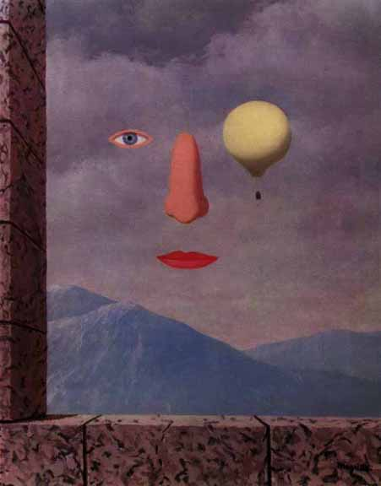
Le siecle des lumieres (The Age of Enlightenment),

Slide 32
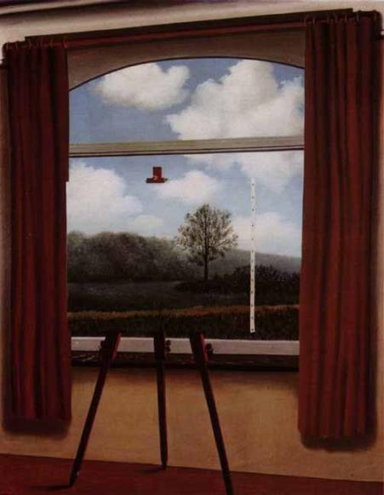
La Condicion Humana (The Human Condition), 1933

Slide 33
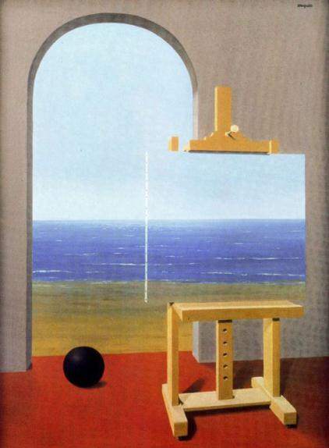
La Condicion Humana (The Human Condition), 1935

Slide 34
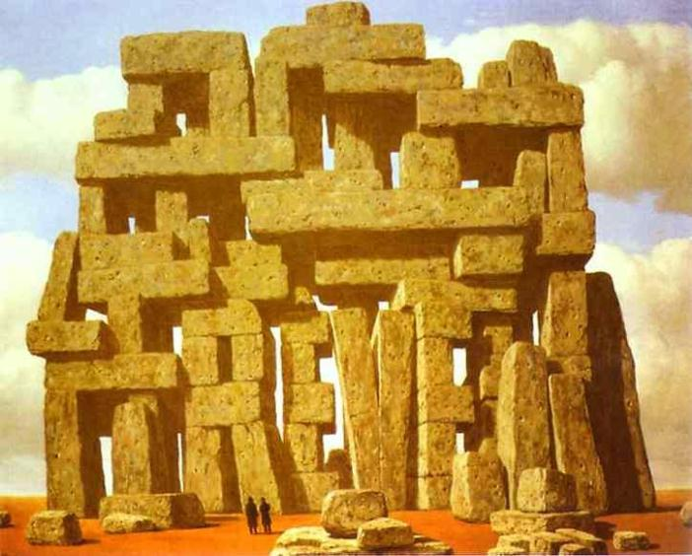
The Art of Conversation, 1950

Slide 35
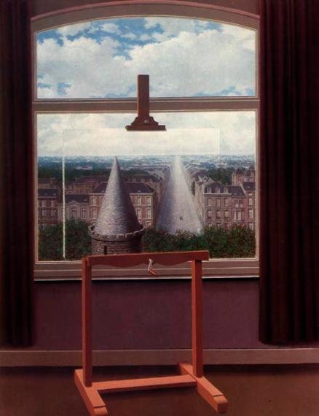
Euclidean Walks, 1955

Slide 36
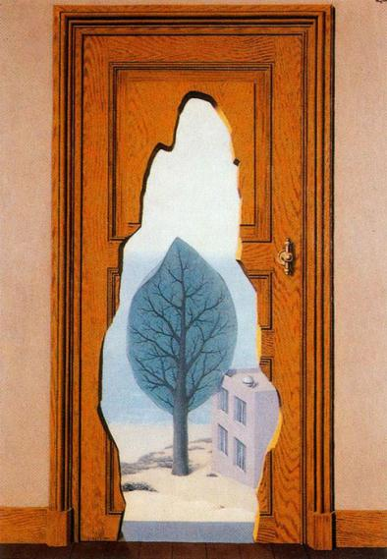
La Perspectiva Amorosa, 1935

Slide 37
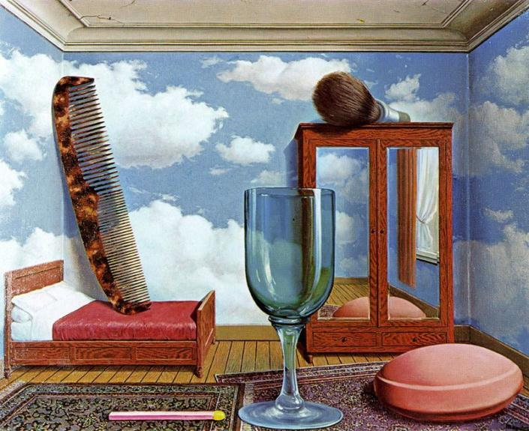
Personal Values, 1951

Slide 38
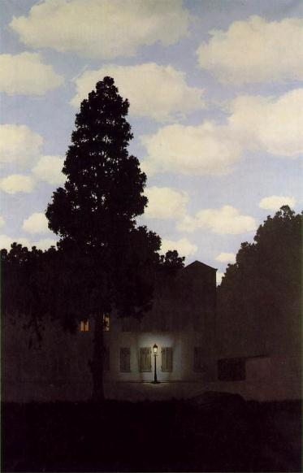
The Empire of Lights, 1954

Slide 39
Yves Tanguy
Nonrepresentational Surrealist

Slide 40
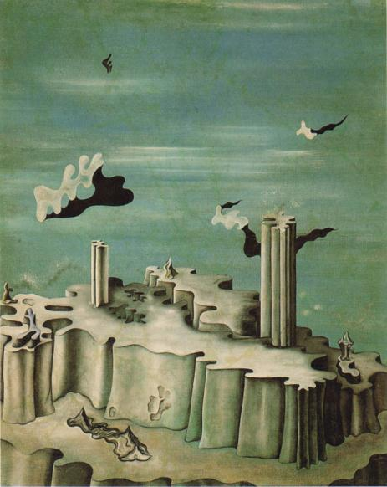
Neither Legends Nor Shapes, 1930

Slide 41
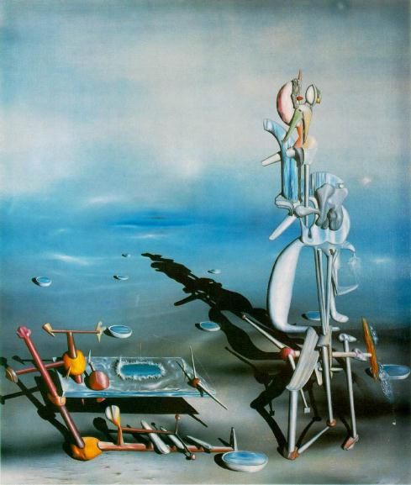
Indefinite Divisibility, 1942

Slide 42
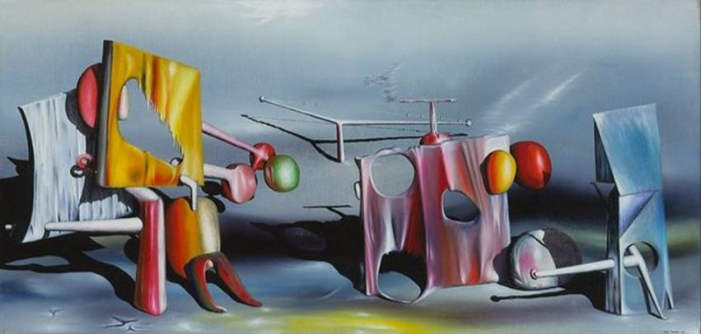
Reply to Red, 1943

Slide 43
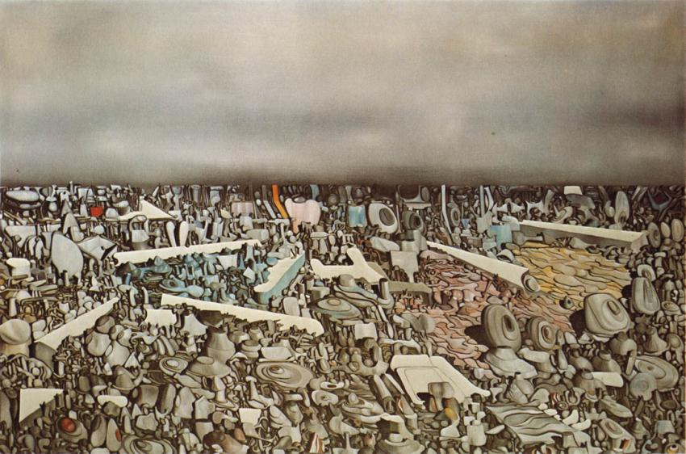
Multiplication of the Arcs, 1954

Slide 44
Thank You
Any Questions?

