Slide 1
Surrealism
The Art of Dreams

Slide 2
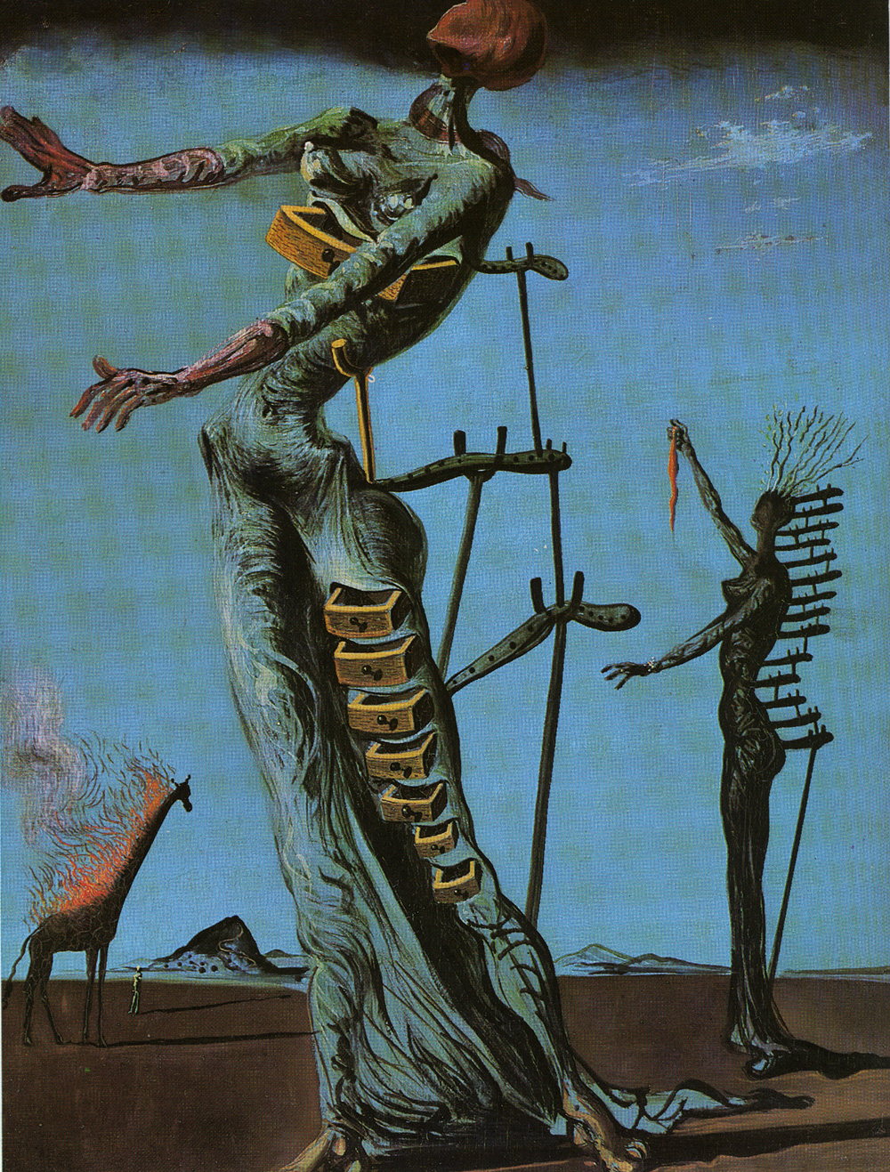
Lighted Giraffes, by Salvador Dali

Slide 3
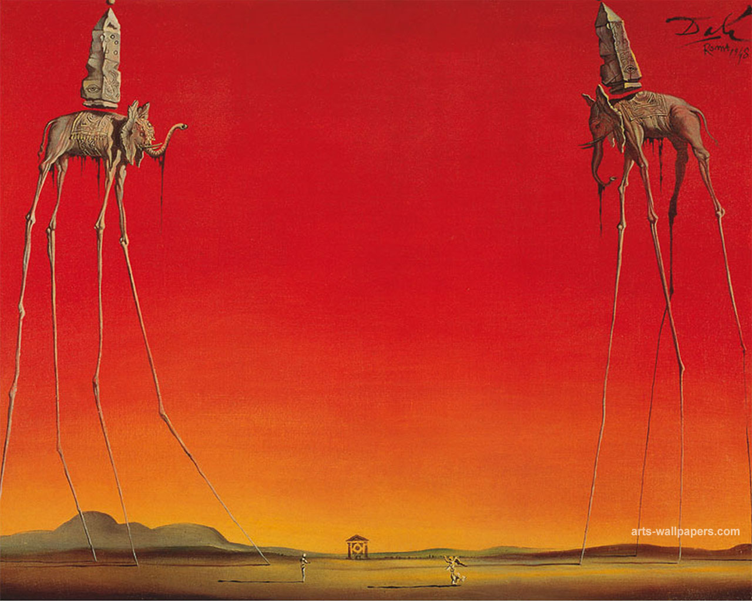
The Elephants, by Salvador Dali

Slide 4
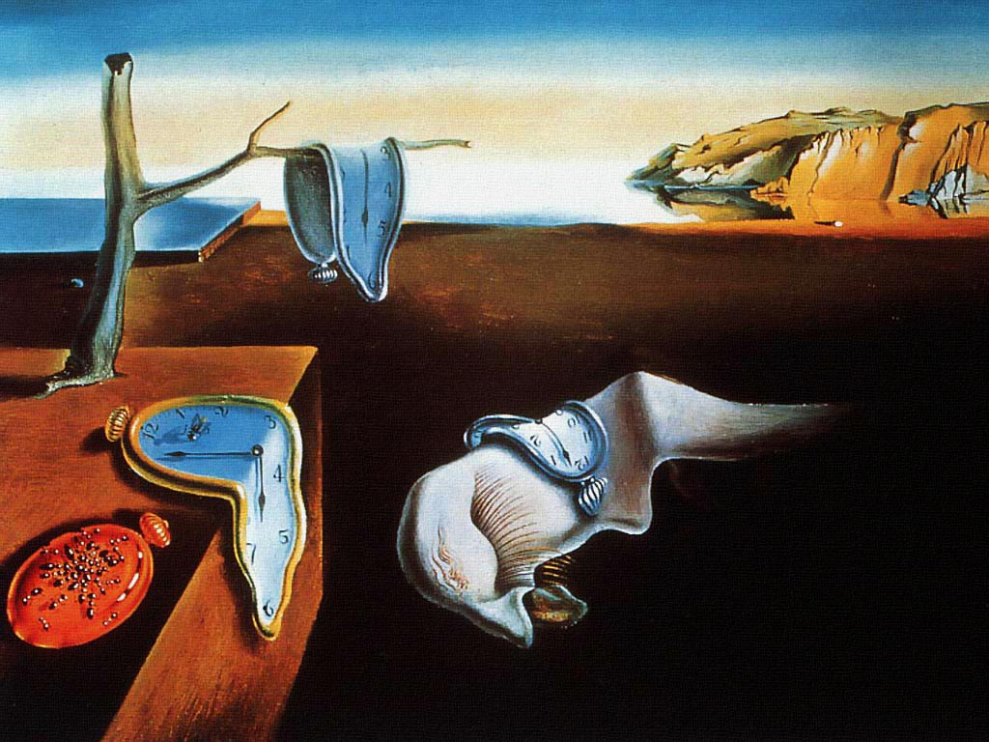
The Persistence of Memory, by Salvador Dali

Slide 5
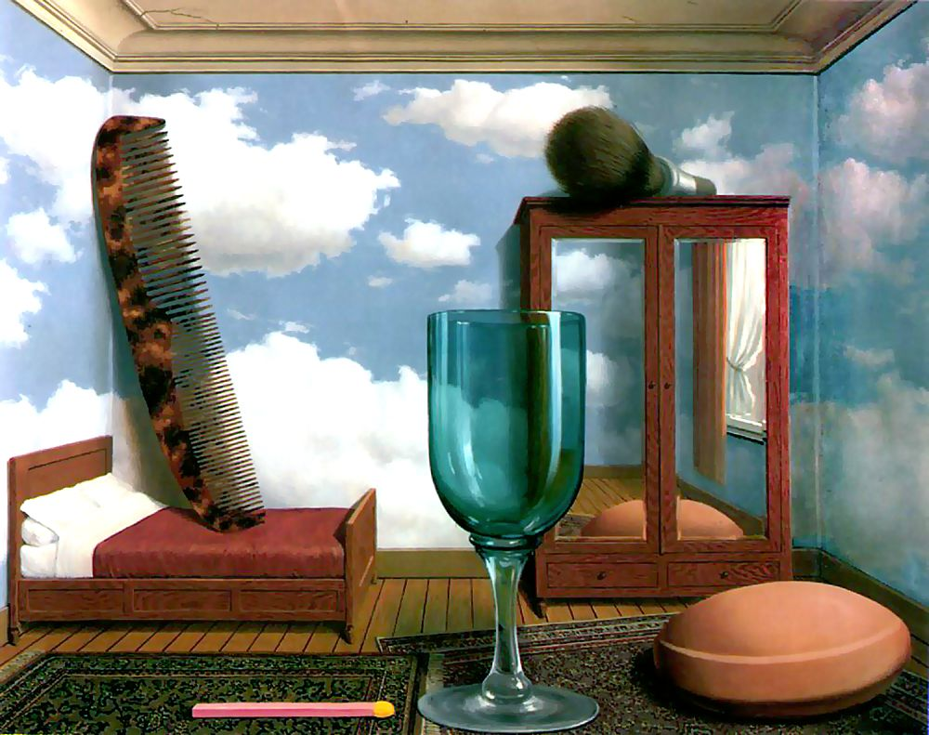
Personal Values, by Rene Magritte

Slide 6
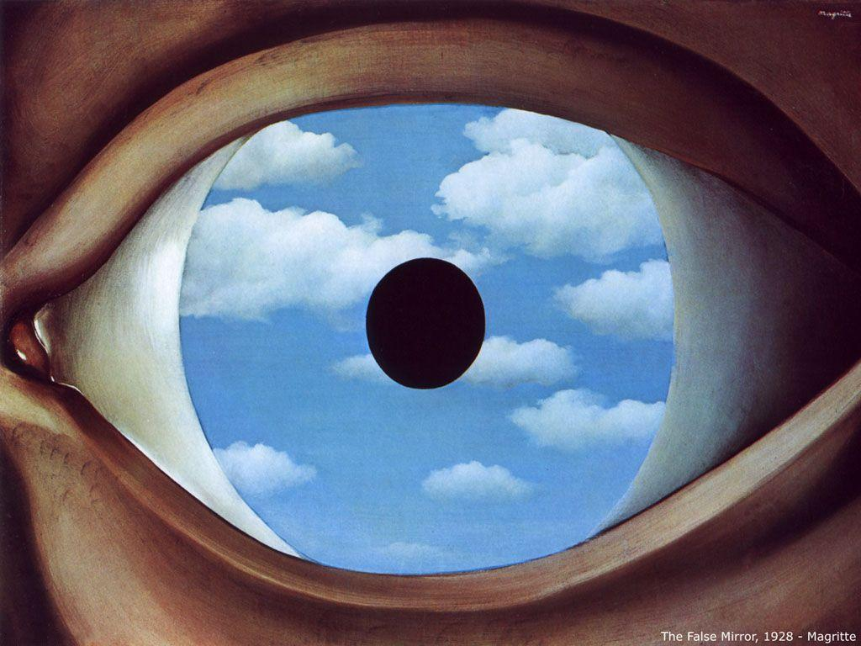
The False Mirror, by Rene Magritte

Slide 7
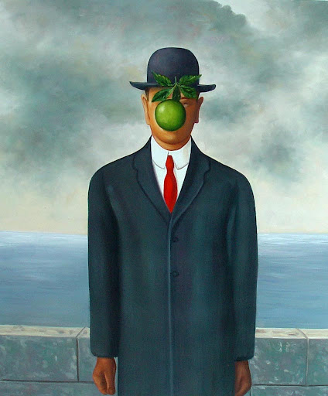
The Son of Man, by Rene Magritte

Slide 8
What surreal art will you make?

