Slide 1
Satirical Printmaking

Slide 2
Honore Daumier

Slide 3
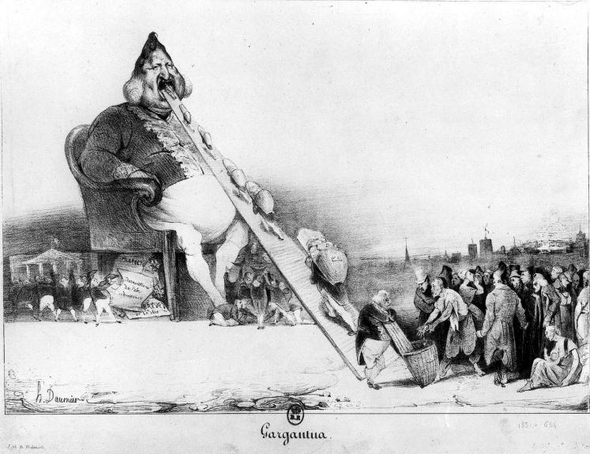
Honore Daumier-- Gargantua

Slide 4
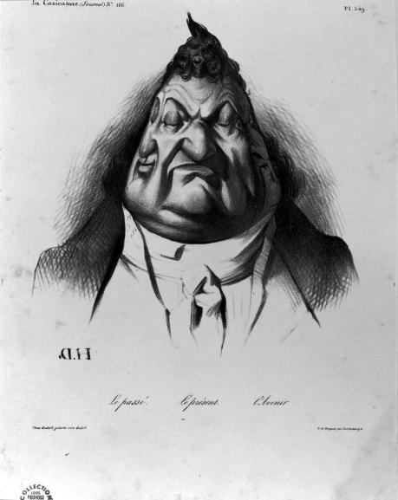
Honore Daumier-- Louis Phillipe 2

Slide 5
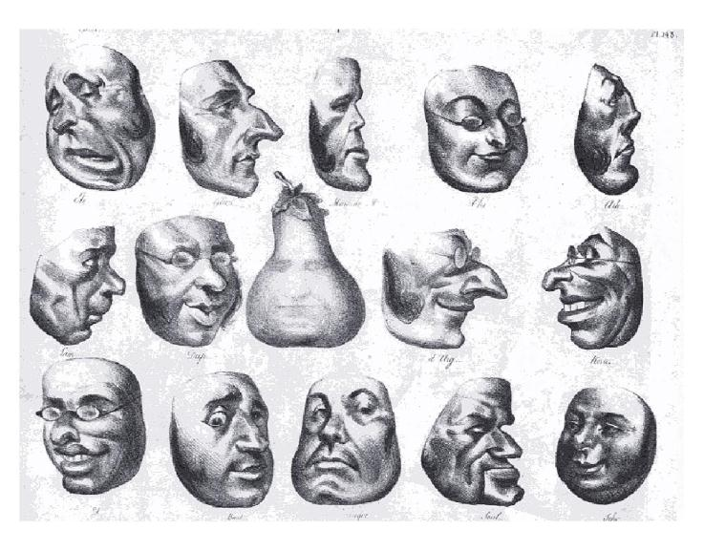
Honore Daumier-- Louis Phillipe

Slide 6
Jose Guadalupe Posada

Slide 7
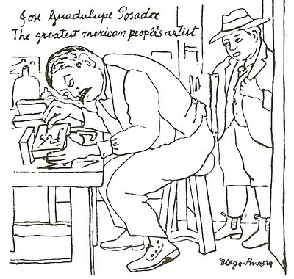
Jose Guadalupe Posada-- The Greatest Mexican People's Artist (illustration by Diego Rivera)

Slide 8
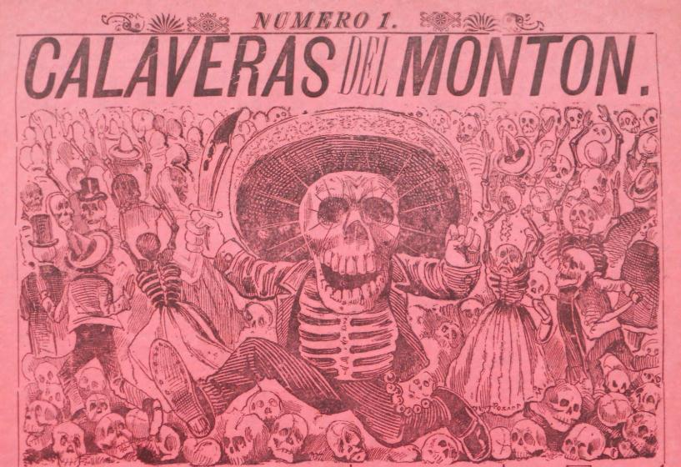
Jose Guadalupe Posada-- Calaveras del Monton

Slide 9
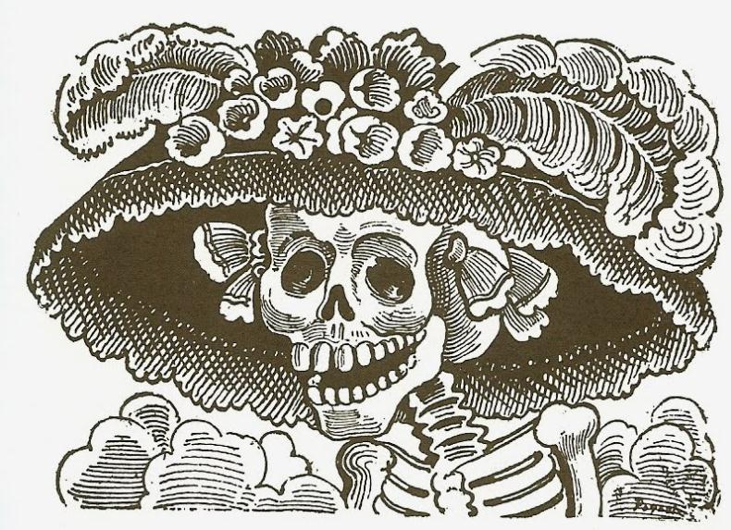
Jose Guadalupe Posada-- La Calavera Catrina

Slide 10
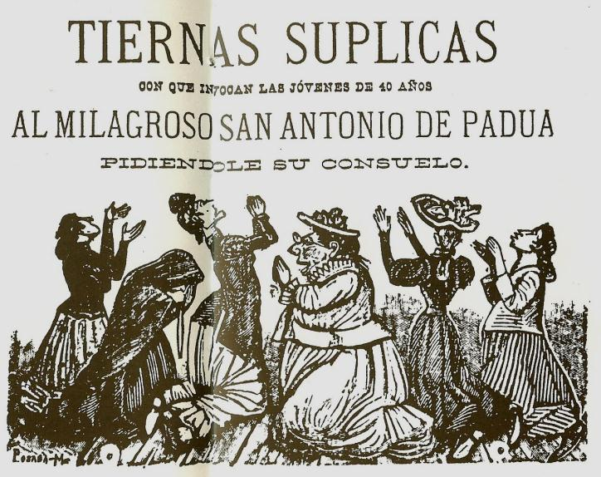
Posada--Tender Entreaties - with which young girls forty years of age invoke the miracle working Saint Antonio of Padua, praying to him for comfort.

Slide 11
Lynd Ward

Slide 12
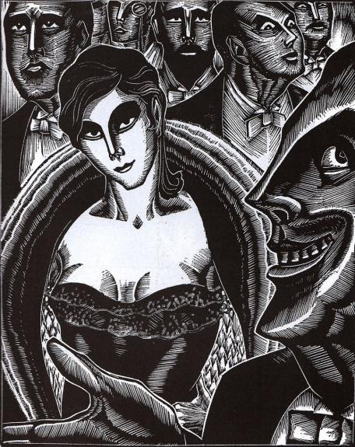
Lynd Ward, Excerpt from God's Man 1

Slide 13
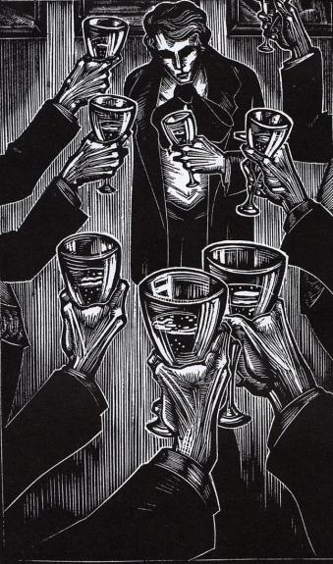
Lynd Ward, Excerpt from God's Man 2

Slide 14
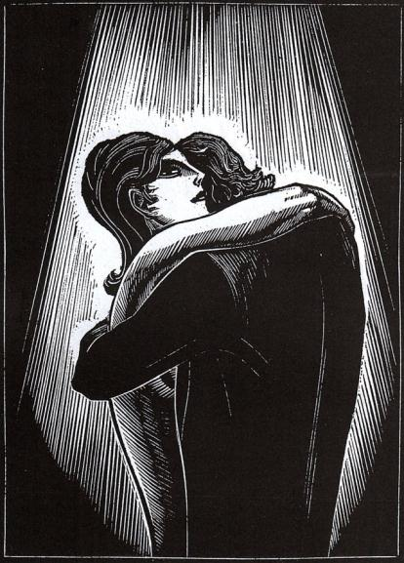
Lynd Ward, Excerpt from God's Man 3

Slide 15
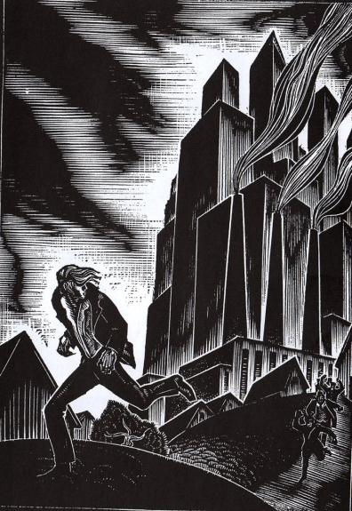
Lynd Ward, Excerpt from God's Man 4

Slide 16
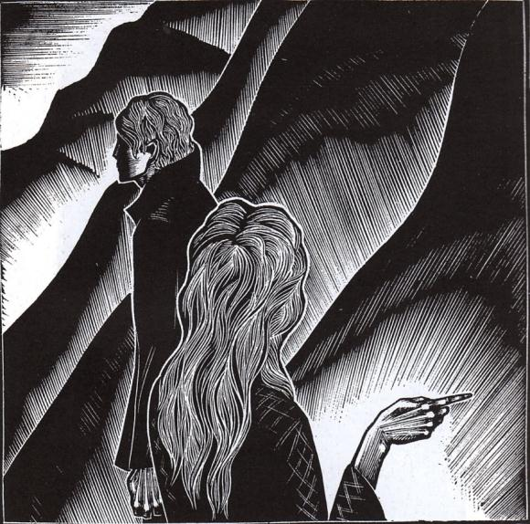
Lynd Ward, Excerpt from God's Man 5

Slide 17
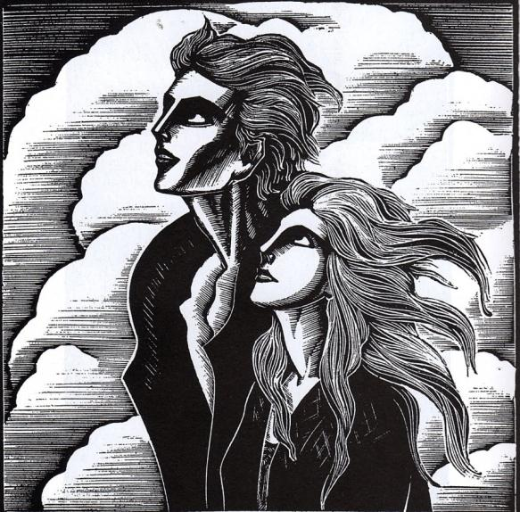
Lynd Ward, Excerpt from God's Man 6

Slide 18
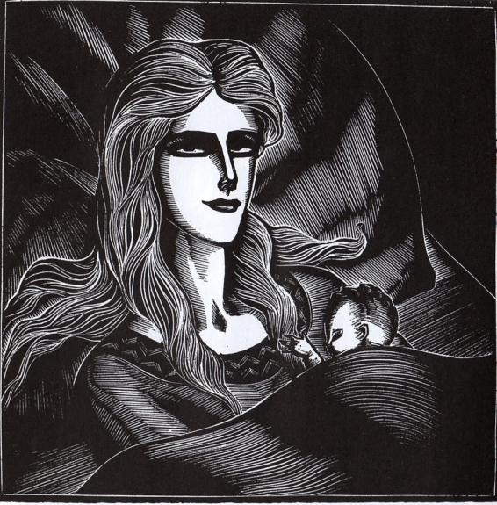
Lynd Ward, Excerpt from God's Man 7

Slide 19
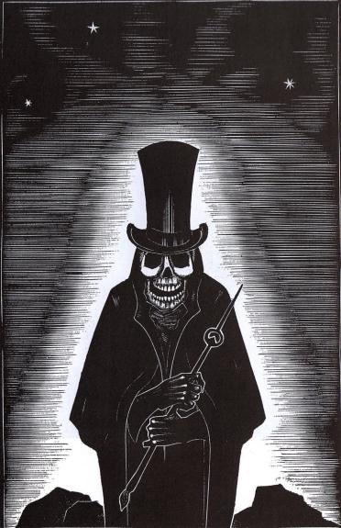
Lynd Ward, Excerpt from God's Man 8

Slide 20
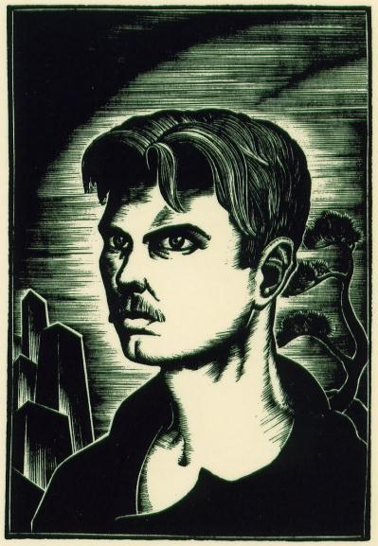
Lynd Ward, Self Portrait

Slide 21
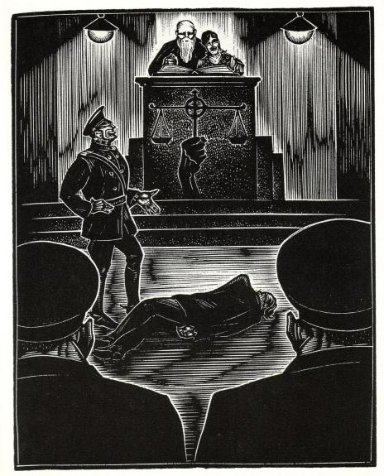
Lynd Ward

Slide 22
Sue Coe

Slide 23
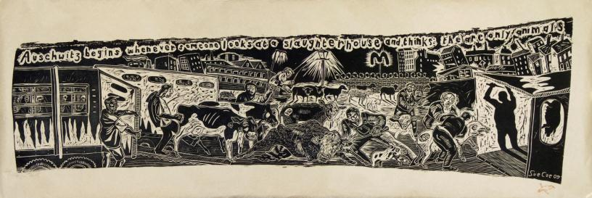
Sue Coe-- Auschwitz

Slide 24
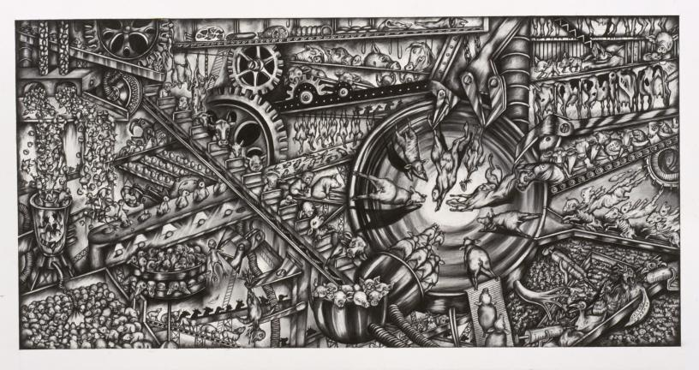
Sue Coe-- Factory Pharm

Slide 25
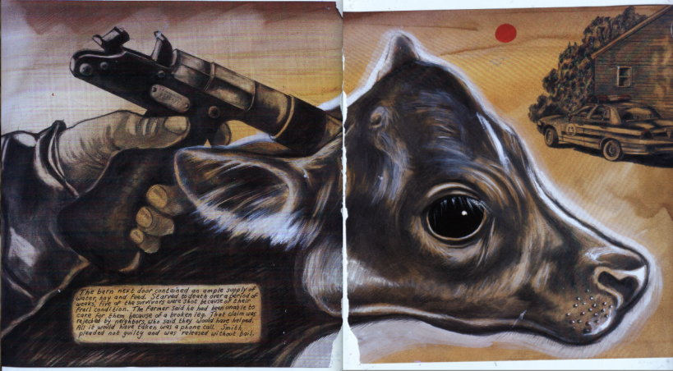
Sue Coe-- Sheep of Fools

Slide 26
Tom Huck

Slide 27
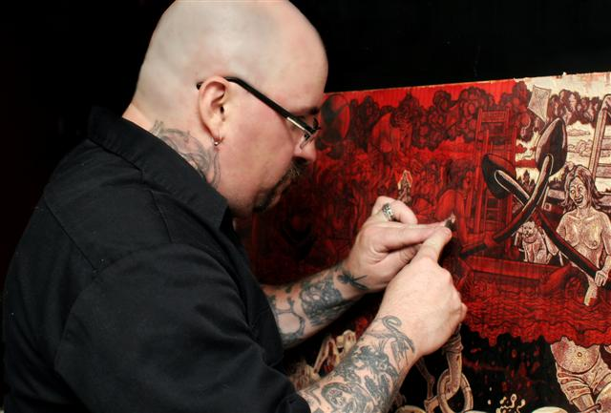
Tom Huck cutting a block

Slide 28
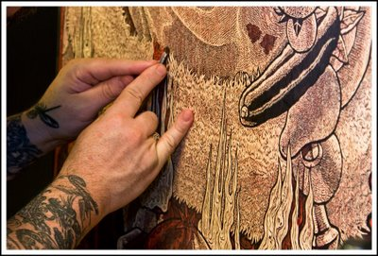
Tom Huck cutting detail

Slide 29
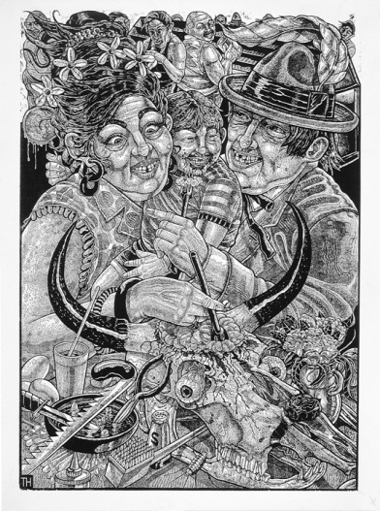
Tom Huck, Beef Brain Buffet

Slide 30
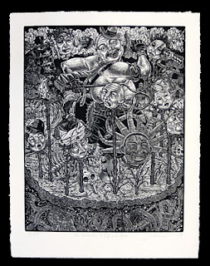
Tom Huck, Commander and Thief Rides Again

Slide 31
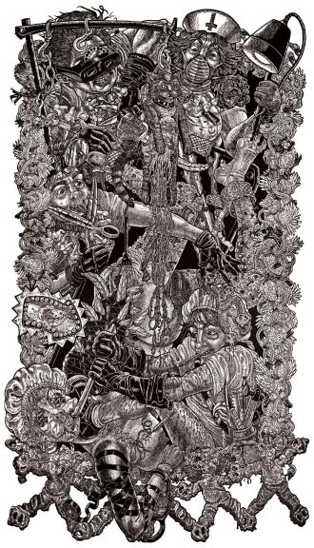
Tom Huck, The Transformation of Brandy Baghead-- center panel

Slide 32
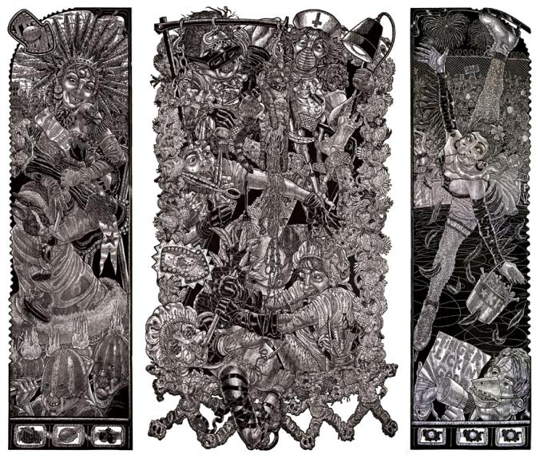
Tom Huck, The Transformation of Brandy Baghead

Slide 33
What will you satirize?

