Slide 1
Positive and Negative Space

Slide 2
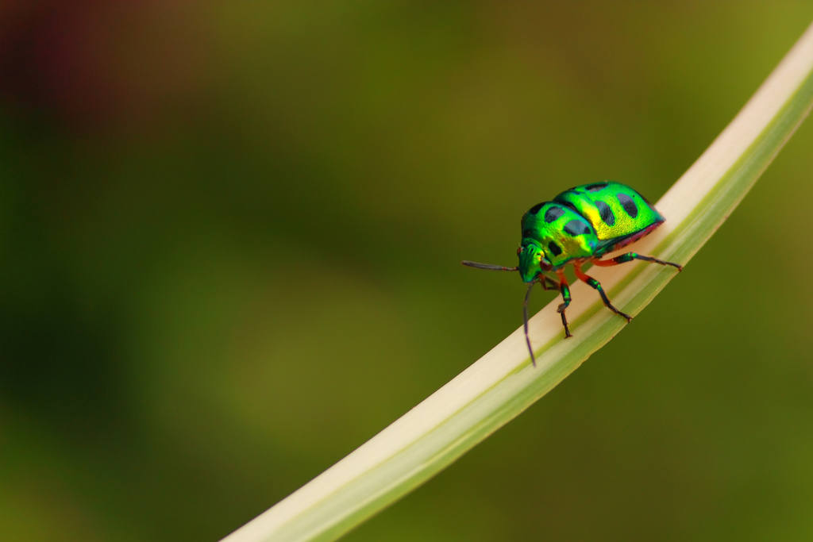

Slide 6
