Slide 1
Figure Painting

Slide 2
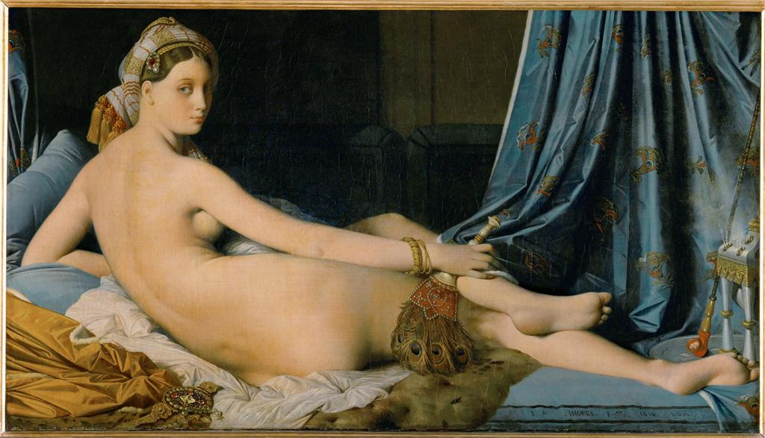
Notes:
Creator: Jean-Auguste-Dominique Ingres Title: The Grand Odalisque Date: 1814 Material: oil on canvas Measurements: 91 x 182 cm Repository: Musée du Louvre Collection: Art, Archaeology and Architecture (Erich Lessing Culture and Fine Arts Archives) ID Number: 40-11-02/37 Source: Image and original data provided by Erich Lessing Culture and Fine Arts Archives/ART RESOURCE, N.Y. Source: http://www.artres.com/c/htm/Home.aspx Source: http://www.artres.com/c/htm/TreePfLight.aspx?ID=LES Rights: Photo Credit: Erich Lessing/ART RESOURCE, N.Y. Rights: Please note that if this image is under copyright, you may need to contact one or more copyright owners for any use that is not permitted under the ARTstor Terms and Conditions of Use or not otherwise permitted by law. While ARTstor tries to update contact information, it cannot guarantee that such information is always accurate. Determining whether those permissions are necessary, and obtaining such permissions, is your sole responsibility.

Slide 3
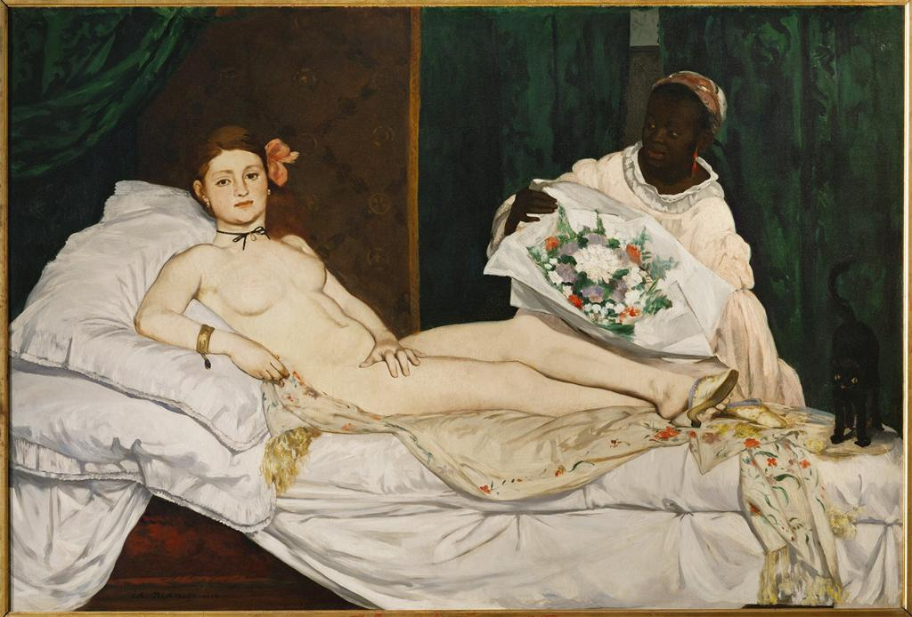
Notes:
Creator: Edouard Manet Title: Olympia Date: 1863-1865 Material: oil on canvas Measurements: 130.5 x 190 cm Repository: Musée d'Orsay Repository: Inv. RF 2772 Collection: Art, Archaeology and Architecture (Erich Lessing Culture and Fine Arts Archives) ID Number: 40-12-01/20 Source: Image and original data provided by Erich Lessing Culture and Fine Arts Archives/ART RESOURCE, N.Y. Source: http://www.artres.com/c/htm/Home.aspx Source: http://www.artres.com/c/htm/TreePfLight.aspx?ID=LES Rights: Photo Credit: Erich Lessing/ART RESOURCE, N.Y. Rights: Please note that if this image is under copyright, you may need to contact one or more copyright owners for any use that is not permitted under the ARTstor Terms and Conditions of Use or not otherwise permitted by law. While ARTstor tries to update contact information, it cannot guarantee that such information is always accurate. Determining whether those permissions are necessary, and obtaining such permissions, is your sole responsibility.

Slide 4
Max Beckmann

Slide 5
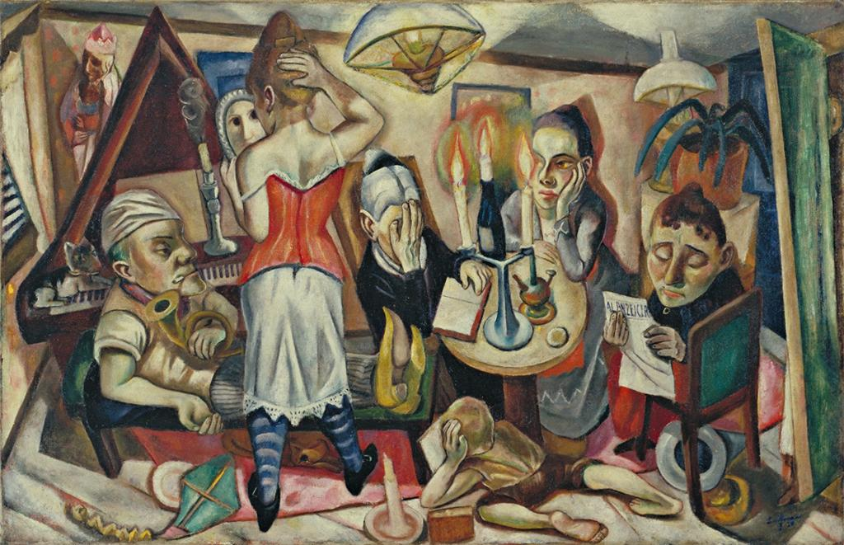
Notes:
Creator: Max Beckmann, German, 1884-1950 Title: Family Picture Work Type: Painting Date: Frankfurt 1920 Material: Oil on canvas Measurements: 25 5/8 x 39 3/4" (65.1 x 100.9 cm) Repository: The Museum of Modern Art Repository: Gift of Abby Aldrich Rockefeller Accession Number: 26.1935 Collection: The Museum of Modern Art: Painting and Sculpture ID Number: 78507 Source: Image and original data provided by the The Museum of Modern Art Source: http://www.moma.org Rights: Your use of this image is restricted to those permitted uses specified in the ARTstor Digital Library Terms and Conditions of Use (http://www.artstor.org/info/about/terms_conditions.jsp). To request permission for any other use within North America, please contact Art Resource, 536 Broadway, New York, NY 10012; phone: 212-505-8700; fax: 212-505-2053; email: requests@artres.com; website: http://www.artres.com/c/htm/StaticPage2.aspx?page=ContactUs. To request permission for any other use outside North America, please contact Scala Archives: Scala Group, S.p., 62 via Chiantigiana, 50011 Antella/Firenze, Italy. Phone 39 055 6233 200, fax 39 055 641124, email archivio@scalagroup.com; http://www.scalarchives.com/web/contatti.asp. Rights: © 2008 Artists Rights Society (ARS), New York / VG Bild-Kunst, Bonn

Slide 6
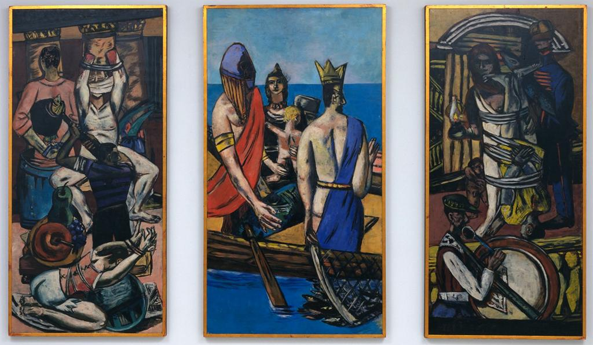
Notes:
Creator: Max Beckmann, German, 1884-1950 Title: Departure Work Type: Painting Date: Frankfurt 1932, Berlin 1933-35 Material: Oil on canvas, three panels Measurements: Side panels 7' 3/4" x 39 1/4" (215.3 x 99.7 cm), center panel 7' 3/4" x 45 3/8" (215.3 x 115.2 cm) Repository: The Museum of Modern Art Repository: Given anonymously (by exchange) Accession Number: 6.1942.a-c Collection: The Museum of Modern Art: Painting and Sculpture ID Number: 78367 Source: Image and original data provided by the The Museum of Modern Art Source: http://www.moma.org Rights: Your use of this image is restricted to those permitted uses specified in the ARTstor Digital Library Terms and Conditions of Use (http://www.artstor.org/info/about/terms_conditions.jsp). To request permission for any other use within North America, please contact Art Resource, 536 Broadway, New York, NY 10012; phone: 212-505-8700; fax: 212-505-2053; email: requests@artres.com; website: http://www.artres.com/c/htm/StaticPage2.aspx?page=ContactUs. To request permission for any other use outside North America, please contact Scala Archives: Scala Group, S.p., 62 via Chiantigiana, 50011 Antella/Firenze, Italy. Phone 39 055 6233 200, fax 39 055 641124, email archivio@scalagroup.com; http://www.scalarchives.com/web/contatti.asp. Rights: © 2008 Artists Rights Society (ARS), New York / VG Bild-Kunst, Bonn

Slide 7
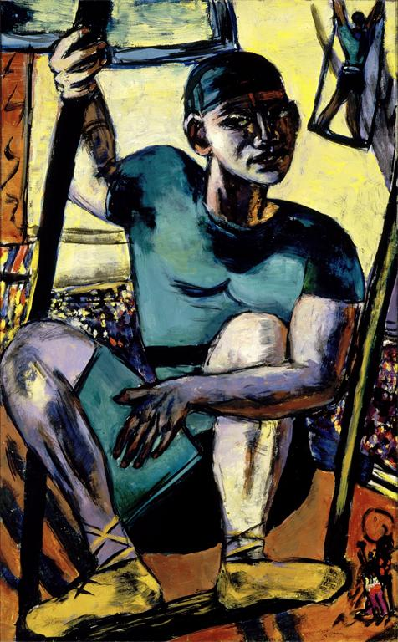
Notes:
Creator: Max Beckmann, German, 18841950 Title: Acrobat on Trapeze Work Type: paintings Date: 1940 Location: Place made: Amsterdam, The Netherlands Material: oil on canvas Measurements: 57 3/8 x 35 7/8 in. (145.7 x 91.1 cm) Repository: Saint Louis Art Museum, Bequest of Morton D. May Accession Number: 852:1983 Collection: Saint Louis Art Museum Source: Image and original data provided by Saint Louis Art Museum Source: http://www.slam.org/ Rights: © Artists Rights Society (ARS), New York, NY / VG Bild-Kunst, Bonn Rights: © 2008 Artists Rights Society (ARS), New York / BILDKUNST, Bonn Rights: Contact Information: Saint Louis Art Museum, One Fine Arts Drive, Forest Park, St. Louis, Missouri 63110; image.request@slam.org Rights: Please note that if this image is under copyright, you may need to contact one or more copyright owners for any use that is not permitted under the ARTstor Terms and Conditions of Use or not otherwise permitted by law. While ARTstor tries to update contact information, it cannot guarantee that such information is always accurate. Determining whether those permissions are necessary, and obtaining such permissions, is your sole responsibility.

Slide 8
Egon Schiele

Slide 9
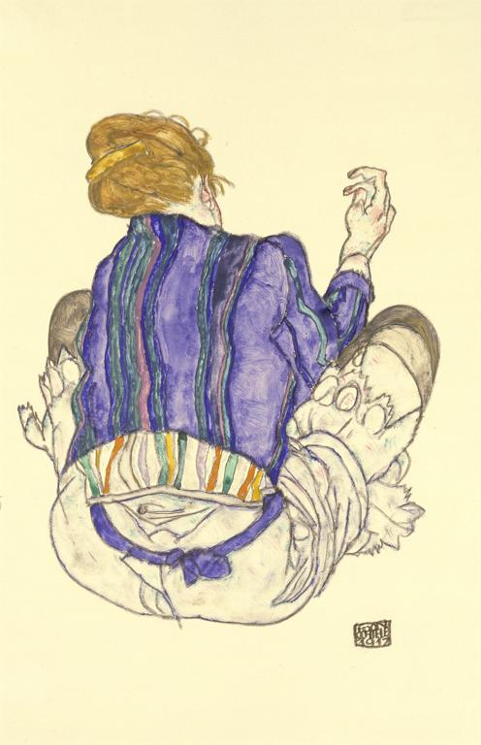
Notes:
Creator: Egon Schiele, Austrian, 1890-1918 Title: Seated Woman Date: 1917 Material: Watercolor, gouache, and pencil on paper Measurements: H. 18-1/4, W. 11-3/4 in. (46.4 x 29.8 cm) Description: [lower right]: EGON /SCHIELE /1917 Repository: The Metropolitan Museum of Art Repository: http://www.metmuseum.org Collection: Metropolitan Museum of Art - Images for Academic Publishing ID Number: 3644 Source: Data From: The Metropolitan Museum of Art Credit Line: The Metropolitan Museum of Art, Bequest of Scofield Thayer, 1982 (1984.433.294) Image Copyright Notice: Image © The Metropolitan Museum of Art Rights: This image was provided by The Metropolitan Museum of Art. Contact information: Image Library, The Metropolitan Museum of Art, 1000 Fifth Avenue, New York, NY 10028, (212) 396-5050 (fax), Scholars.License@MetMuseum.org Rights: Image © The Metropolitan Museum of Art Rights: This image is available for uses permitted under the ARTstor Terms and Conditions of Use, such as teaching and study, as well as for scholarly publications, through the Images for Academic Publishing (IAP) initiative. If you are seeking to use this image for scholarly publication, you should click on the IAP icon below the thumbnail image.

Slide 10
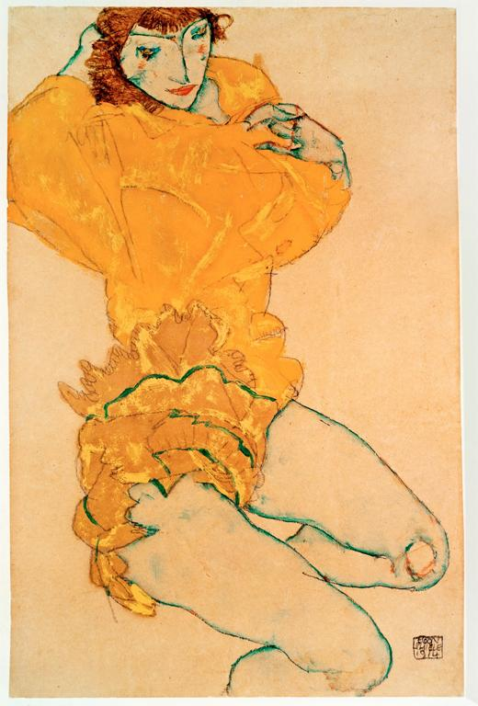
Notes:
Creator: Egon Schiele Title: Woman Undressing Work Type: drawing Date: 1914 Material: gouache and pencil Measurements: 48.2 x 31.1 cm Repository: Miyagi-ken Bijutsukan. Collection: Art, Archaeology and Architecture (Erich Lessing Culture and Fine Arts Archives) Source: Image and original data provided by Erich Lessing Culture and Fine Arts Archives/ART RESOURCE, N.Y. Source: http://www.artres.com/c/htm/Home.aspx Source: http://www.artres.com/c/htm/TreePfLight.aspx?ID=LES Rights: Photo Credit: Erich Lessing/ART RESOURCE, N.Y. Rights: Please note that if this image is under copyright, you may need to contact one or more copyright owners for any use that is not permitted under the ARTstor Terms and Conditions of Use or not otherwise permitted by law. While ARTstor tries to update contact information, it cannot guarantee that such information is always accurate. Determining whether those permissions are necessary, and obtaining such permissions, is your sole responsibility.

Slide 11
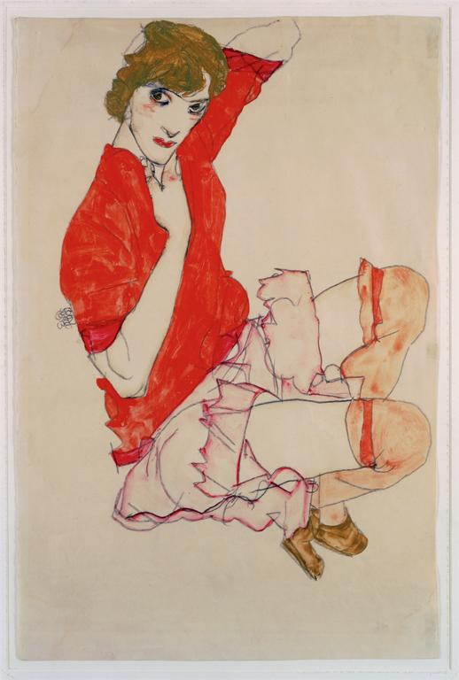
Notes:
Creator: Egon Schiele Title: Wally in a Red Blouse with Raised Knees Work Type: watercolor Date: 1913 Material: gouache, watercolor and pencil Measurements: 31.8 x 48 cm Repository: Private Collection Collection: Art, Archaeology and Architecture (Erich Lessing Culture and Fine Arts Archives) Source: Image and original data provided by Erich Lessing Culture and Fine Arts Archives/ART RESOURCE, N.Y. Source: http://www.artres.com/c/htm/Home.aspx Source: http://www.artres.com/c/htm/TreePfLight.aspx?ID=LES Rights: Photo Credit: Erich Lessing/ART RESOURCE, N.Y. Rights: Please note that if this image is under copyright, you may need to contact one or more copyright owners for any use that is not permitted under the ARTstor Terms and Conditions of Use or not otherwise permitted by law. While ARTstor tries to update contact information, it cannot guarantee that such information is always accurate. Determining whether those permissions are necessary, and obtaining such permissions, is your sole responsibility.

Slide 12
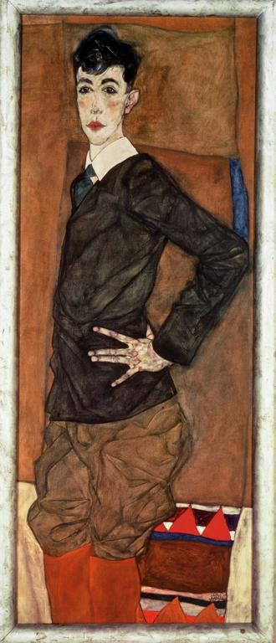
Notes:
Creator: Egon Schiele Title: Erich Lederer Work Type: painting Date: 1912 Material: oil and gouache Measurements: 139 x 55 cm Repository: Öffentliche Kunstsammlung Basel Collection: Art, Archaeology and Architecture (Erich Lessing Culture and Fine Arts Archives) Source: Image and original data provided by Erich Lessing Culture and Fine Arts Archives/ART RESOURCE, N.Y. Source: http://www.artres.com/c/htm/Home.aspx Source: http://www.artres.com/c/htm/TreePfLight.aspx?ID=LES Rights: Photo Credit: Erich Lessing/ART RESOURCE, N.Y. Rights: Please note that if this image is under copyright, you may need to contact one or more copyright owners for any use that is not permitted under the ARTstor Terms and Conditions of Use or not otherwise permitted by law. While ARTstor tries to update contact information, it cannot guarantee that such information is always accurate. Determining whether those permissions are necessary, and obtaining such permissions, is your sole responsibility.

Slide 13
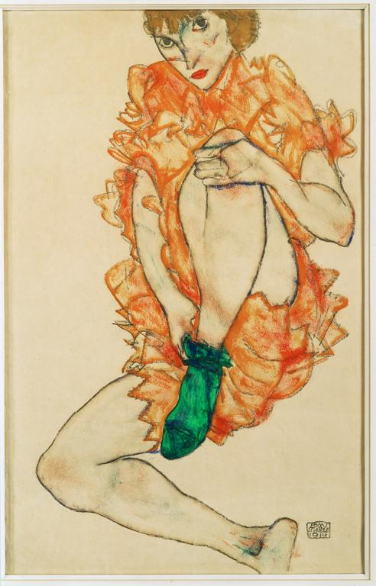
Notes:
Creator: Egon Schiele Title: Green Stocking Work Type: drawing Date: 1914 Material: gouache and pencil Measurements: 47 x 29.2 cm Repository: Private Collection Collection: Art, Archaeology and Architecture (Erich Lessing Culture and Fine Arts Archives) Source: Image and original data provided by Erich Lessing Culture and Fine Arts Archives/ART RESOURCE, N.Y. Source: http://www.artres.com/c/htm/Home.aspx Source: http://www.artres.com/c/htm/TreePfLight.aspx?ID=LES Rights: Photo Credit: Erich Lessing/ART RESOURCE, N.Y. Rights: Please note that if this image is under copyright, you may need to contact one or more copyright owners for any use that is not permitted under the ARTstor Terms and Conditions of Use or not otherwise permitted by law. While ARTstor tries to update contact information, it cannot guarantee that such information is always accurate. Determining whether those permissions are necessary, and obtaining such permissions, is your sole responsibility.

Slide 14
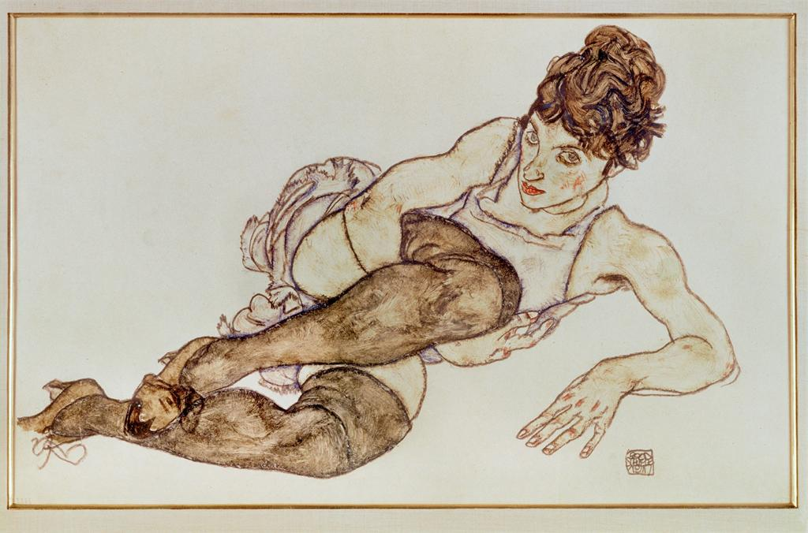
Notes:
Creator: Egon Schiele Title: Reclining Woman with Black Stockings Work Type: drawing Date: 1917 Material: gouache and black crayon Measurements: 29.4 x 46 cm Repository: Private Collection Collection: Art, Archaeology and Architecture (Erich Lessing Culture and Fine Arts Archives) Source: Image and original data provided by Erich Lessing Culture and Fine Arts Archives/ART RESOURCE, N.Y. Source: http://www.artres.com/c/htm/Home.aspx Source: http://www.artres.com/c/htm/TreePfLight.aspx?ID=LES Rights: Photo Credit: Erich Lessing/ART RESOURCE, N.Y. Rights: Please note that if this image is under copyright, you may need to contact one or more copyright owners for any use that is not permitted under the ARTstor Terms and Conditions of Use or not otherwise permitted by law. While ARTstor tries to update contact information, it cannot guarantee that such information is always accurate. Determining whether those permissions are necessary, and obtaining such permissions, is your sole responsibility.

Slide 15
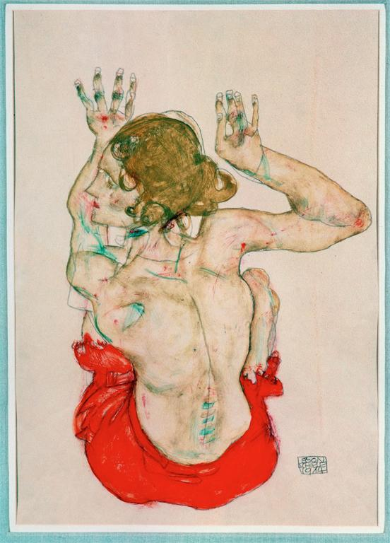
Notes:
Creator: Egon Schiele Title: Female Nude Seated on Red Drapery from Behind Work Type: watercolor Date: 1914 Material: gouache, watercolor and pencil Measurements: 48.2 x 31.8 cm Repository: Graphische Sammlung Albertina Collection: Art, Archaeology and Architecture (Erich Lessing Culture and Fine Arts Archives) Source: Image and original data provided by Erich Lessing Culture and Fine Arts Archives/ART RESOURCE, N.Y. Source: http://www.artres.com/c/htm/Home.aspx Source: http://www.artres.com/c/htm/TreePfLight.aspx?ID=LES Rights: Photo Credit: Erich Lessing/ART RESOURCE, N.Y. Rights: Please note that if this image is under copyright, you may need to contact one or more copyright owners for any use that is not permitted under the ARTstor Terms and Conditions of Use or not otherwise permitted by law. While ARTstor tries to update contact information, it cannot guarantee that such information is always accurate. Determining whether those permissions are necessary, and obtaining such permissions, is your sole responsibility.

Slide 16
Degas

Slide 17
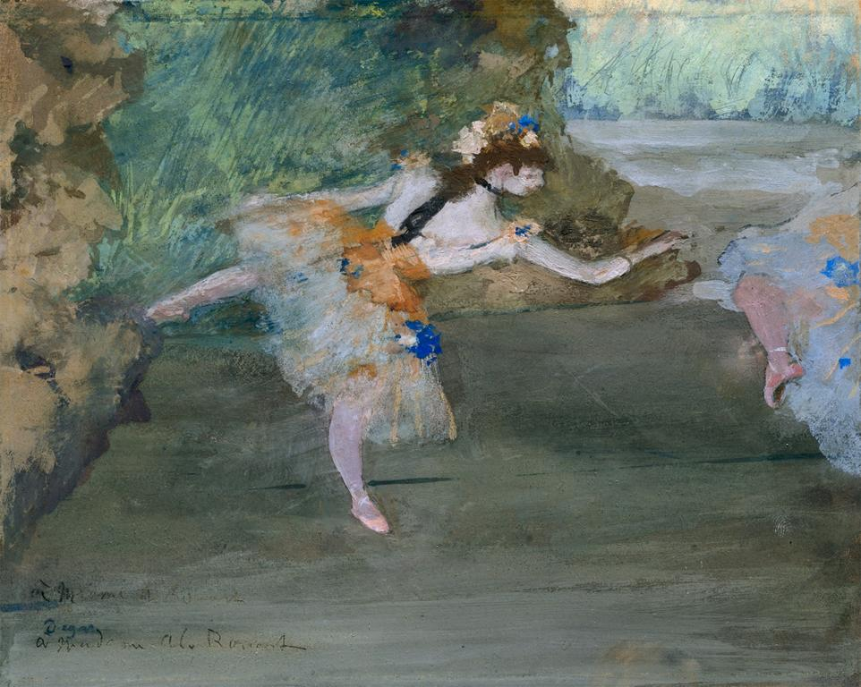
Notes:
Creator: Hilaire-Germain-Edgar Degas, French, 1834-1917 Title: Dancer Onstage Date: ca. 1877 Material: Gouache over graphite underdrawing on thin wove commercially coated yellow paper, laid down on board Measurements: Paper 6 3/4 x 8 3/8 in. (17.1 x 21.3 cm); board 7 x 9 in. (17.8 x 22.9 cm) Description: Inscribed (lower left): à M[on?] ami A Rouart / à Madame Al. Rouart (to my[?] friend A Rouart / to Madame Al. Rouart); stamped (lower left): Degas Repository: The Metropolitan Museum of Art Repository: http://www.metmuseum.org Collection: Metropolitan Museum of Art - Images for Academic Publishing ID Number: 573 Source: Data From: The Metropolitan Museum of Art Credit Line: The Metropolitan Museum of Art, The Lesley and Emma Sheafer Collection, Bequest of Emma A. Sheafer, 1973 (1974.356.30) Image Copyright Notice: Image © The Metropolitan Museum of Art Rights: This image was provided by The Metropolitan Museum of Art. Contact information: Image Library, The Metropolitan Museum of Art, 1000 Fifth Avenue, New York, NY 10028, (212) 396-5050 (fax), Scholars.License@MetMuseum.org Rights: Image © The Metropolitan Museum of Art Rights: This image is available for uses permitted under the ARTstor Terms and Conditions of Use, such as teaching and study, as well as for scholarly publications, through the Images for Academic Publishing (IAP) initiative. If you are seeking to use this image for scholarly publication, you should click on the IAP icon below the thumbnail image.

Slide 18
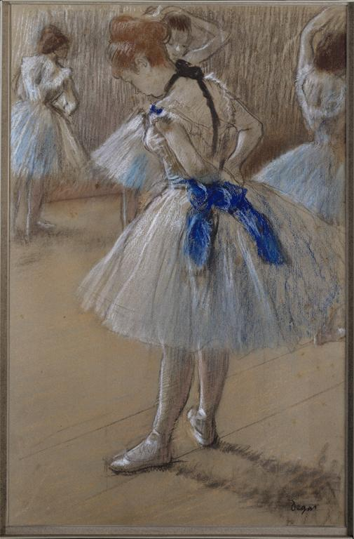
Notes:
Creator: Hilaire-Germain-Edgar Degas, French, Paris 1834 - 1917 Paris Culture: French Title: Dancer Period: 19th Century Date: ca. 1880 Material: Pastel, charcoal, and chalk on paper Measurements: sheet: 19 1/4 x 12 1/2 in. (48.9 x 31.8 cm) Description: lower right: Degas Repository: The Metropolitan Museum of Art Repository: http://www.metmuseum.org Collection: Metropolitan Museum of Art - Images for Academic Publishing ID Number: 11505 Source: Data From: The Metropolitan Museum of Art Credit Line: The Metropolitan Museum of Art, The Walter H. and Leonore Annenberg Collection, Gift of Walter H. and Leonore Annenberg, 2001, Bequest of Walter H. Annenberg, 2002 (2001.202.2) (2001.202.2) Image Copyright Notice: Image © The Metropolitan Museum of Art Rights: This image was provided by The Metropolitan Museum of Art. Contact information: Image Library, The Metropolitan Museum of Art, 1000 Fifth Avenue, New York, NY 10028, (212) 396-5050 (fax), Scholars.License@MetMuseum.org Rights: Image © The Metropolitan Museum of Art Rights: This image is available for uses permitted under the ARTstor Terms and Conditions of Use, such as teaching and study, as well as for scholarly publications, through the Images for Academic Publishing (IAP) initiative. If you are seeking to use this image for scholarly publication, you should click on the IAP icon below the thumbnail image.

Slide 19
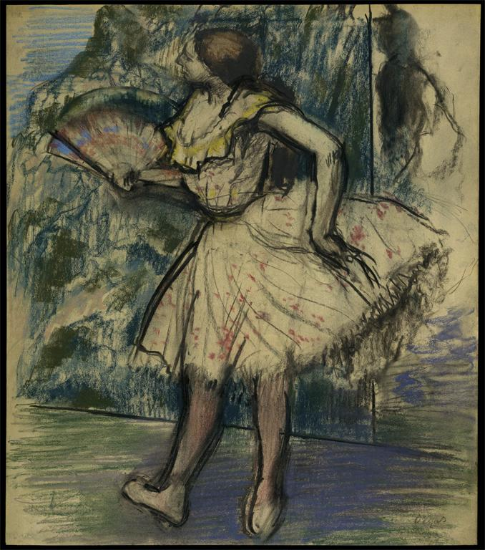
Notes:
Creator: Edgar Degas, French, 1834-1917 Title: Dancer with a Fan Date: ca. 1890-95 Material: Pastel and charcoal on buff-colored wove tracing paper Measurements: 21 7/8 x 19 1/4 in. (55.6 x 48.9 cm) Description: Signed (lower right): Degas Repository: The Metropolitan Museum of Art Repository: http://www.metmuseum.org Collection: Metropolitan Museum of Art - Images for Academic Publishing ID Number: 575 Source: Data From: The Metropolitan Museum of Art Credit Line: The Metropolitan Museum of Art, H. O. Havemeyer Collection, Bequest of Mrs. H. O. Havemeyer, 1929 (29.100.557) Image Copyright Notice: Image © The Metropolitan Museum of Art Rights: This image was provided by The Metropolitan Museum of Art. Contact information: Image Library, The Metropolitan Museum of Art, 1000 Fifth Avenue, New York, NY 10028, (212) 396-5050 (fax), Scholars.License@MetMuseum.org Rights: Image © The Metropolitan Museum of Art Rights: This image is available for uses permitted under the ARTstor Terms and Conditions of Use, such as teaching and study, as well as for scholarly publications, through the Images for Academic Publishing (IAP) initiative. If you are seeking to use this image for scholarly publication, you should click on the IAP icon below the thumbnail image.

Slide 20
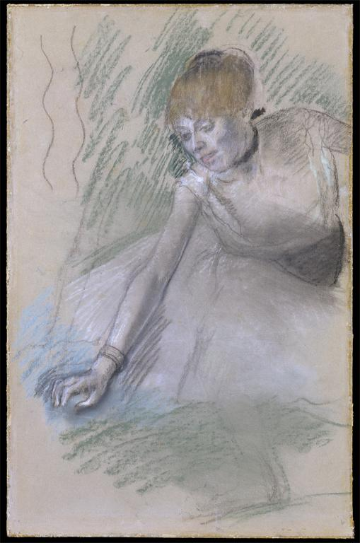
Notes:
Creator: Edgar Degas, French, 1834-1917 Title: Kneeling Dancer Date: 1880-85 Material: Pastel on paper, laid down on board Measurements: 19 1/4 x 12 3/4 in. (48.9 x 32.4 cm) Repository: The Metropolitan Museum of Art Repository: http://www.metmuseum.org Collection: Metropolitan Museum of Art - Images for Academic Publishing ID Number: 3215 Source: Data From: The Metropolitan Museum of Art Credit Line: The Metropolitan Museum of Art, Gift of The Philip and Janice Levin Foundation, 2007 (2007.332.1) Image Copyright Notice: Image © The Metropolitan Museum of Art Rights: This image was provided by The Metropolitan Museum of Art. Contact information: Image Library, The Metropolitan Museum of Art, 1000 Fifth Avenue, New York, NY 10028, (212) 396-5050 (fax), Scholars.License@MetMuseum.org Rights: Image © The Metropolitan Museum of Art Rights: This image is available for uses permitted under the ARTstor Terms and Conditions of Use, such as teaching and study, as well as for scholarly publications, through the Images for Academic Publishing (IAP) initiative. If you are seeking to use this image for scholarly publication, you should click on the IAP icon below the thumbnail image.

Slide 21
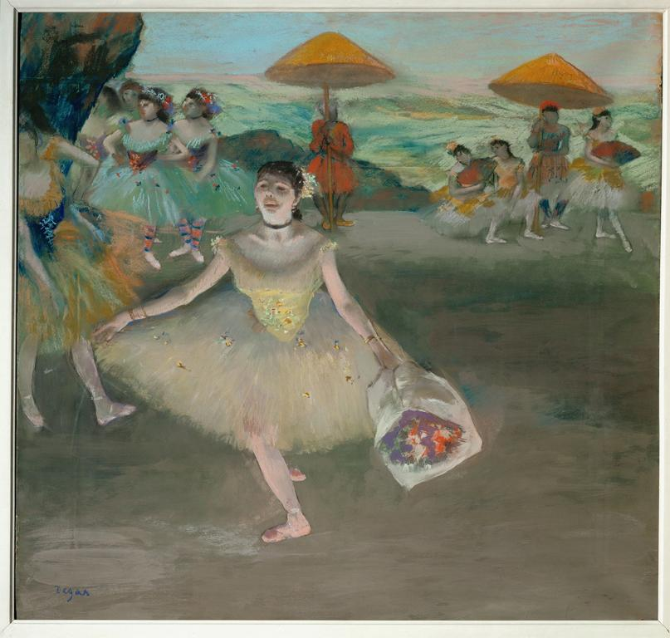
Notes:
Creator: Edgar Degas Title: Ballet Dancer Saluting (Danseuse au Bouquet, Saluant) Work Type: drawing Date: c. 1877 Material: pastel and gouache on paper, mounted on canvas Measurements: 72 x 77.5 cm Repository: Musée d'Orsay Collection: Art, Archaeology and Architecture (Erich Lessing Culture and Fine Arts Archives) ID Number: 40-12-01/ 6 Source: Image and original data provided by Erich Lessing Culture and Fine Arts Archives/ART RESOURCE, N.Y. Source: http://www.artres.com/c/htm/Home.aspx Source: http://www.artres.com/c/htm/TreePfLight.aspx?ID=LES Rights: Photo Credit: Erich Lessing/ART RESOURCE, N.Y. Rights: Please note that if this image is under copyright, you may need to contact one or more copyright owners for any use that is not permitted under the ARTstor Terms and Conditions of Use or not otherwise permitted by law. While ARTstor tries to update contact information, it cannot guarantee that such information is always accurate. Determining whether those permissions are necessary, and obtaining such permissions, is your sole responsibility.

Slide 22
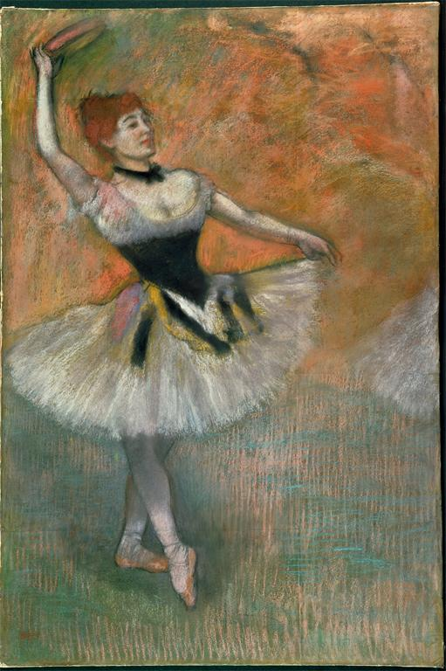
Notes:
Creator: Edgar Degas Title: Dancer with Tambourine Work Type: drawing Date: c. 1882 Material: pastel on paper Measurements: 97 x 65 cm Repository: Private Collection Collection: Art, Archaeology and Architecture (Erich Lessing Culture and Fine Arts Archives) ID Number: 40-11-15/68 Source: Image and original data provided by Erich Lessing Culture and Fine Arts Archives/ART RESOURCE, N.Y. Source: http://www.artres.com/c/htm/Home.aspx Source: http://www.artres.com/c/htm/TreePfLight.aspx?ID=LES Rights: Photo Credit: Erich Lessing/ART RESOURCE, N.Y. Rights: Please note that if this image is under copyright, you may need to contact one or more copyright owners for any use that is not permitted under the ARTstor Terms and Conditions of Use or not otherwise permitted by law. While ARTstor tries to update contact information, it cannot guarantee that such information is always accurate. Determining whether those permissions are necessary, and obtaining such permissions, is your sole responsibility.

Slide 23
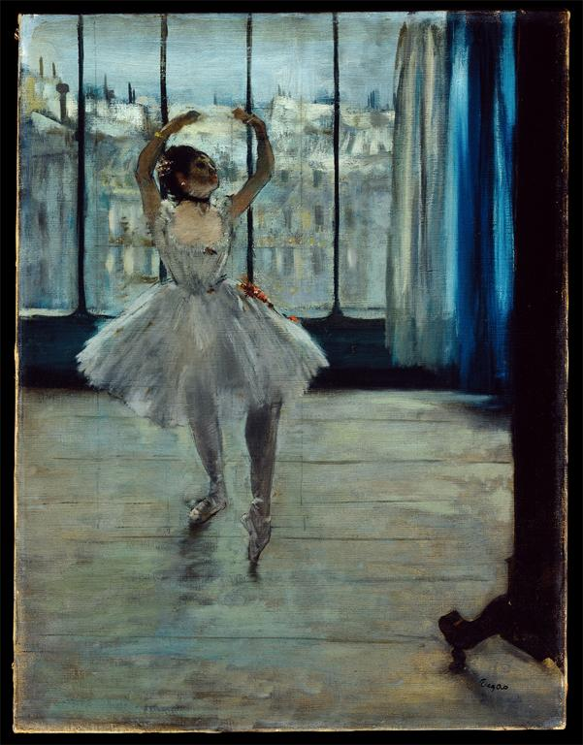
Notes:
Creator: Edgar Degas Title: Ballerina Posing for a Photograph (Dancer before a Window) Work Type: painting Date: c. 1877-79 Material: oil on canvas Measurements: 65 x 50 cm Repository: Pushkin Museum of Fine Arts Collection: Italian and other European Art (Scala Archives) Source: Image and original data provided by SCALA, Florence/ART RESOURCE, N.Y. Source: http://www.artres.com/c/htm/Home.aspx Source: http://www.scalarchives.com Rights: (c) 2006, SCALA, Florence / ART RESOURCE, N.Y. Rights: Please note that if this image is under copyright, you may need to contact one or more copyright owners for any use that is not permitted under the ARTstor Terms and Conditions of Use or not otherwise permitted by law. While ARTstor tries to update contact information, it cannot guarantee that such information is always accurate. Determining whether those permissions are necessary, and obtaining such permissions, is your sole responsibility.

Slide 24
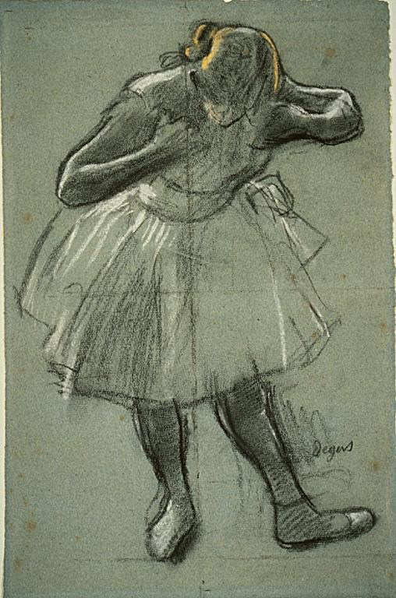
Notes:
Creator: Hilaire Germain Edgar Degas Creator: French; 1834-1917 Title: Dancer Bending Forward Title: Dancer Bending Forward (the Curtsey) Title: Dancer Curtseying Work Type: Drawings and Watercolors Work Type: charcoal Work Type: Drawing Work Type: Prints and Drawings Date: 1874-1890 Material: Charcoal, with stumping, heightened with white and yellow pastel with stumping, on blue laid paper, ruled with charcoal. Measurements: sheet: 462 x 304 mm Description: Signed "Degas" in black chalk, l.r. Repository: The Art Institute of Chicago, Mr. and Mrs. Martin A. Ryerson Collection Repository: Chicago, Illinois, USA Repository: 1933.1230 Repository: http://www.artic.edu/aic/ Collection: The Art Institute of Chicago Collection Collection: Formerly in The AMICO Library ID Number: AIC_.1933.1230 Source: Data From: The Art Institute of Chicago Rights: Photography © The Art Institute of Chicago Rights: This image was provided by The Art Institute of Chicago, Chicago, Illinois, USA. Contact information: Aimee L. Marshall, Manager of Rights Licensing, The Art Institute of Chicago, 111 South Michigan Avenue, Chicago, IL 60603, (312) 499-4258 (ph), (312) 499-4231 (fax), amarshall@artic.edu. Rights: Please note that if this image is under copyright, you may need to contact one or more copyright owners for any use that is not permitted under the ARTstor Terms and Conditions of Use or not otherwise permitted by law. While ARTstor tries to update contact information, it cannot guarantee that such information is always accurate. Determining whether those permissions are necessary, and obtaining such permissions, is your sole responsibility.

Slide 25
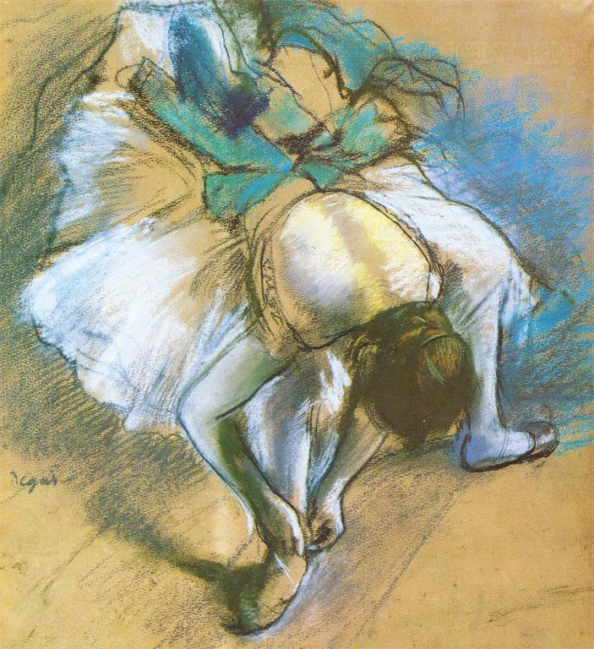
Notes:
Creator: Edgar Degas (French draftsman, 1834-1917) Title: Dancer Adjusting Her Slipper Work Type: drawing Work Type: drawings Date: ca. 1880-1885 Material: pastel on paper Technique: drawing, pastel Measurements: height: 42.6 cm Measurements: width: 34.3 cm Style Period: Western: Nineteenth Century Subject: Dancers in art Collection: Minneapolis College of Art and Design Collection ID Number: Accession: 17105 Source: Image and catalog data provided by Allan T. Kohl, Minneapolis College of Art and Design Rights: Please note that if this image is under copyright, you may need to contact one or more copyright owners for any use that is not permitted under the ARTstor Terms and Conditions of Use or not otherwise permitted by law. While ARTstor tries to update contact information, it cannot guarantee that such information is always accurate. Determining whether those permissions are necessary, and obtaining such permissions, is your sole responsibility.

Slide 26
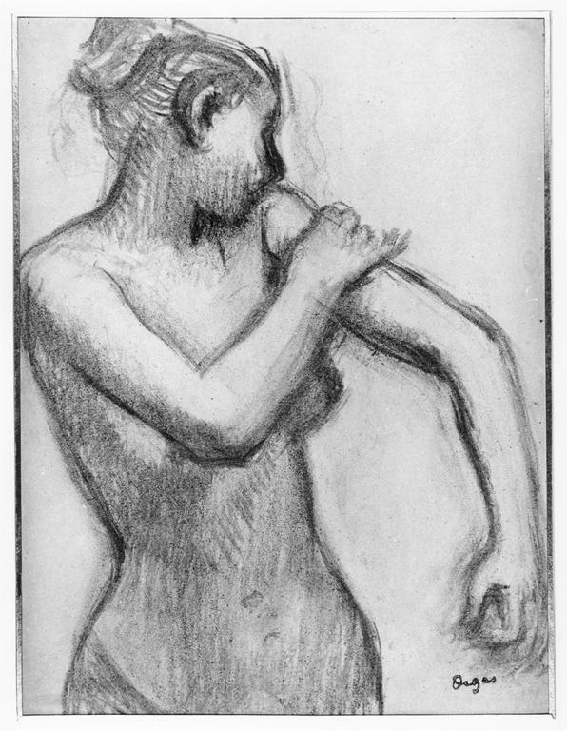
Notes:
Creator: Edgar Degas (1834-1917) Title: Study of a nude woman bathing Date: 1849-1917 Material: charcoal Measurements: 360 x 270 mm Description: This composition relates to Degas' painting 'En attendant l'entrée en scène', now in the National Gallery of Art, Washington. In the painting the dancer wears a tunic; in this drawing she is nude. The reason the drawing appears weak is that Degas took a counterproof from it in order to reverse the image. Description: Recto bears signature stamp lr (L.658) and verso inscribed in blue crayon "1189/Pb570" and studio stamp (L.657). Repository: British Museum. Dept. of Prints and Drawings Repository: http://www.britishmuseum.org/ Accession Number: 1920-4-20-13 Collection: Gernsheim Photographic Corpus of Drawings ID Number: 50706 Source: Image and original data provided by the Gernsheim Photographic Corpus of Drawings from photo campaigns that began in 1939 Rights: Please note that if this image is under copyright, you may need to contact one or more copyright owners for any use that is not permitted under the ARTstor Terms and Conditions of Use or not otherwise permitted by law. While ARTstor tries to update contact information, it cannot guarantee that such information is always accurate. Determining whether those permissions are necessary, and obtaining such permissions, is your sole responsibility.

Slide 27
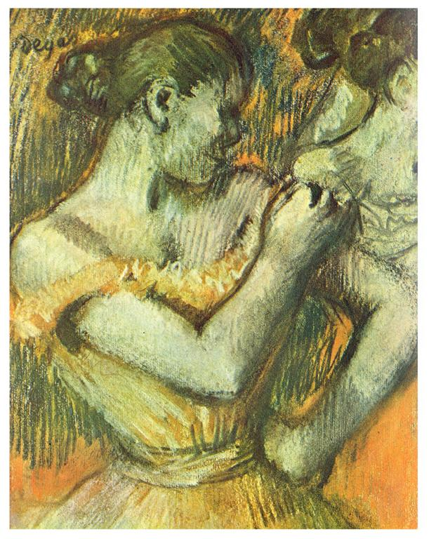
Notes:
Creator: Edgar Degas (French draftsman, 1834-1917) Title: Dancer adjusting her shoulder-strap Work Type: drawing Work Type: drawings Date: ca. 1896 Material: pastel on paper Technique: drawing, pastel Measurements: height: 35 cm Measurements: width: 27 cm Style Period: Western: Nineteenth Century Subject: Dancers in art Subject: figure, female Collection: Minneapolis College of Art and Design Collection ID Number: Accession: 18106 Source: Image and catalog data provided by Allan T. Kohl, Minneapolis College of Art and Design Rights: Please note that if this image is under copyright, you may need to contact one or more copyright owners for any use that is not permitted under the ARTstor Terms and Conditions of Use or not otherwise permitted by law. While ARTstor tries to update contact information, it cannot guarantee that such information is always accurate. Determining whether those permissions are necessary, and obtaining such permissions, is your sole responsibility.

Slide 28
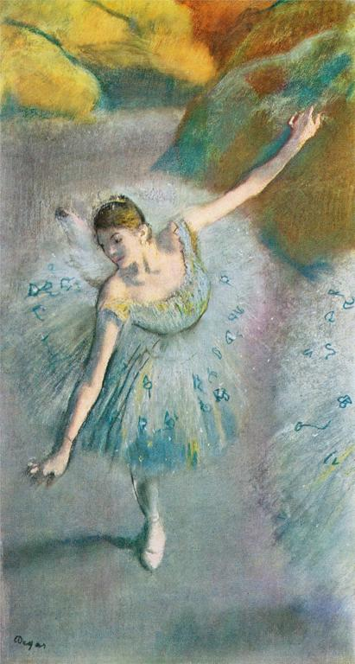
Notes:
Creator: Edgar Degas (French painter, 1834-1917) Title: Blue Dancer Work Type: painting Work Type: drawings; paintings Date: ca. 1883 Material: pastel on paper Technique: pastel Measurements: height: 28 in Measurements: width: 15 in Style Period: Western: Nineteenth Century Description: Collection of Mr. and Mrs. Charles S. Payson, New York Subject: Dancers in art Collection: Minneapolis College of Art and Design Collection ID Number: Accession: 17120 Source: Image and catalog data provided by Allan T. Kohl, Minneapolis College of Art and Design Rights: Please note that if this image is under copyright, you may need to contact one or more copyright owners for any use that is not permitted under the ARTstor Terms and Conditions of Use or not otherwise permitted by law. While ARTstor tries to update contact information, it cannot guarantee that such information is always accurate. Determining whether those permissions are necessary, and obtaining such permissions, is your sole responsibility.

Slide 29
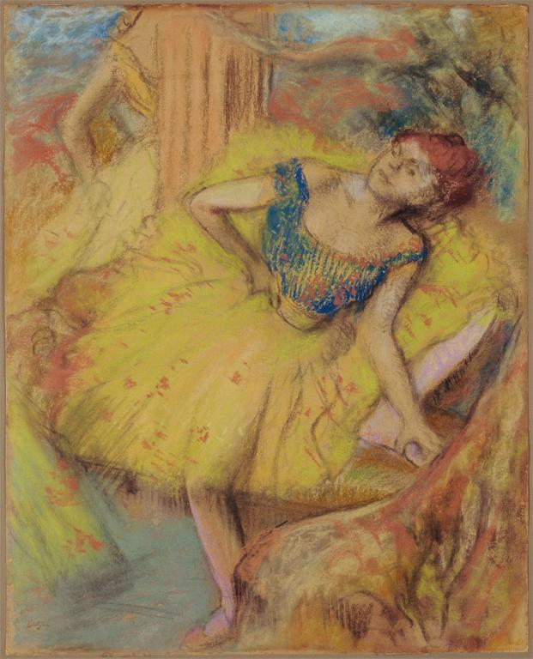
Notes:
Creator: Edgar Degas, French, 1834-1917 Title: Dancer Date: c. 1897-1900 Material: Pastel and charcoal on light brown paper Measurements: Sheet: 560 x 450 mm. (22 1/16 x 17 11/16 in.) Repository: Baltimore Museum of Art Repository: The Cone Collection, formed by Dr. Claribel Cone and Miss Etta Cone of Baltimore, Maryland Accession Number: 1950.205 Collection: Baltimore Museum of Art Collection: http://www.artbma.org/ ID Number: 27344 Rights: For permission to reproduce images for uses not covered by the Terms and Conditions, please contact Image Services & Rights, The Baltimore Museum of Art, 10 Art Museum Drive, Baltimore, Maryland 21218; 443-573-1850 or 443- 573- 1853; rights@artbma.org. Rights: Please note that if this image is under copyright, you may need to contact one or more copyright owners for any use that is not permitted under the ARTstor Terms and Conditions of Use or not otherwise permitted by law. While ARTstor tries to update contact information, it cannot guarantee that such information is always accurate. Determining whether those permissions are necessary, and obtaining such permissions, is your sole responsibility.

Slide 30
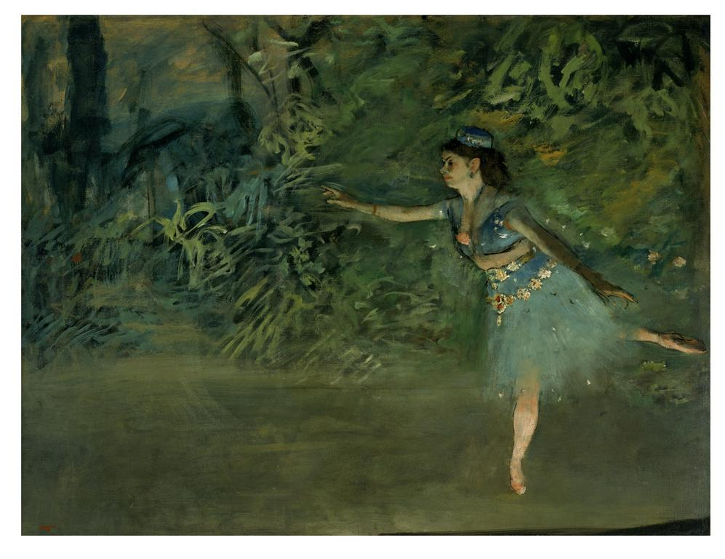
Notes:
Creator: Degas, Edgar, 1834 - 1917 Culture: French Title: Dancer on the Stage Work Type: Painting Date: ca. 1877-1880 Material: oil on canvas Measurements: stretcher: 36 x 46 1/2 in.; 91.44 x 118.11 cm Description: unsigned, undated, sale stamp in reddish orange paint at lower left: Degas Repository: Smith College Museum of Art, Northampton, MA Repository: Gift of Paul Rosenberg and Company Accession Number: SC 1955:14 Collection: Smith College Museum of Art Collection: http://www.smith.edu/artmuseum/ Rights: Contact info: Louise A. Laplante, Collections Manager/Registrar, Smith College Museum of Art, Northampton, MA 01063; Tel No.: 413-585-2765; Fax: 413-527-1595; llaplant@smith.edu Rights: Please note that if this image is under copyright, you may need to contact one or more copyright owners for any use that is not permitted under the ARTstor Terms and Conditions of Use or not otherwise permitted by law. While ARTstor tries to update contact information, it cannot guarantee that such information is always accurate. Determining whether those permissions are necessary, and obtaining such permissions, is your sole responsibility.

Slide 31
Lucian freud

Slide 32
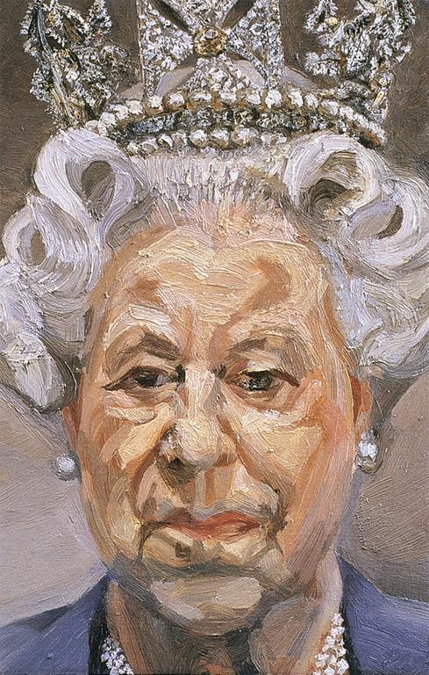
Notes:
Creator: Freud, Lucian, 1922- Title: HM Queen Elizabeth II Date: 2001 Subject: Elizabeth II, Queen of Great Britain, 1926- Subject: Painting--Germany--21st C. A.D Subject: Portraits--Royalty Subject: Portraits--Queens Subject: Diamonds Subject: Tiaras Subject: Faces Subject: Heads Subject: Brushwork Subject: Costume Subject: Crowns Collection: ARTstor Slide Gallery Source: Data From: University of California, San Diego

Slide 33
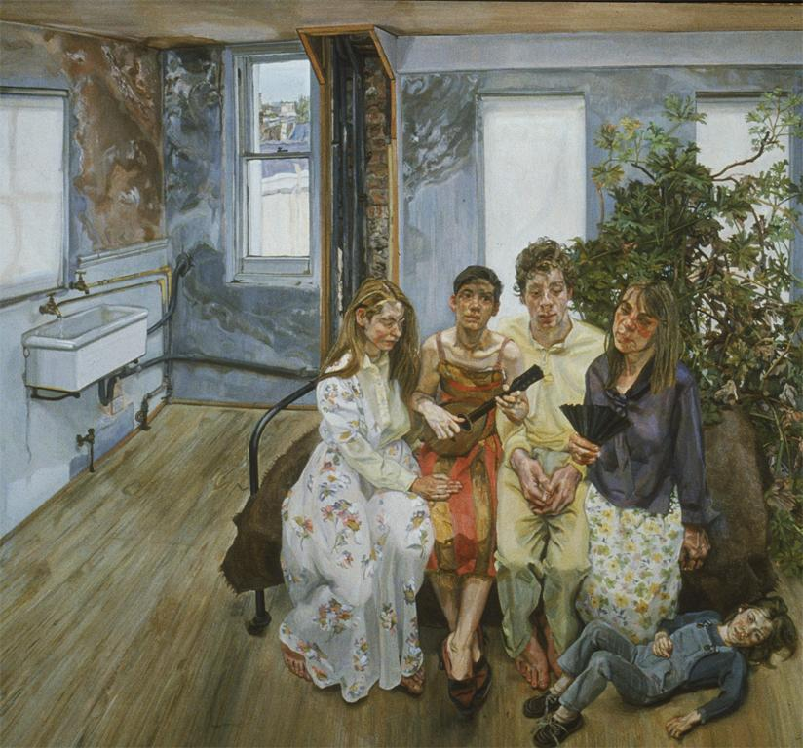
Notes:
Creator: Freud, Lucian Title: Large Interior W.ll (after Watteau) Date: 1981-3 Measurements: 185x198cm Subject: Interior views Subject: Painting--Germany--20th C. A.D Collection: ARTstor Slide Gallery Source: Data from: University of California, San Diego

Slide 34
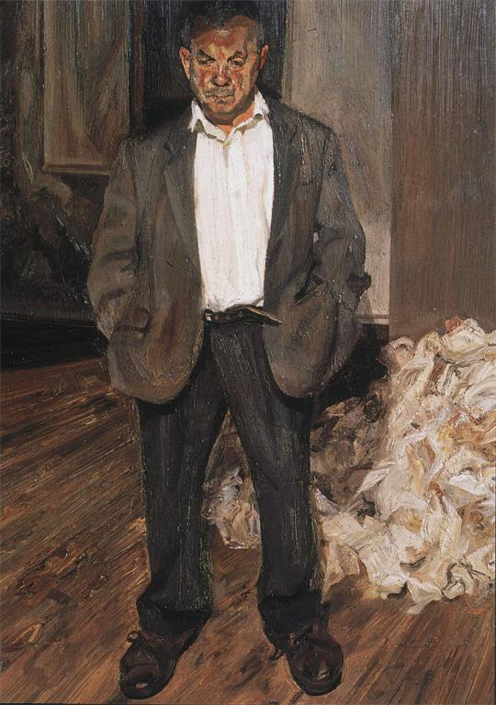
Notes:
Creator: Freud, Lucian Title: Bruce Bernard Work Type: Painting Date: 1992 Material: oil on canvas Measurements: 114.2 X 83.7 cm Subject: Painting--Germany--20th C. A.D Subject: Portraits--Male Collection: ARTstor Slide Gallery Source: Data from: University of California, San Diego

Slide 35
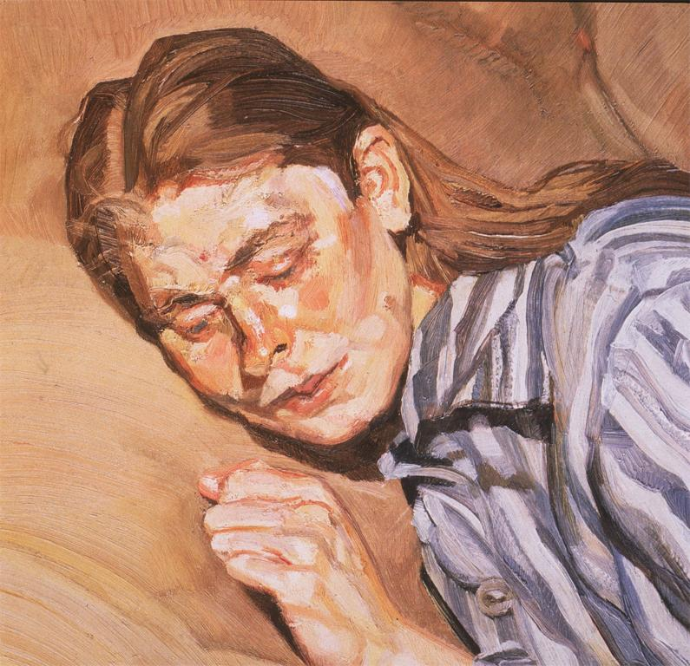
Notes:
Creator: Freud, Lucian Title: Girl in Striped Nightdress Work Type: painting Date: 1983-5 Material: oil on canvas Measurements: 30.5 X 25.6 cm Subject: Painting--Germany--20th C. A.D Subject: Portraits--Female Collection: ARTstor Slide Gallery Source: Data from: University of California, San Diego

Slide 36
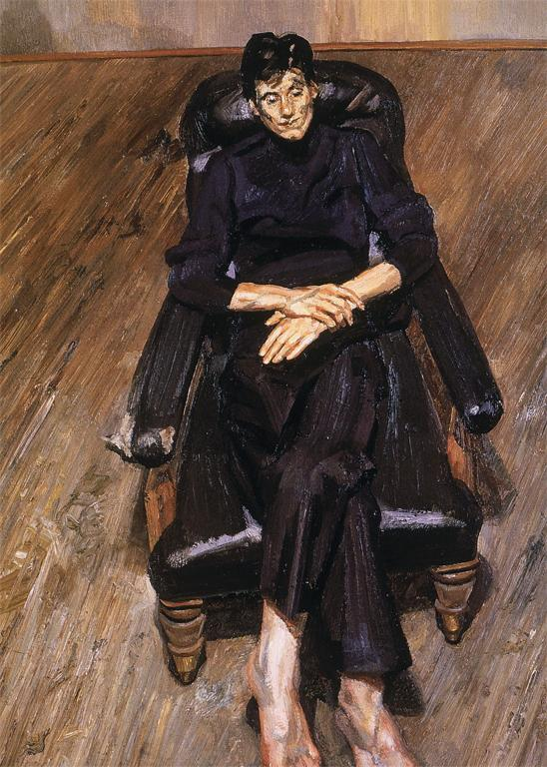
Notes:
Creator: Freud, Lucian Title: Bella Work Type: Painting Date: 1996 Material: oil on canvas Measurements: 103 X 76 cm Subject: Painting--Germany--20th C. A.D Subject: Portraits Collection: ARTstor Slide Gallery Source: Data from: University of California, San Diego

Slide 37
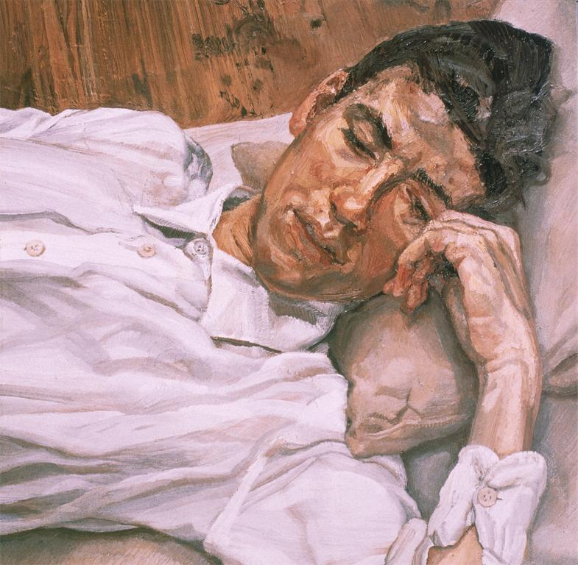
Notes:
Creator: Freud, Lucian Title: Bella Work Type: painting Date: 1986-7 Material: oil on canvas Measurements: 55.9 X 50.8 cm Subject: Painting--Germany--20th C. A.D Subject: Portraits--Male Collection: ARTstor Slide Gallery Source: Data from: University of California, San Diego

Slide 38
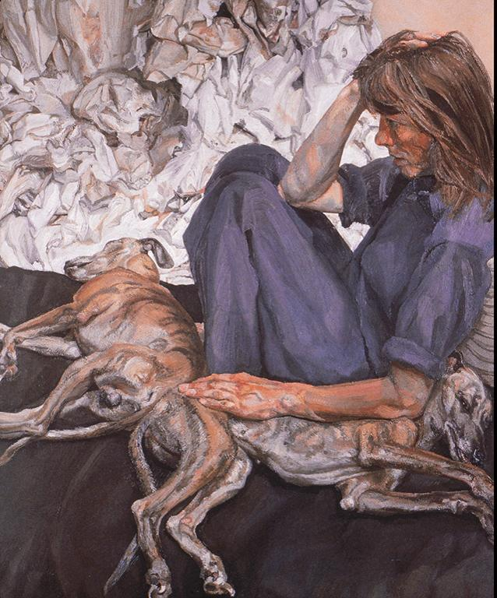
Notes:
Creator: Freud, Lucian Title: Triple Portrait Work Type: Painting Date: 1986-7 Material: oil on canvas Measurements: 120 x 100 cm Subject: Dogs Subject: Painting--Germany--20th C. A.D Subject: Portraits--Female Collection: ARTstor Slide Gallery Source: Data from: University of California, San Diego

Slide 39
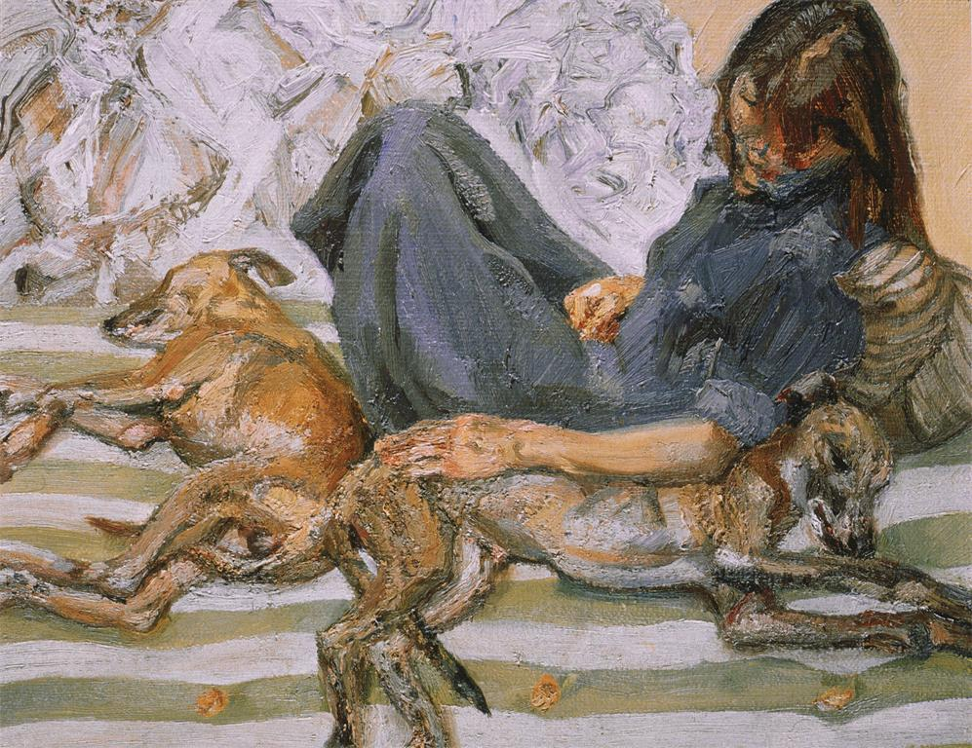
Notes:
Creator: Freud, Lucian Title: Triple Portrait Work Type: painting Date: 1987-8 Material: oil on canvas Measurements: 21.5 X 25.5 cm Subject: Dogs Subject: Painting--Germany--20th C. A.D Subject: Portraits--Female Collection: ARTstor Slide Gallery Source: Data from: University of California, San Diego

Slide 40
Gustav klimt

Slide 41
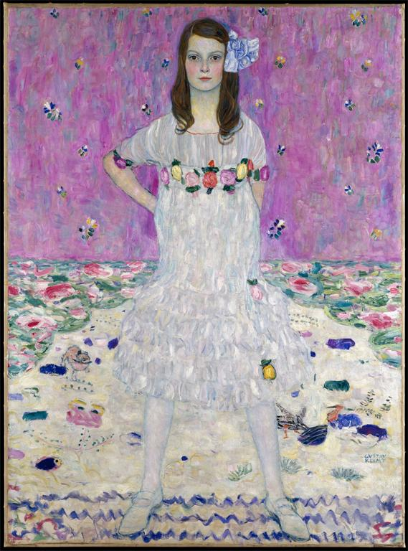
Notes:
Creator: Gustav Klimt, Austrian, 1862-1918 Title: Mäda Primavesi (1903-2000) Date: 1912 Material: Oil on canvas Measurements: 59 x 43 1/2 in. (149.9 x 110.5 cm) Description: Signed (lower right): GVSTAV / KLIMT Repository: The Metropolitan Museum of Art Repository: http://www.metmuseum.org Collection: Metropolitan Museum of Art - Images for Academic Publishing ID Number: 1263 Source: Data From: The Metropolitan Museum of Art Credit Line: The Metropolitan Museum of Art, Gift of André and Clara Mertens, in memory of her mother, Jenny Pulitzer Steiner, 1964 (64.148) Photograph by Schecter Lee Image Copyright Notice: Image © The Metropolitan Museum of Art Rights: This image was provided by The Metropolitan Museum of Art. Contact information: Image Library, The Metropolitan Museum of Art, 1000 Fifth Avenue, New York, NY 10028, (212) 396-5050 (fax), Scholars.License@MetMuseum.org Rights: Image © The Metropolitan Museum of Art Rights: This image is available for uses permitted under the ARTstor Terms and Conditions of Use, such as teaching and study, as well as for scholarly publications, through the Images for Academic Publishing (IAP) initiative. If you are seeking to use this image for scholarly publication, you should click on the IAP icon below the thumbnail image.

Slide 42
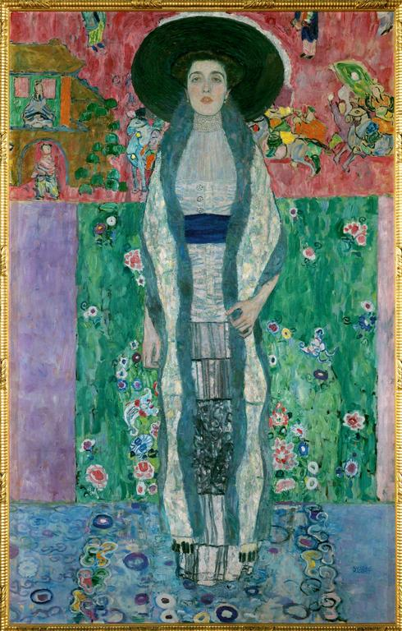
Notes:
Creator: Gustav Klimt Title: Adele Bloch-Bauer II, Standing Work Type: painting Date: 1912 Repository: Private Collection, on loan to Österreichische Galerie Belvedere. Restituted to the Heirs of Ferdinand and Adele Bloch-Bauer. Collection: Art, Archaeology and Architecture (Erich Lessing Culture and Fine Arts Archives) ID Number: 40-17-05/64 Source: Image and original data provided by Erich Lessing Culture and Fine Arts Archives/ART RESOURCE, N.Y. Source: http://www.artres.com/c/htm/Home.aspx Source: http://www.artres.com/c/htm/TreePfLight.aspx?ID=LES Rights: Photo Credit: Erich Lessing/ART RESOURCE, N.Y. Rights: Please note that if this image is under copyright, you may need to contact one or more copyright owners for any use that is not permitted under the ARTstor Terms and Conditions of Use or not otherwise permitted by law. While ARTstor tries to update contact information, it cannot guarantee that such information is always accurate. Determining whether those permissions are necessary, and obtaining such permissions, is your sole responsibility.

Slide 43
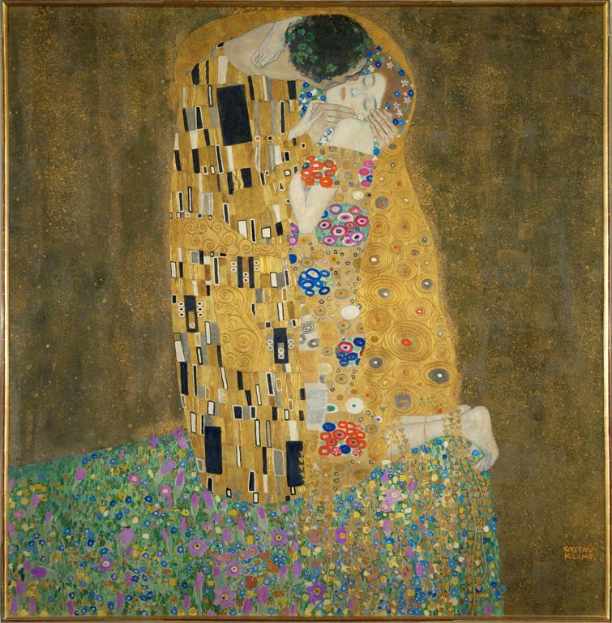
Notes:
Creator: Gustav Klimt Title: The Kiss Date: 1907-1908 Material: oil on canvas Measurements: 180 x 180 cm Repository: Österreichische Galerie Belvedere, Vienna Collection: Art, Archaeology and Architecture (Erich Lessing Culture and Fine Arts Archives) ID Number: 40-16-01/31 Source: Image and original data provided by Erich Lessing Culture and Fine Arts Archives/ART RESOURCE, N.Y. Source: http://www.artres.com/c/htm/Home.aspx Source: http://www.artres.com/c/htm/TreePfLight.aspx?ID=LES Rights: Photo Credit: Erich Lessing/ART RESOURCE, N.Y. Rights: Please note that if this image is under copyright, you may need to contact one or more copyright owners for any use that is not permitted under the ARTstor Terms and Conditions of Use or not otherwise permitted by law. While ARTstor tries to update contact information, it cannot guarantee that such information is always accurate. Determining whether those permissions are necessary, and obtaining such permissions, is your sole responsibility.

Slide 44
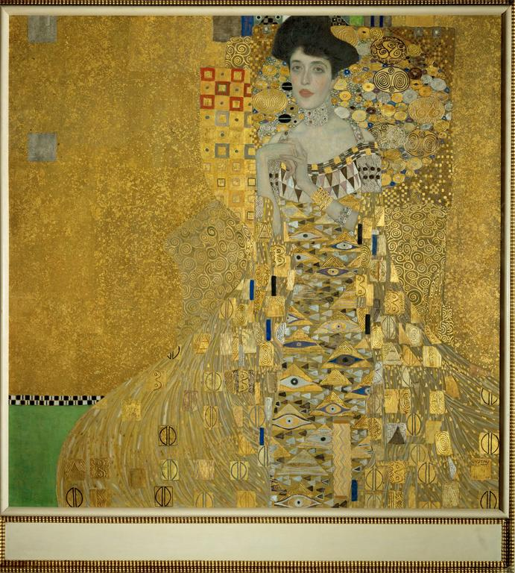
Notes:
Creator: Gustav Klimt Title: Adele Bloch-Bauer I Work Type: painting Date: 1907 Material: oil, silver, gold on canvas Repository: Neue Galerie New York Collection: Art, Archaeology and Architecture (Erich Lessing Culture and Fine Arts Archives) ID Number: 40-16-01/29 Source: Image and original data provided by Erich Lessing Culture and Fine Arts Archives/ART RESOURCE, N.Y. Source: http://www.artres.com/c/htm/Home.aspx Source: http://www.artres.com/c/htm/TreePfLight.aspx?ID=LES Rights: Photo Credit: Erich Lessing/ART RESOURCE, N.Y. Rights: Please note that if this image is under copyright, you may need to contact one or more copyright owners for any use that is not permitted under the ARTstor Terms and Conditions of Use or not otherwise permitted by law. While ARTstor tries to update contact information, it cannot guarantee that such information is always accurate. Determining whether those permissions are necessary, and obtaining such permissions, is your sole responsibility.

Slide 45
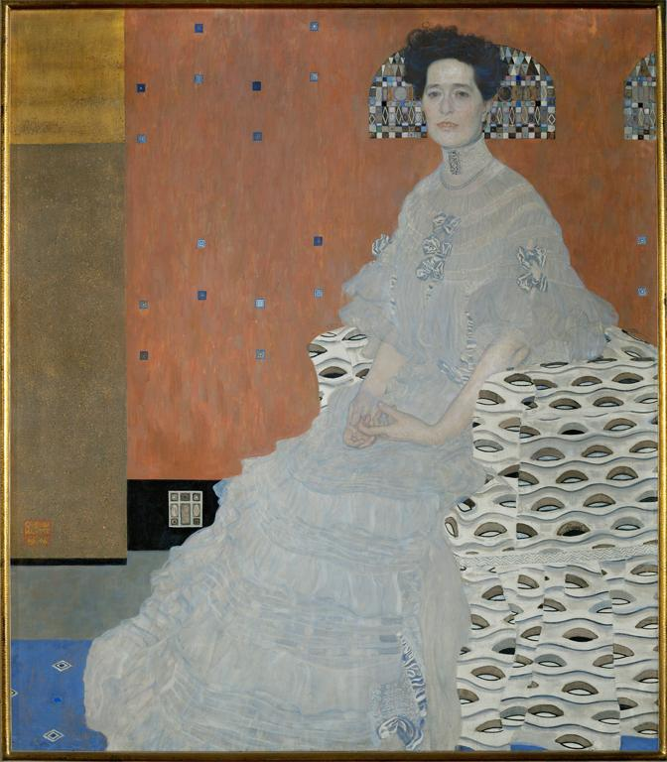
Notes:
Creator: Gustav Klimt Title: Fritza Riedler Work Type: painting Date: 1906 Material: oil on canvas Measurements: 152 x 134 cm Repository: Österreichische Galerie Belvedere Collection: Art, Archaeology and Architecture (Erich Lessing Culture and Fine Arts Archives) ID Number: 40-16-01/33 Source: Image and original data provided by Erich Lessing Culture and Fine Arts Archives/ART RESOURCE, N.Y. Source: http://www.artres.com/c/htm/Home.aspx Source: http://www.artres.com/c/htm/TreePfLight.aspx?ID=LES Rights: Photo Credit: Erich Lessing/ART RESOURCE, N.Y. Rights: Please note that if this image is under copyright, you may need to contact one or more copyright owners for any use that is not permitted under the ARTstor Terms and Conditions of Use or not otherwise permitted by law. While ARTstor tries to update contact information, it cannot guarantee that such information is always accurate. Determining whether those permissions are necessary, and obtaining such permissions, is your sole responsibility.

Slide 46
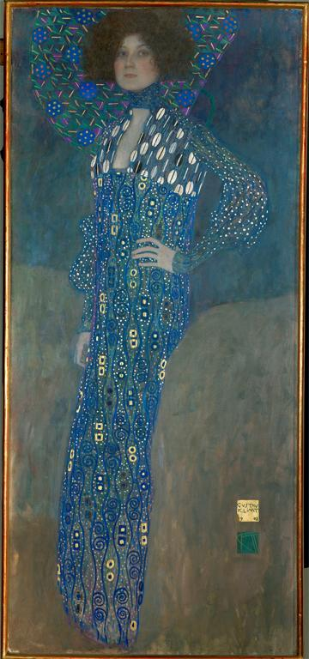
Notes:
Creator: Gustav Klimt Title: Emilie Flöge Work Type: painting Date: 1902 Material: oil on canvas Measurements: 181 x 84 cm Repository: Historisches Museum der Stadt Wien Collection: Art, Archaeology and Architecture (Erich Lessing Culture and Fine Arts Archives) Source: Image and original data provided by Erich Lessing Culture and Fine Arts Archives/ART RESOURCE, N.Y. Source: http://www.artres.com/c/htm/Home.aspx Source: http://www.artres.com/c/htm/TreePfLight.aspx?ID=LES Rights: Photo Credit: Erich Lessing/ART RESOURCE, N.Y. Rights: Please note that if this image is under copyright, you may need to contact one or more copyright owners for any use that is not permitted under the ARTstor Terms and Conditions of Use or not otherwise permitted by law. While ARTstor tries to update contact information, it cannot guarantee that such information is always accurate. Determining whether those permissions are necessary, and obtaining such permissions, is your sole responsibility.

Slide 47
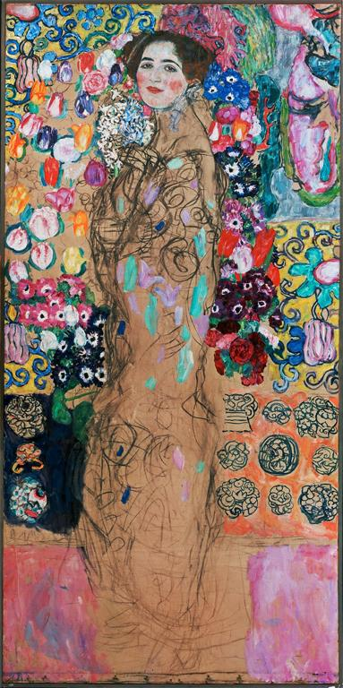
Notes:
Creator: Gustav Klimt Title: Portrait of a Woman Work Type: painting Date: 1917-1918 Material: oil on canvas Measurements: 180 x 90 cm Description: unfinished Repository: Lentos Kunstmuseum Linz Collection: Art, Archaeology and Architecture (Erich Lessing Culture and Fine Arts Archives) ID Number: 39-16-03/65 Source: Image and original data provided by Erich Lessing Culture and Fine Arts Archives/ART RESOURCE, N.Y. Source: http://www.artres.com/c/htm/Home.aspx Source: http://www.artres.com/c/htm/TreePfLight.aspx?ID=LES Rights: Photo Credit: Erich Lessing/ART RESOURCE, N.Y. Rights: Please note that if this image is under copyright, you may need to contact one or more copyright owners for any use that is not permitted under the ARTstor Terms and Conditions of Use or not otherwise permitted by law. While ARTstor tries to update contact information, it cannot guarantee that such information is always accurate. Determining whether those permissions are necessary, and obtaining such permissions, is your sole responsibility.

Slide 48
Alice neel

Slide 49
Notes:
Creator: Alice Neel Creator: American, 1900-1984, North American; American Title: Linda Nochlin and Daisy Work Type: Paintings Date: 1973 Material: Oil on canvas Measurements: 141.9 x 111.8 cm (55 7/8 x 44 in.) Description: Full View Repository: Museum of Fine Arts, Boston Repository: Boston, Massachusetts, USA Repository: Seth K. Sweetser Fund Repository: 1983.496 Repository: http://www.mfa.org/ Collection: Museum of Fine Arts, Boston, Collection Collection: Formerly in The AMICO Library ID Number: BMFA.1983.496 Source: Data From: Museum of Fine Arts, Boston Rights: This image was provided by Museum of Fine Arts, Boston. Contact information: Debra LaKind, Head of Rights & Licensing, Museum of Fine Arts, Boston, 465 Huntington Avenue, Boston, MA 02115, (617) 369-4386 (ph), (617) 369-4340 (fax), dlakind@mfa.org. Rights: Please note that if this image is under copyright, you may need to contact one or more copyright owners for any use that is not permitted under the ARTstor Terms and Conditions of Use or not otherwise permitted by law. While ARTstor tries to update contact information, it cannot guarantee that such information is always accurate. Determining whether those permissions are necessary, and obtaining such permissions, is your sole responsibility.

Slide 50
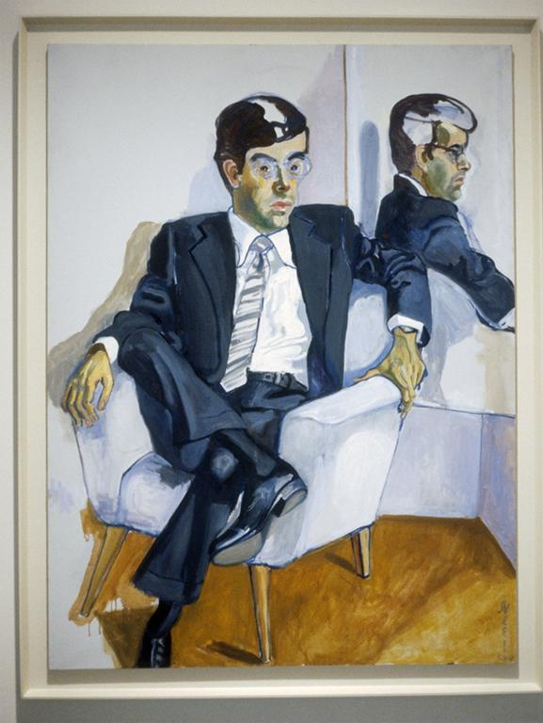
Notes:
Creator: Alice Neel Title: Richard in the Era of the Corporation Work Type: Paintings Date: 1979 Location: Exhibited at Cheim & Read, Spring 1998 Material: oil on canvas Measurements: 60" x 45" Description: Photographer: Larry Qualls Collection: Contemporary Art (Larry Qualls Archive) Source: Image and original data provided by Larry Qualls Rights: Please note that if this image is under copyright, you may need to contact one or more copyright owners for any use that is not permitted under the ARTstor Terms and Conditions of Use or not otherwise permitted by law. While ARTstor tries to update contact information, it cannot guarantee that such information is always accurate. Determining whether those permissions are necessary, and obtaining such permissions, is your sole responsibility.

Slide 51
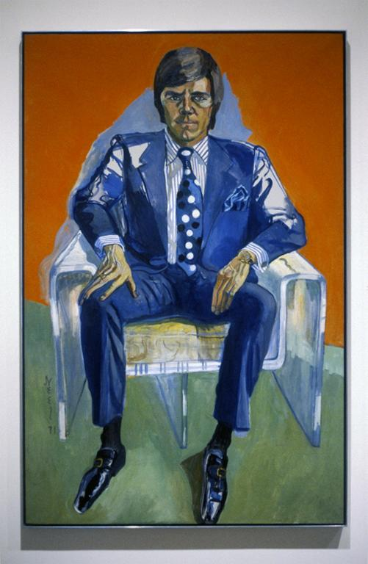
Notes:
Creator: Alice Neel Title: Timothy Collins Work Type: Paintings Date: 1971 Location: Exhibited at Cheim & Read, Spring 1998 Material: oil on canvas Measurements: 65" x 41 3/4" Description: Photographer: Larry Qualls Collection: Contemporary Art (Larry Qualls Archive) Source: Image and original data provided by Larry Qualls Rights: Please note that if this image is under copyright, you may need to contact one or more copyright owners for any use that is not permitted under the ARTstor Terms and Conditions of Use or not otherwise permitted by law. While ARTstor tries to update contact information, it cannot guarantee that such information is always accurate. Determining whether those permissions are necessary, and obtaining such permissions, is your sole responsibility.

Slide 52
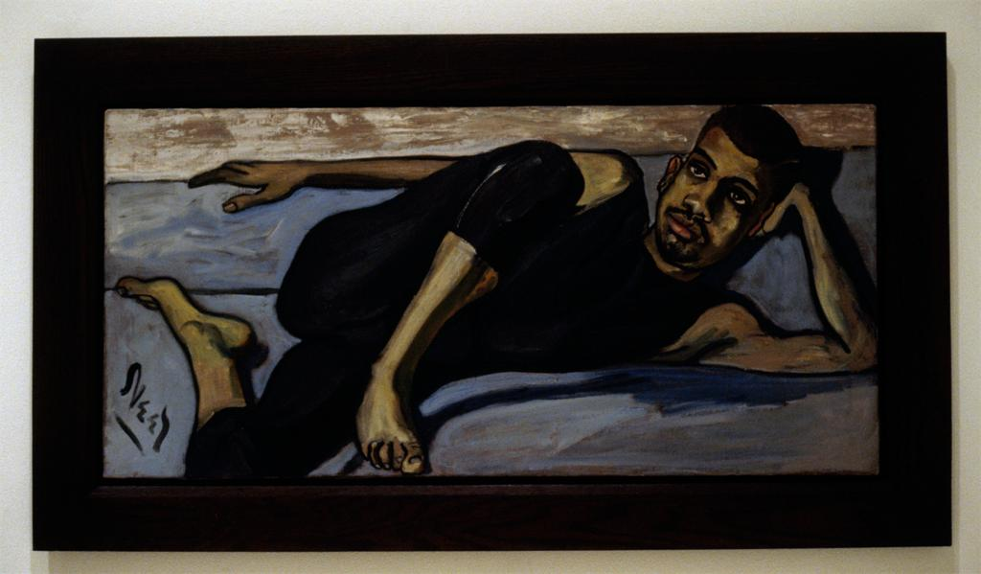
Notes:
Creator: Alice Neel Title: Ballet Dancer Work Type: Paintings Date: 1950 Location: Exhibited at Robert Miller Gallery, Fall 1993 Material: oil on canvas Measurements: 20 x 43 inches Description: Photographer: Larry Qualls Collection: Contemporary Art (Larry Qualls Archive) Source: Image and original data provided by Larry Qualls Rights: Please note that if this image is under copyright, you may need to contact one or more copyright owners for any use that is not permitted under the ARTstor Terms and Conditions of Use or not otherwise permitted by law. While ARTstor tries to update contact information, it cannot guarantee that such information is always accurate. Determining whether those permissions are necessary, and obtaining such permissions, is your sole responsibility.

Slide 53
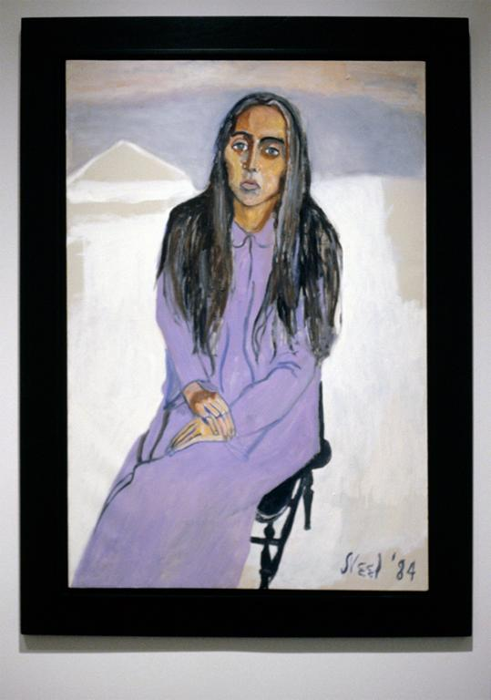
Notes:
Creator: Alice Neel Title: Ginny Work Type: Paintings Date: 1984 Location: Exhibited at Robert Miller Gallery, Fall 2000 Material: oil on canvas Measurements: 44" x 30" Description: Photographer: Larry Qualls Collection: Contemporary Art ( Larry Qualls Archive) Source: Image and original data provided by Larry Qualls Rights: Please note that if this image is under copyright, you may need to contact one or more copyright owners for any use that is not permitted under the ARTstor Terms and Conditions of Use or not otherwise permitted by law. While ARTstor tries to update contact information, it cannot guarantee that such information is always accurate. Determining whether those permissions are necessary, and obtaining such permissions, is your sole responsibility.

Slide 54
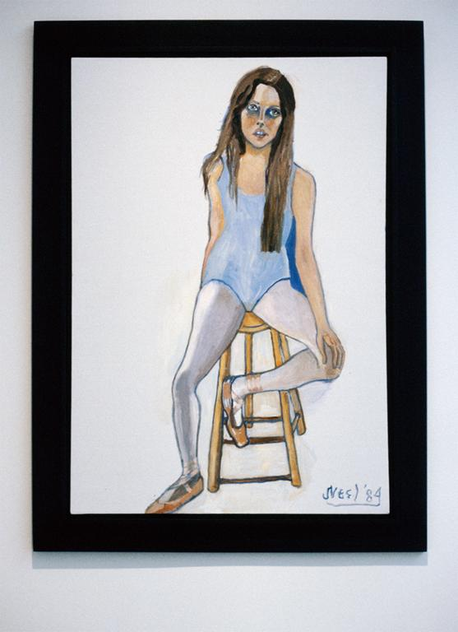
Notes:
Creator: Alice Neel Title: Elizabeth Work Type: Paintings Date: 1984 Location: Exhibited at Robert Miller Gallery, Fall 2000 Material: oil on canvas Measurements: 46" x 32" Description: Photographer: Larry Qualls Collection: Contemporary Art ( Larry Qualls Archive) Source: Image and original data provided by Larry Qualls Rights: Please note that if this image is under copyright, you may need to contact one or more copyright owners for any use that is not permitted under the ARTstor Terms and Conditions of Use or not otherwise permitted by law. While ARTstor tries to update contact information, it cannot guarantee that such information is always accurate. Determining whether those permissions are necessary, and obtaining such permissions, is your sole responsibility.

Slide 55
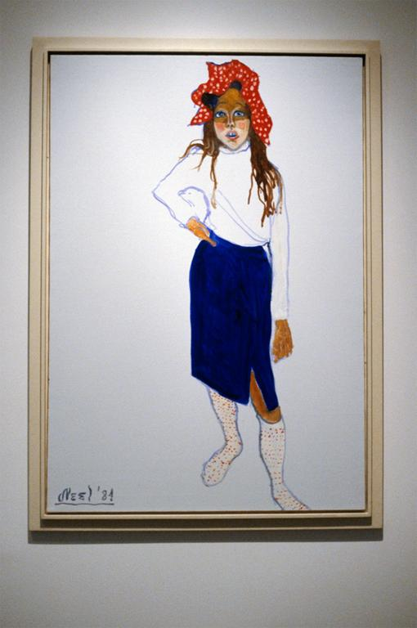
Notes:
Creator: Alice Neel Title: Elizabeth Work Type: Paintings Date: 1984 Location: Exhibited at Robert Miller Gallery, Fall 2000 Material: oil on canvas Measurements: 46" x 32" Description: Photographer: Larry Qualls Collection: Contemporary Art ( Larry Qualls Archive) Source: Image and original data provided by Larry Qualls Rights: Please note that if this image is under copyright, you may need to contact one or more copyright owners for any use that is not permitted under the ARTstor Terms and Conditions of Use or not otherwise permitted by law. While ARTstor tries to update contact information, it cannot guarantee that such information is always accurate. Determining whether those permissions are necessary, and obtaining such permissions, is your sole responsibility.

Slide 56
Richard diebenkorn

Slide 57
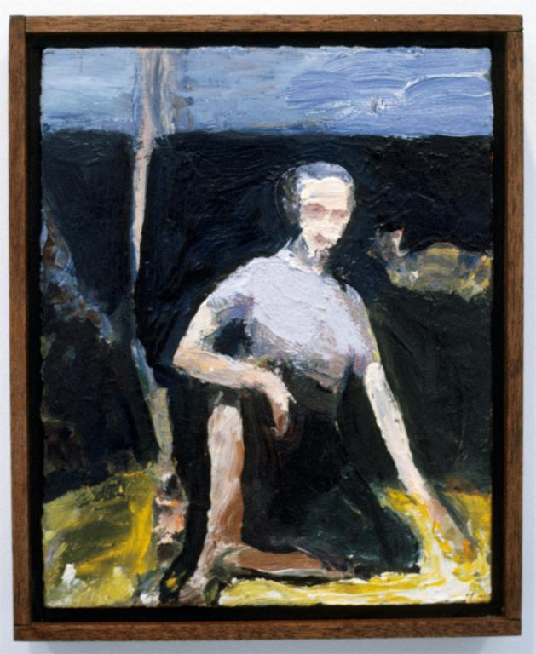
Notes:
Creator: Richard Diebenkorn Title: Untitled (Woman Seated, Arm on Knee) (RD 1164) Work Type: Paintings Date: 1957-1966 Location: Exhibited at Greenberg Van Doren Gallery, Winter 2002 Material: oil on canvas Measurements: 13" x 12" Description: Photographer: Larry Qualls Collection: Contemporary Art ( Larry Qualls Archive) Source: Image and original data provided by Larry Qualls Rights: Please note that if this image is under copyright, you may need to contact one or more copyright owners for any use that is not permitted under the ARTstor Terms and Conditions of Use or not otherwise permitted by law. While ARTstor tries to update contact information, it cannot guarantee that such information is always accurate. Determining whether those permissions are necessary, and obtaining such permissions, is your sole responsibility.

Slide 58
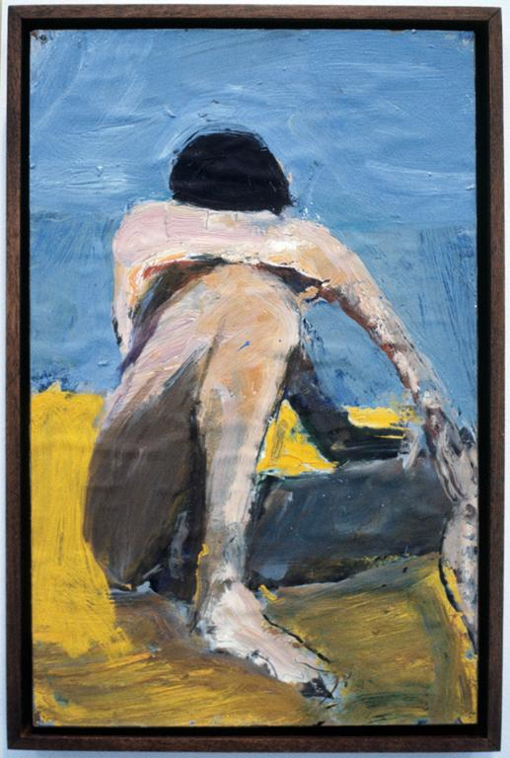
Notes:
Creator: Richard Diebenkorn Title: Head on Arm (RD 1162) Work Type: Paintings Date: 1957-1965 Location: Exhibited at Greenberg Van Doren Gallery, Winter 2002 Material: oil on paper mounted on masonite Measurements: 17 1/2" x 14 1/4" Description: Photographer: Larry Qualls Collection: Contemporary Art ( Larry Qualls Archive) Source: Image and original data provided by Larry Qualls Rights: Please note that if this image is under copyright, you may need to contact one or more copyright owners for any use that is not permitted under the ARTstor Terms and Conditions of Use or not otherwise permitted by law. While ARTstor tries to update contact information, it cannot guarantee that such information is always accurate. Determining whether those permissions are necessary, and obtaining such permissions, is your sole responsibility.

Slide 59
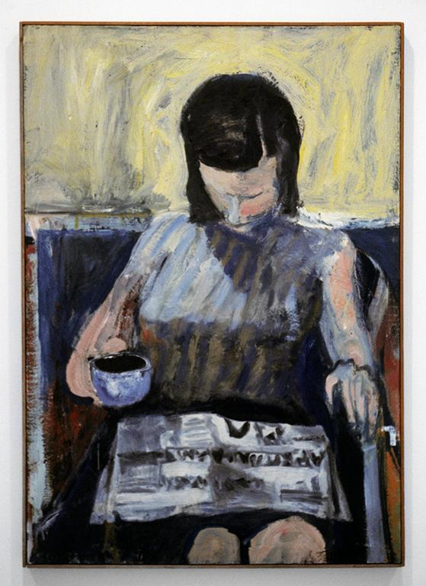
Notes:
Creator: Richard Diebenkorn Title: Woman with Newspaper (RD 1302) Work Type: Paintings Date: 1960 Location: Exhibited at Greenberg Van Doren Gallery, Winter 2002 Material: oil on canvas Measurements: 48" x 34" Description: Photographer: Larry Qualls Collection: Contemporary Art ( Larry Qualls Archive) Source: Image and original data provided by Larry Qualls Rights: Please note that if this image is under copyright, you may need to contact one or more copyright owners for any use that is not permitted under the ARTstor Terms and Conditions of Use or not otherwise permitted by law. While ARTstor tries to update contact information, it cannot guarantee that such information is always accurate. Determining whether those permissions are necessary, and obtaining such permissions, is your sole responsibility.

Slide 60
Notes:
Creator: Richard Diebenkorn, American, Portland, Oregon, 1922-1993, Berkeley, California Title: Woman in Profile Work Type: painting Date: 1958 Material: oil on canvas Measurements: 68 1/8 in. x 59 in. (173.04 cm x 149.86 cm) Description: <p>Artist: Richard Diebenkorn grew up in San Francisco and attended Stanford University, and later the California School of Fine Arts (now the San Francisco Art Institute). Although well established as an abstract painter, Diebenkorn returned to figuration in the mid-1950s. He incorporated the dominant expressive painting style into representational canvases, often landscapes.</p><p>In 1966, he moved to Santa Monica and returned to quasi-geometric abstraction, though his work continued to evoke the landscape and the hazy coastal light of Southern California. Like his earlier works, Diebenkorn's later abstractions allow the accumulated drawn and painted traces of his painstaking process to remain visible.</p><p>In 1988, he returned to live in Northern California, where failing health forced him to concentrate on small-scale works until his death five years later.</p> Repository: San Francisco Museum of Modern Art Repository: Bequest of Howard E. Johnson Accession Number: 84.196 Subject: women; windows; chairs; grids; solitary Collection: San Francisco Museum of Modern Art (SFMOMA) ID Number: 4421 Source: Image and original data provided by the San Francisco Museum of Modern Art Source: http://www.sfmoma.org/ Rights: © Estate of Richard Diebenkorn Rights: Please note that if this image is under copyright, you may need to contact one or more copyright owners for any use that is not permitted under the ARTstor Terms and Conditions of Use or not otherwise permitted by law. While ARTstor tries to update contact information, it cannot guarantee that such information is always accurate. Determining whether those permissions are necessary, and obtaining such permissions, is your sole responsibility.

Slide 61
Fin.

