Slide 1
Caricatures

Slide 2
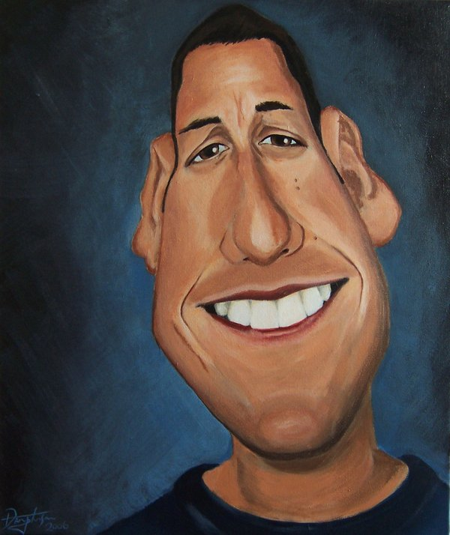

Slide 3
Adam Sandler

Slide 4
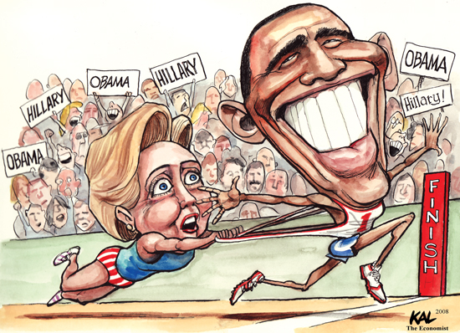

Slide 5
Barack Obama and Hillary Clinton

Slide 6
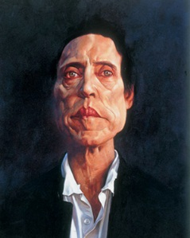

Slide 7
Christopher Walken

Slide 8
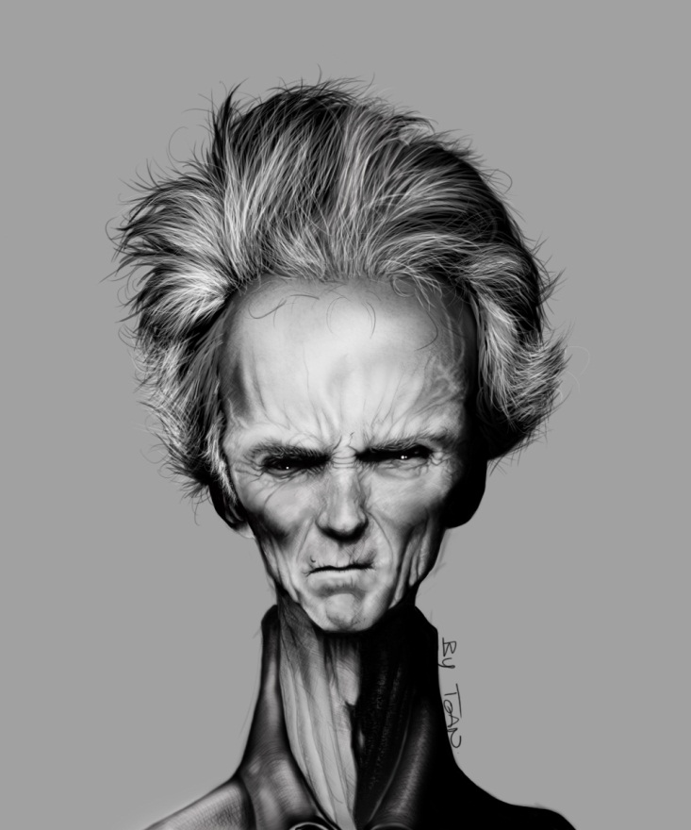

Slide 9
Clint Eastwood

Slide 10
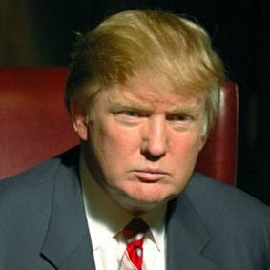
Donald Trump Photo

Slide 11
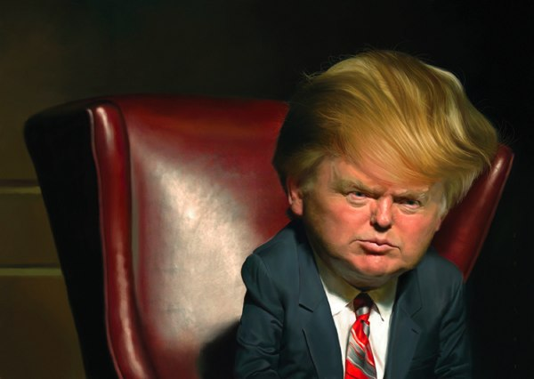
Donald Trump Caricature

Slide 12
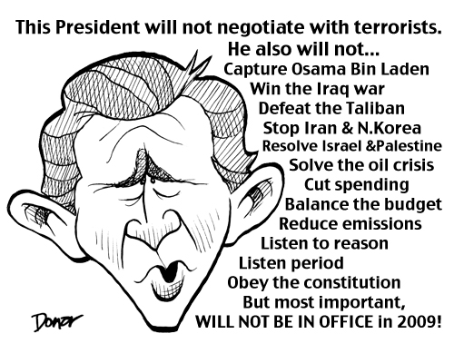

Slide 13
George Bush

Slide 14
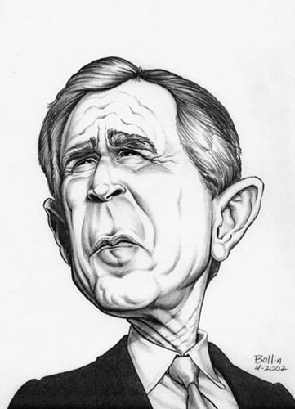
George Bush

Slide 15
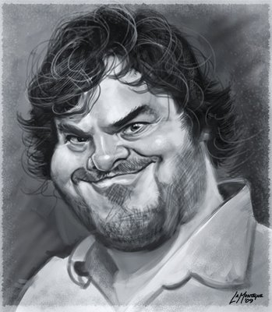

Slide 16
Jack Black

Slide 17
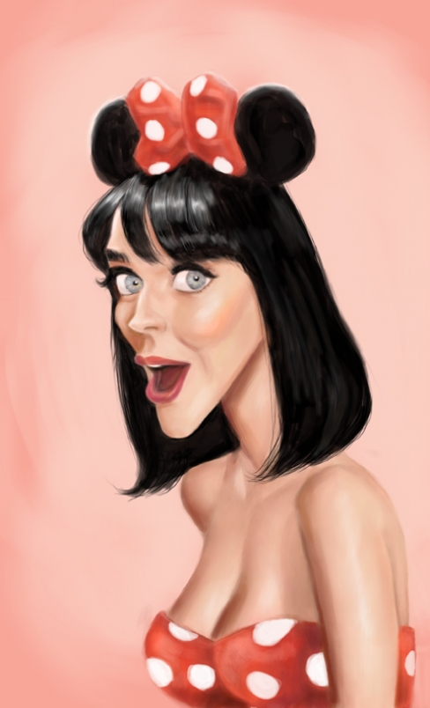

Slide 18
Katy Perry

Slide 19
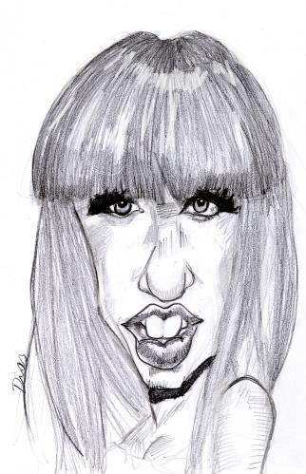

Slide 20
Lady Gaga

Slide 21
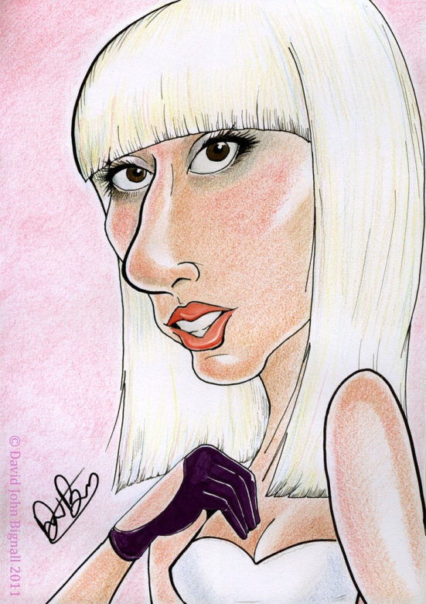
Lady Gaga

Slide 22
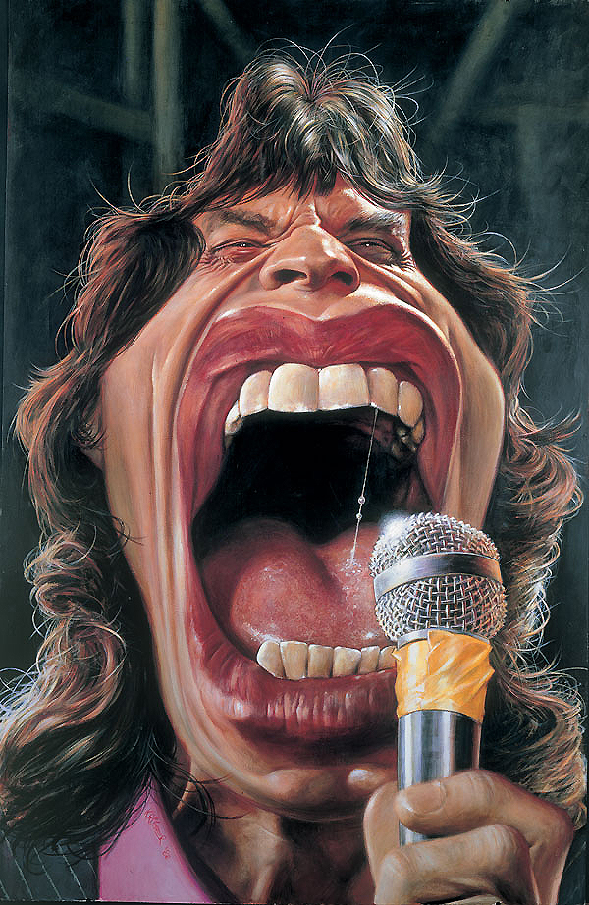

Slide 23
Mick Jagger

Slide 24
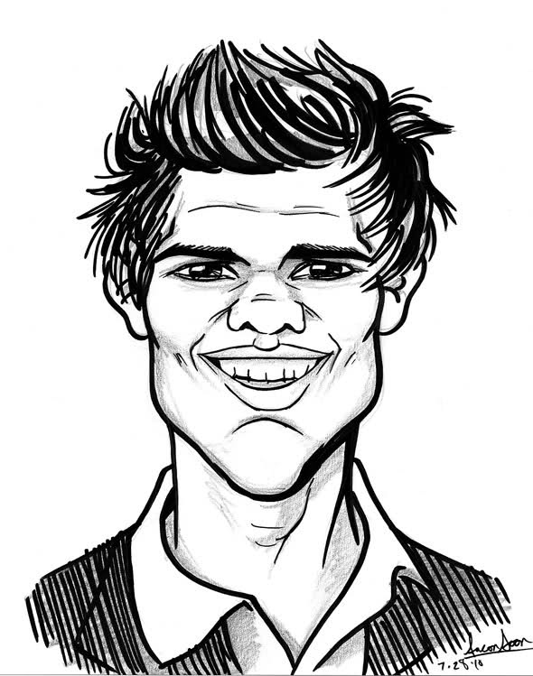

Slide 25
Taylor Lautner

Slide 26
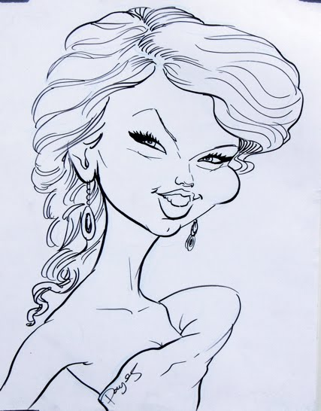

Slide 27
Taylor Swift

Slide 28
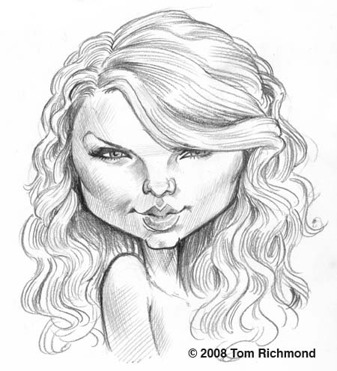
Taylor Swift

Slide 29
How will you caricature yourself?

